Slide 1
Recent Adventures in Toxicology
Varuna Ruggoo
April 2014

Slide 2
Case 1
53 F history of depression
Found at home by daughter in bed with empty pill boxes 30mins ago
Anniversary of husband’s death
GCS 14, confused, drowsy
BP 110, HR 120, sats 98% RA, T 36.4
AV called, family on their way

Slide 3
Case 1
What’s next?

Slide 4
ECG on arrival

Slide 5
The ECG in TCA overdose
Sinus tachycardia
QRS duration >100ms
  Absence does not exclude TCA toxicity
  Prospective study of 49 patients¹
  QRS <100ms- no seizures
  QRS >100ms- 34% seizures
  QRS >160ms- 50% ventricular dysrhythmias
R wave in AVR
  Rightward terminal 40-ms frontal plane QRS vector²
  R wave >3mm or R/S ratio > 0.7³
  Absence of this makes diagnosis less likely
  Consider other causes of rightward axis shift
1 Boehnert et al, Value of the QRS duration versus the serum drug level in predicting seizures and ventricular arrhythmias after an acute overdose of tricyclic antidepressants N Engl J Med. 1985 Aug 22;313(8):474-9
2 Niemann JT et al, Electrocardiographic criteria for tricyclic antidepressant cardiotoxicity. Am J Cardiol. 1986 May 1;57(13):1154-9.
3 Liebelt et al, ECG lead aVR versus QRS interval in predicting seizures and arrhythmias in acute TCA toxicity. Ann Emerg Med. 1995 Aug;26(2):195-201.

Slide 6
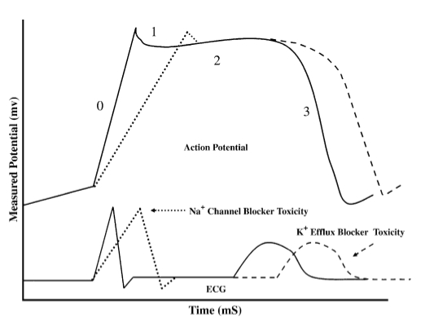
Effects of Na-channel blockade on the cardiac action potential and ECG tracing
Sodium-channel blockade causes prolongation of phase zero of the cardiac action potential with resultant widening of the QRS complex.
Holstege CP, Eldridge DL, Rowden AK. ECG manifestations: the poisoned patient. Emerg Med Clin North Am. 2006 Feb;24(1):159-77

Slide 7
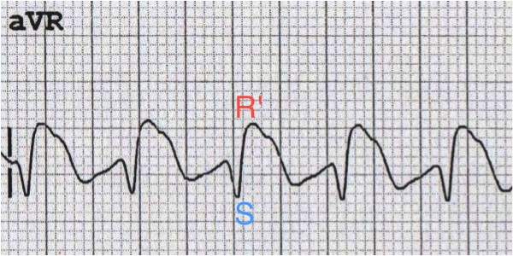
Dominant R wave in aVR

Slide 8
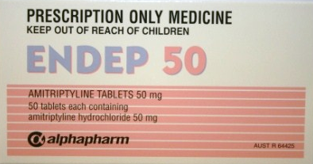
Meanwhile, back in R1…
More agitated
HR 160
VBG pH 7.25 CO2 45 bic 24
Family confirms: 50 x 50mg Amitriptyline
and 20 x 10mg Diazepam
Risk assessment?

Slide 9
Case 1- risk assessment
>10mg/kg potential for hypotension, arrhythmias, coma, seizures within 2-4 hrs
> 30mg/kg expected to result in severe life-threatening toxicity
  pH dependent cardiotoxicity and neurotoxicity
  Coma lasting >24hrs
Cardiac and CNS toxicity closely related¹
  Broadening QRS, hypotension, SBP <80 prior to seizure
  Seizures aggravate CVS instability- acidosis, increases free TCA
Expected clinical manifestation of 35mg/kg amitriptyline
  Rapid deterioration within 1-2 hours of ingestion
  CNS: impaired consciousness level, seizures
  CVS effects: tachycardia, hypotension, arrhythmias
  Anticholinergic toxidrome- including prolonged delirium in recovery phase
1 Taboulet P, Michard F, Muszynski J, et al. Cardiovascular repercussions of seizures during cyclic antidepressant poisoning. J Toxicol Clin Toxicol 1995;33:205–11

Slide 10
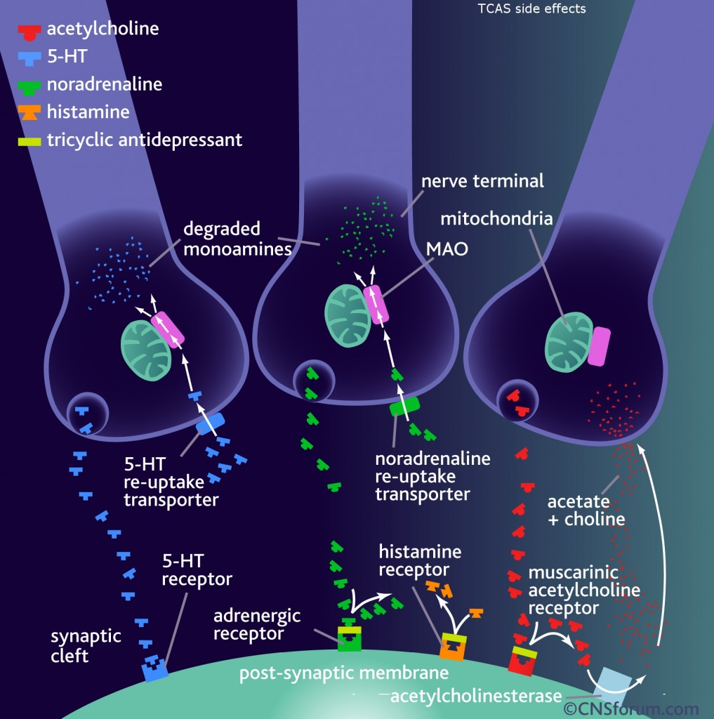
Pharmacologic Effects of TCAs
NE & Serotonin Reuptake Inhibition | Initial hypertension quickly followed by hypotension
Na+ Channel Blockade | CVS: QRS Prolongation Hypotension — depresses myocardial contractility Ventricular dysrhythmias CNS: seizures
Anticholinergic (M1) blockade | Anticholinergic toxidrome
Antihistaminergic | CNS stimulation or sedation
alpha1 Adrenergic Antagonism | Hypotension
GABA-A Receptor Blockade | Seizures
K+ Channel Blockade | QT Prolongation

Slide 11
Toxicokinetics and Toxicodynamics
Absorption and distribution
  Rapidly absorbed, peak levels within 2hrs- can be delayed due to AC effects
  Highly lipid soluble
  Protein binding 95% bound to AAG, free drug 10%
  Vd 5-20 L/kg
    Clinical toxicity develops when drug still in distribution phase
  Weak bases
    Acidosis causes ionized fraction to increase and slow distribution
Metabolism and Elimination
  Cyt P450 – zero order kinetics in OD
  Low renal elimination

Slide 12
Principles of management of acute TCA toxicity
Agitation heralds seizures and CV collapse
Avoid sedation without adequate monitoring
Avoid acidosis- increases free TCA
Flumazenil should not be administered in suspected TCA OD¹
Potential life threats
  Coma
  Respiratory acidosis
  Seizures
  Cardiac dysrhythmias
  Cardiac arrest
1 Mordel et al, Seizures after flumazenil administration in a case of combined benzodiazepine and tricyclic antidepressant overdose. Crit Care Med. 1992 Dec;20(12):1733-4.

Slide 13
Management of Acute TCA toxicity
Resuscitation: ABC’S
Prompt intubation and hyperventilation at onset of severe toxicity
Sodium bicarbonate
  hyperventilate to pH 7.45-7.55
Decontamination¹
  Activated charcoal within 1-2 hours
  No role for gastric lavage, induced emesis or WBI
  Large Vd and high protein binding precludes extracorporeal procedures such as HP, HD
Ventricular dysrhythmias- NaHCO3
Seizures- titrated benzodiazepines
Hypotension- iv fluid, NaHCO3, vasopressors (NA preferred)
Supportive care and monitoring in ICU
Screening tests in DSP
1 Dargan et al, The management of tricyclic antidepressant poisoning : the role of gut decontamination, extracorporeal procedures and fab antibody fragments. Toxicol Rev. 2005;24(3):187-94.

Slide 14
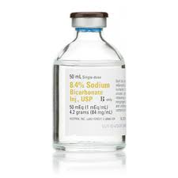
Sodium Bicarbonate

Slide 15
Sodium Bicarbonate
NaHCO3 → Na+ + HCO3 -

Slide 16
Role of sodium bicarbonate in reversing cardiotoxicity
Indications for use: severe cardiotoxicity
  QRS > 120ms
  Hypotension resistant to fluid challenge
  Cardiac arrest and ventricular dysrhythmias
  Prevention of acidosis: seizures, respiratory acidosis from prolonged intubation
Available evidence does not support prophylactic alkalinisation in absence of life-threatening CVS toxicity¹
Mechanism of action multifactorial and poorly understood²
  Sodium load
  Increasing plasma protein binding by alkalinisation
  Altering charge of TCA-receptor complex by alkalinisation
  Correction of TCA-induced acidosis
Give as boluses- endpoint QRS <100ms, HD stable, watch pH and Na
Intubation and hyperventilation to pH 7.45-7.55 is essential
1 Blackman K et al, Plasma alkalinization for tricyclic antidepressant toxicity: a systematic review. Emerg Med (Fremantle). 2001 Jun;13(2):204-10
2 Bradberry SM et al, Management of the cardiovascular complications of TCA poisoning : role of sodium bicarbonate. Toxicol Rev. 2005;24(3):195-204..

Slide 17
Case 1 ECG- post treatment

Slide 18
Seizure management
Present evidence does not support need for prophylactic therapy¹
Titrated IV benzodiazepine
Avoid phenytoin
Depth of coma most accurate predictor of major seizure activity²
Beware respiratory depressant effects
  Worsen acidosis and hypoxia-> increase risk of arrhythmias
  Oxygenate well
  Acid base mx
  Binding of TCA to plasma protein pH dependent->increase in acidity results in displacement of bound TCA and increased pharmacological effect
1 Bateman ND. Tricyclic antidepressant poisoning: central nervous system effects and management. Toxicological Reviews 2005; 24(3): 181-186.
2 Emmerman CL et al, Level of consciousness as a predictor of complications following tricyclic overdose. Ann Emerg Med. 1987 Mar;16(3):326-30.

Slide 19
Case 1 continued
GCS drops to 3
RSI fentanyl/midazolam/sux, 50mmol sodium bicarb peri-intubation
Vent settings SIMV-VC TV 500ml PEEP 5 FiO2 60% RR 20
ETCO2 31 BP 93 HR 110
Bolus 100mmol sodium bicarbonate
50g AC via NGT
Midazolam and sodium bicarbonate infusion

Slide 20
ICU bed ready, but…
Patient has a GTC seizure, BP 60
VBG pH 7.55 CO2 20 bic 34
ECG shows wide complex brady
Options?

Slide 21
ICU bed ready, but…
Patient has a GTC seizure, BP 60
VBG pH 7.55 CO2 20 bic 34
ECG shows wide complex brady
Options?
Check ventilator circuit/settings/EtCO2
Consider non-toxicologic causes of hypotension
Check electrolytes: Ca, K
Adjunct treatment for severe TCA toxicity

Slide 22
Adjunct treatment
Hypertonic saline
  Animal evidence to support use of HTS after other therapies have been maximized¹
  Human evidence is limited to case reports
  Consider HTS if NaHCO3 ineffective and pH of 7.50-7.55 has been reached
Class IB agents: Lignocaine, Phenytoin
  Recommended in refractory cardiotoxicity with severe alkalosis and hypernatremia²
  Evidence for Lignocaine more convincing than phenytoin
  Postulated mechanism: dissociate rapidly from cardiac NaC
Magnesium sulphate
  May help, risk of torsade low in tachycardia
Lipid emulsion therapy
ECMO
Future research: TCA-Fab
1 McCabe et al, Experimental tricyclic antidepressant toxicity: a randomized, controlled comparison of hypertonic saline solution, sodium bicarbonate, and hyperventilation. Ann Emerg Med. 1998 Sep;32(3 Pt 1):329-33.
2 Foianini et al, What is the role of lidocaine or phenytoin in tricyclic antidepressant-induced cardiotoxicity? Clin Toxicol (Phila). 2010 May;48(4):325-30. doi: 10.3109/15563650.2010.487050.

Slide 23
Case 1 in ICU
Transferred to ICU, supportive management
QRS and haemodynamics improved
Extubated at 24hrs
SB CL psych, MH admit

Slide 24
Case 1- ECG in ICU

Slide 25
TCA toxicity in ED
TCA mortality/morbidity¹
  Cohort 256 antidepressant poisonings (TCA vs newer agents)
  Longer median length of stay
  Greater need for intubation
  Higher incidence of seizures
Fex TCA= Expert level
ED management
  Identify toxic doses- risk assessment
  Rapid onset CVS/CNS toxicity
  Prompt intubation, hyperventilation and NaHCO3 can be life saving
1 Bateman ND. Tricyclic antidepressant poisoning: central nervous system effects and management. Toxicological Reviews 2005; 24(3): 181-186.

Slide 26
Case 2
17F, no past medical history
Lives with parents and grandmother
Fight with mum, storms out
3 hours later, states she has taken ‘Gran’s pills’
Mum calls an ambulance
Present to ED with weakness and dizziness
Pale, diaphoretic, but awake, GCS 15
BP 90/60 HR 50 T 36.5
Physical exam otherwise NAD

Slide 27
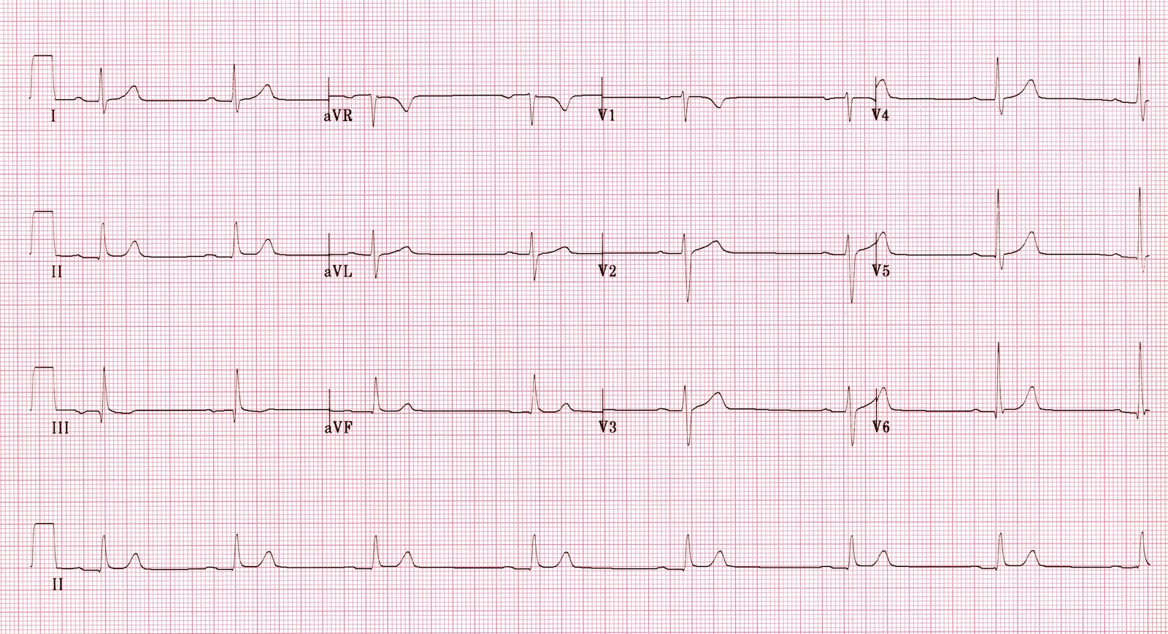
ECG on arrival
Notes:
HR 40 PR 240ms

Slide 28
Question 1
What is the most likely aetiology of this toxicity?
A- Digoxin
B- Verapamil
C- Metoprolol
D- Clonidine
E- Amlodipine

Slide 29
Answer 1
Unsure at this stage, can be..
A- Digoxin
B- Verapamil
C- Metoprolol
D- Clonidine
  Sedation
E- Amlodipine
  Reflex tachycardia

Slide 30
Question 2
What lab tests can help narrow the differential diagnosis?
A- Glucose
B- Sodium
C- Potassium
D- Calcium
E- Both A and C

Slide 31
Answer 2
What lab tests can help narrow the differential diagnosis?
A- Glucose
B- Sodium
C- Potassium
D- Calcium
E- Both A and C

Slide 32
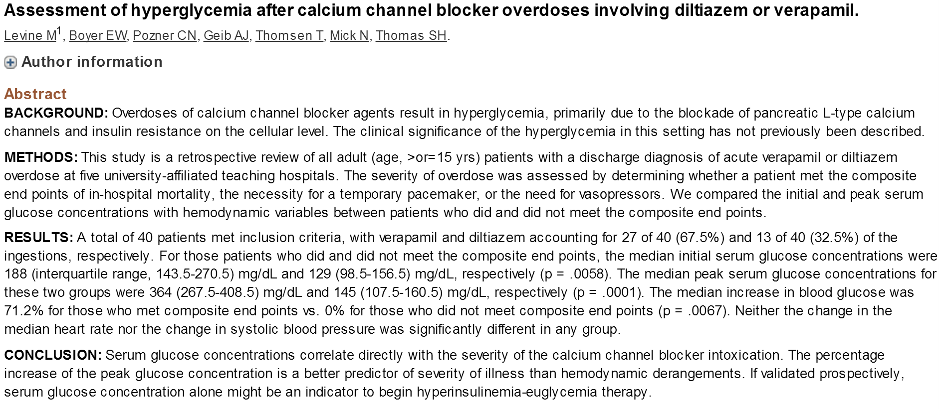
Hyperglycaemia in CCB overdose

Slide 33
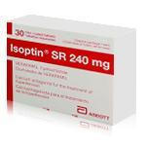
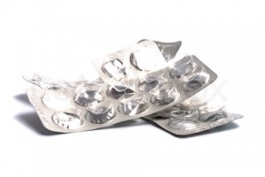
Case 2 continues
ECG as shown previously
BSL 18mmol/L
Serum potassium 4.8 mmol/L
Confirms taking 20X 240 Verapamil SR 3 hrs ago
Risk assessment?

Slide 34
Case 2- Risk Assessment
Potentially life-threatening overdose
Serious toxicity
  >10 tabs verapamil SR (160mg or 240mg SR capsules) or diltiazem (180mg, 240mg or 360mg SR capsules)
SR: Onset of symptoms can be delayed 12-16hrs, peak 24hrs
CVS toxicity:
  bradycardia, 1st degree heart block, hypotension
  Can progress to refractory shock and death
  Complications: AMI, stroke, mesenteric ischemia
Metabolic effects

Slide 35
Question 4
Verapamil toxicity results from:
A- systemic hypotension
B- negative inotropy, chronotropy and dromotropy
C- decreased afterload
D- coronary vasodilation
E- all of the above

Slide 36
Answer 4
Verapamil toxicity results from:
A- systemic hypotension
B- negative inotropy, chronotropy and dromotropy
C- decreased afterload
D- coronary vasodilation
E- all of the above
Inhibition L- type Calcium channels
  Myocardium -decreased force of contraction
  SA/AV nodal tissue- decreased heart rate and conduction
  Vascular smooth muscle- relaxation and vasodilation

Slide 37
Case 2 continues
Feels unwell
Fluid bolus given, 2L saline
Blood pressure 74/40 HR 45
What are you going to do next?
  A- adrenaline
  B- glucagon
  C- calcium
  D- high dose insulin
  E- dopamine

Slide 38
Answer
What are you going to do next?
A- Adrenaline
B- Glucagon
C- Calcium
D- High dose insulin
E- Dobutamine

Slide 39
CCB toxicity management
Early controlled intubation and ventilation if clinically indicated
Decontamination- MDAC/WBI
Graduated approach to hypotension:
  Fluid resuscitation
  Invasive BP monitoring and early echo
  Calcium
  HIET- start early
  Atropine- limited efficacy in severe toxicity
  Catecholamine infusion- numerous case reports success and failures of wide variety of agents
Cardiac pacing
  Ventricular pacing to bypass AV block
Consider early ECLS or IABP if poor response to other measures
Lipid emulsion therapy- consider in refractory shock

Slide 40
High Dose Insulin Euglycemic Therapy
Multiple case reports : beneficial use of HIET in humans, with an overall survival rate of 85%.
No RCT to date
HIET may allow the heart to overcome the metabolic starvation that results from calcium channel blocker toxicity, which compounds the direct cardiotoxic effects
Multiple theories suggested

Slide 41
HIET
Start with 1unit /kg bolus short acting insulin
+ 25g Glucose (unless marked hyperglycemia)
Infusion 1 unit/kg/hr titrated to effect up top 10 units/kg/hr
START EARLY: 30-60 min lag to effect
Monitor BSL and potassium
Therapeutic endpoints:
  Improvement in SBP >90
  Adequate HR >60
  Resolution of academia, adequate urine output, maintenance of euglycemia
  Reversal of cardiac conduction abnormalities
  Improved mentation
Nickson CP, Little M. Early use of high-dose insulin Euglycemic therapy for verapamil toxicity. Med J Aust. 2009 Sep 21;191(6):350-2.

Slide 42
Case 2- progress
Art line BP 82/56
Started on HIET and NA
Transferred to ICU
Infusions maintained for 36 hours
Weaned off NA and HIET
CL psych review and counselling

Slide 43
Calcium Channel Blocker Toxicity
Potentially life-threatening: early Toxicology Consult
Verapamil and Diltiazem commonly ingested in SR preparation
Delayed CVS collapse (8-16h)
Management:
  Airway management
  Decontamination: AC, WBI in dw Toxicology
  Urgent echo
  Early HIET
Extraordinary measures: ECMO, LIE, IABP

Slide 44
Case 3
16F with history of BPD and ADHD
Meds: Quetiapine, Fluoxetine, Temazepam
Well known to Stepping Stones (and Toxicology)
Under 2:1 care at Wesley mission youth service (DHS)
History of holding up pharmacies and stealing drugs
Recent dc from adolescent psych after 4.5g Quetiapine OD
Represents 24hours after discharge with repeat Quetiapine OD

Slide 45
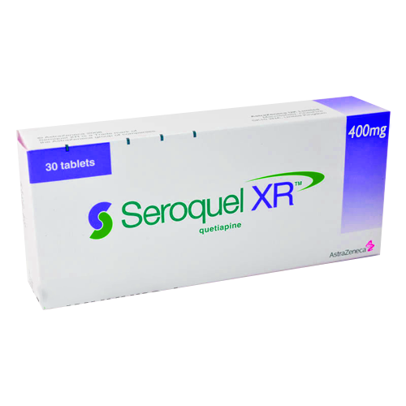
Case 3
2050 intentional OD Quetiapine XR
ED at 2200, drowsy, GCS 15, BP 110 HR 100 sats 99% ra T 37.5
ECG sinus tachycardia, QT 360ms, QRS 80ms
Monitored in A1, SSU ETOX at 0115
Hx confirmed: 30 x 400mg Quetiapine XR
Risk assessment?

Slide 46
Quetiapine toxicity
Tachycardia (common)
Reduced level of consciousness
Coma
  Dose >3g
Respiratory depression
Hypotension
ECG changes
  Prolonged QT, low risk of TdP
Anticholinergic delirium
Delayed onset and prolonged duration of symptoms with XR preparations

Slide 47
Case 3 ECG

Slide 48
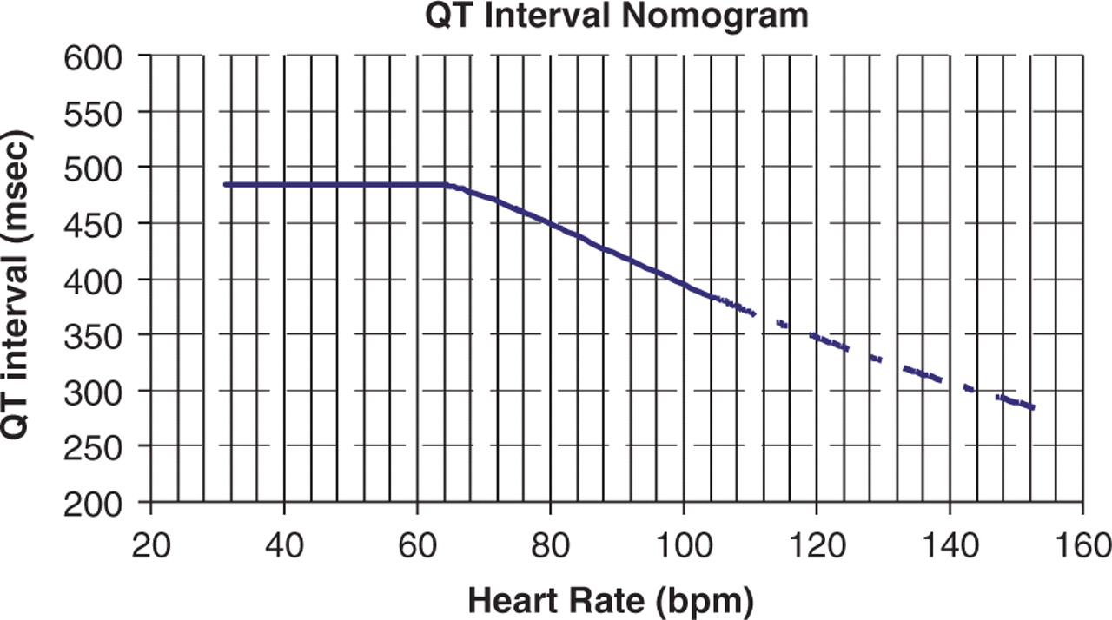

QT Interval Nomogram for determining ‘at risk’ QT–HR pairs from a single 12-lead ECG
Chan A et al. QJM 2007;100:609-615

Slide 49
QT estimation

Slide 50
Case 3 continued
12 hours after ingestion, decreased GCS
TF to ICU in view of airway issues
Remained tachycardic and drowsy for 72 hours
Transferred to Adolescent Psychiatry at MMC, dc 2 days later
Represented 12 hours after discharge with 16g Quetiapine XR OD…

Slide 51
Quetiapine Toxicity
2nd generation atypical antipsychotic
Emerging as one of leading causes of toxic coma in Australia
Dose dependent sedation, tachycardia and hypotension
Toxicity
  <3g generally benign
  >3g sedation, tachycardia, hypotension
  Onset 2-4hrs, coma lasts up to 48hr
  Delayed onset and prolonged symptom duration with XR preparations
Management
  Airway, AC, hypotension- fluid, pressors if refractory

Slide 52
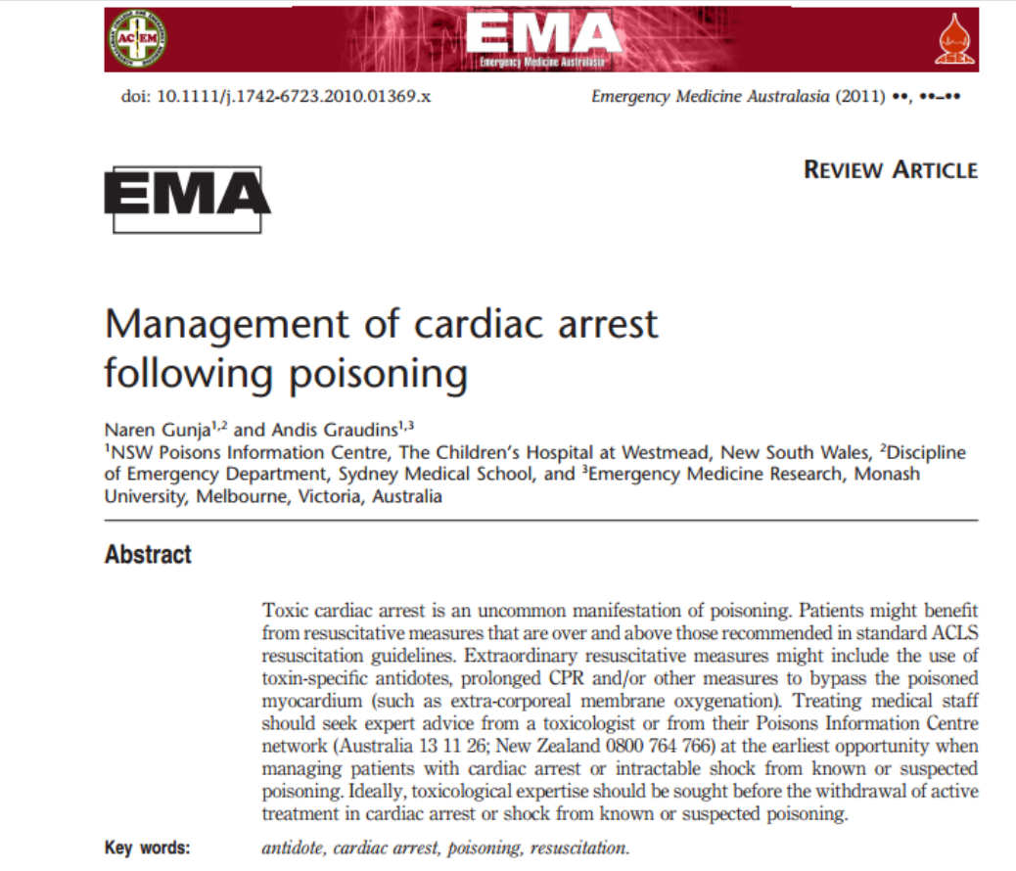
Tox ACLS

Slide 53
Management of cardiac arrest following poisoning
Toxic cardiac arrest or shock
ABC and ACLS protocols
Large bore iv access
Crystalloid fluid bolus/cathecolamines
Early echo- pump vs. vasoplegia
Toxicology Consult
Specific antidotal therapy
Consider: other inotropes, ECMO, HD, IABP, cardiac pacing, ILE
All patients: optimise electrolytes, maintain euglycemia, consider prolonged resuscitation, maintain communication with Toxicologist
Source: Gunja N, Graudins A. Management of cardiac arrest following poisoning. Emerg Med Australasia. 2011 Feb;23(1):16-22

