Slide 1
Implementing paediatric procedural sedation in emergency departments – spread and sustain
Child and family centred care in practice – distraction and comforting techniques
Gerry Silk
Paediatric Nurse Consultant

Slide 2
Benefits of family centred practice
Improvement in medical & developmental outcomes
Greater responsiveness to patient and family identified needs
Enhanced patient and family satisfaction
Increased staff and department satisfaction
Creation of a more supportive work place environment
Creation of more effective learning environment for professionals in training
Reduction in anxiety and procedure times
Reduction in healthcare costs
Johnson,B. H., Resource manual for hospitals moving forward with family-centred care, 2001

Slide 3
Challenges to family centred care in EDs
Lack of previous relationship with patient/family
Acute nature of events prompting an ED visit
Complex cultural & societal variations
Unaccompanied minors
Presentations related to abuse or non accidental injury
Reluctance on part of health care professional to involve families in invasive procedures
Heightened anxiety in families
Power imbalance between health professionals and families
Committee on Paediatric Emergency Medicine, Patient & Family Centred of Children in an E.D., 2008

Slide 4
Benefits of distraction
Provides an alternate focus for the to child to shift attention away from the painful procedure to something more positive
Provides coping strategies to the child and family to decrease distress and promote pain relief
Reduces parent perceptions of child distress
Reduces need for pharmacological methods of pain management
Empowers the child and family to learn coping strategies, giving them the opportunity for choice

Slide 5
How to use distraction
Distraction strategies should invoke the child’s imagination, sense of play, and attention must be carefully considered to child’s developmental abilities
Child or young person’s chooses distraction tool of choice
Child will more willingly shift attention away if procedure is known, the distraction is self chosen, and situation holds no surprises
Distraction should be engaging, it’s okay if child will like to look during procedure
Enables caregiver to have a structured role during the procedure
Kuttner, L. A Child in Pain (2010); Sinha et al, (2006)

Slide 6
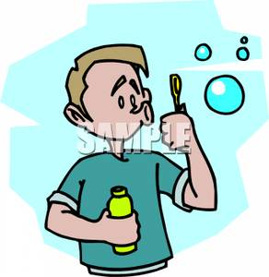
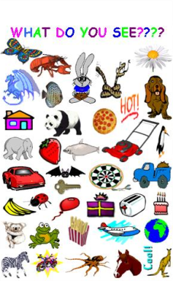
Distraction options
Blowing bubbles: blow them up high, how far can you blow the bubbles, how many can you count?
Focus on object in room
Think of favourite place
Interactive books
Hold mum’s hand
Big belly breath
Distraction card

Slide 7
What else helps?
Prepare the child before the procedure
Provide the child with the option to look or not during the procedure
Stories and questions about personal interests
Pain relief

Slide 8
Principles of positioning the child for comfort
“Hugging hold” is secure and comforting
Adult provides positive assistance, not negative restraining
Upright position promotes sense of control and security
Body/extremity is isolated and allows easy and safe access
Important that the adult remains close to soothe and comfort the child

Slide 9
Key messages
Children do feel and remember pain
Use plain language when speaking with children and families, it is okay to be honest with explanations
Choose developmentally appropriate distraction prior to procedure
Provide most comfortable position possible
Individualize coping strategies to child and family
Non-pharmacological pain management improves success

Slide 10
Comfort tips by developmental level
Developmental Level | Comfort Intervention
Toddler | Caregiver present if possible, comfort positioning, dummy for comfort if used, shaker toy, pop-up book, sound button book, glitter wand, singing
Preschool | Choice to sit with parent or not, bubbles, I spy/sound book, counting, singing, relaxing breathing, squeeze ball, hand holding by caregiver
School Age | Choice to sit up or lay down for procedures, engage in relaxing breathing, TV, I spy book, counting, squeeze ball, Find it, game player, choice to engage in non-procedural talk, hand holding by caregiver
Adolescent | Deep breathing, game player, music/i-pod, I spy book, choice to engage in non-procedural talk

