Slide 1
QUESTION 21
Dr Sarah Mikhail MBBS FACEM DEMT - Casey Hospital

Slide 2
THE QUESTION:
It is Saturday 1800 and you are the consultant in charge of a tertiary hospital ED. You have been notifies of a collision between two trains. There are a number of causalities and potentially a chemical spill.

Slide 3
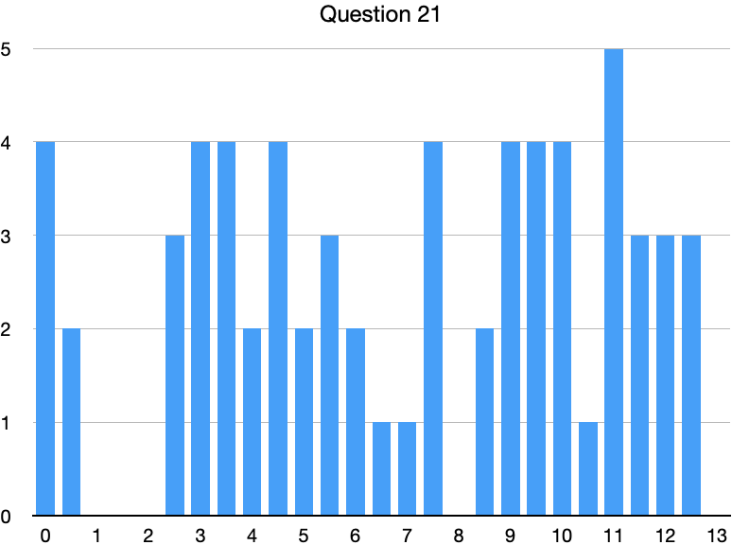
MARKS
PASS MARK: 9 PASS RATE: 42%

Slide 4
PART A
List the Seven (7) important initial information do you need from the scene?
M - Major incident declared, activate plan
E - Exact location
T - Type of incident
H- Hazards
A - Access
N - NUMBER and TYPE of casualties
E - Emergency services PRESENT and REQUIRED

Slide 5
PART B
State the two (2) types of on-scene triage that occur and what is each used to determine.
Triage sieve:
Designed to determine who should be taken to which patient treatment zone and in what order
Triage sort:
Designed to determine the order of transportation from the patient treatment post to hospital

Slide 6
PART C
Send (for help) –ACTIVATE DISASTER CODE/PLAN, inform anyone that this code doesn't activate
Staff - call in extra, ask to stay back, allocate roles, brief them,
Space - Decanting patients, establishing your areas for triage and ambulatory care, morgue, communications and in this case DECONTAMINATION
Stuff - you will likely need more everything, more monitors, lines, radiology, ventilators, ultrasounds, plasters and wound care stuff, PPE, disaster packs esp triage packs

