Slide 1
Q19
TAD
Core clinical knowledge
Rx of TAD
Med vs Sx
Meds used
Reasons for non operative Rx
Easy prop
Very poor description

Slide 2
Q19
A 71 year old man presents with a 2 hour history of severe chest pain radiating through to his back. He has a past history of hypertension.
His observations:
BP 200/100 mmHg
PR 85 /min
RR 16 /min
Temp 36.5 °C
GCS 15

Slide 3
Q19 i Av 2.3 / 5
71 man
2 hour
severe chest pain
radiating through to his back
PMHx hypertension
BP 200/100 mmHg

Slide 4
i
Bad:
Lack of time/ care to look at image
9 minute Q
“Aortic dissection”
“Enlarged aorta”
Stanford type II
Likely widened mediastinum
Possible dissection down coronary a
What would you write in notes/ say on phone?????

Slide 5
ii Av 3.5/ 6
List three (3) medications that you may use in the treatment of this condition.
Provide one (1) justification for each choice. (6 marks)

Slide 6
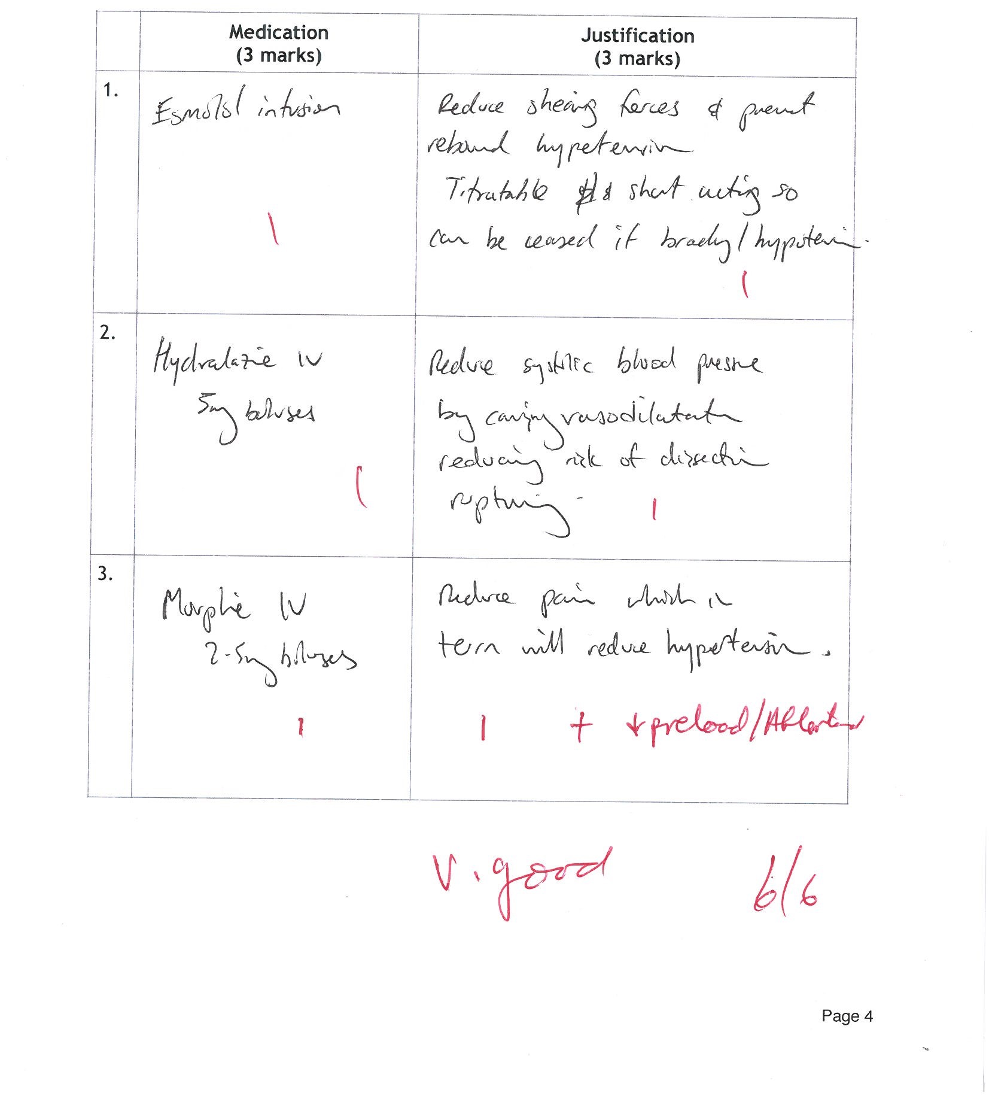
Boom !

Slide 7
ii
Bad
Morphine omitted
Fentanyl
VD prior to/ or without Bblocker
Justification
“if rapid reduction required”
“to reduce BP”
≠ dose and rate

Slide 8
iii Av 0.83 / 1 Av 0.83 / 2
State your choice of optimal definitive treatment for this patient. (1 mark)
List two (2) justifications for your choice of definitive treatment. (2 marks)

Slide 9
justifications for your choice
Evidence based RxOC for Type A/ Ascending Aorta involvement
Prevent rupture of false lumen
Re-establish blood flow to occluded side branches
Correct associated aortic valve incompetence
Prevent pericardial tamponade
Reduces complication of dissection down/up major vessels with associated mortality
Increases 5 yr survival

Slide 10
iv AV 3.5/ 5
List five (5) factors that may lead you to not choose this optimal definitive treatment.

Slide 11
v
Bad
Spaces- Reasons to no choose Sx…..
THINK
TAKE TIME
Omitted pt choice/ Medical POA

Slide 12
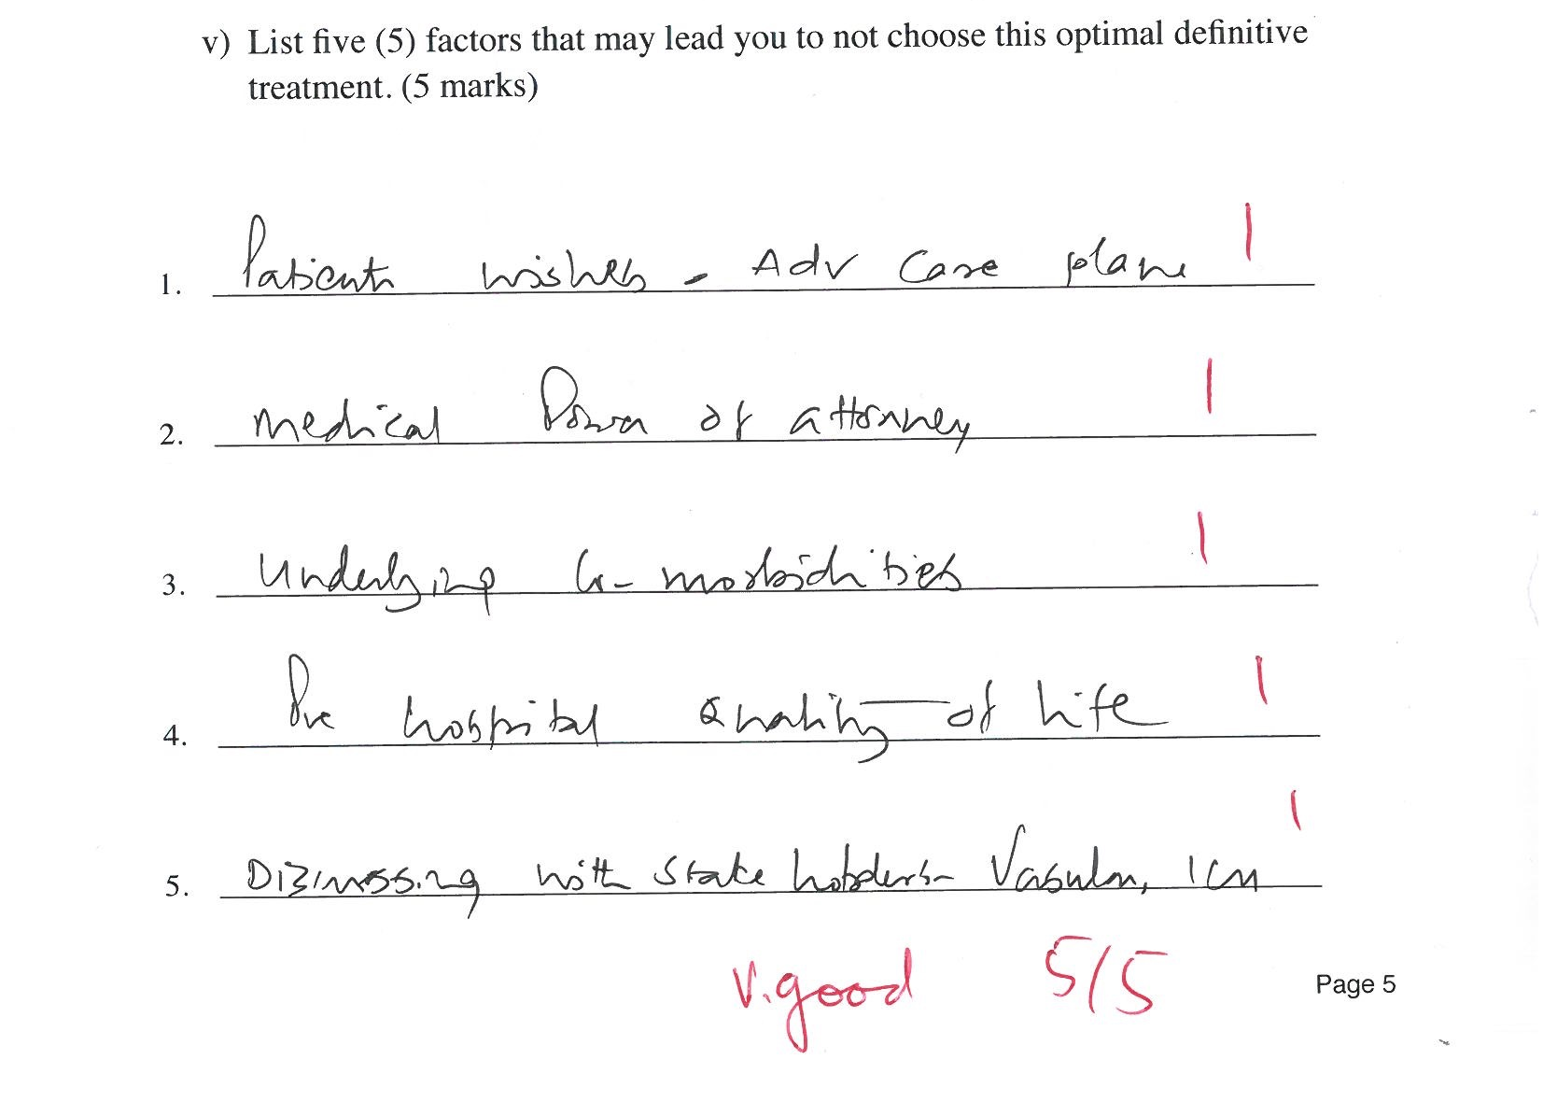

Slide 13
Advanced directives- not for Sx
Pt/ MPOA refusal
Significant comorbidities
Poor QOL
Significant complication already exists associated with end organ irreversible damage eg dissection down coronary a
Cardiac arrest
Surgical opinion / refusal to offer Rx

