Slide 1
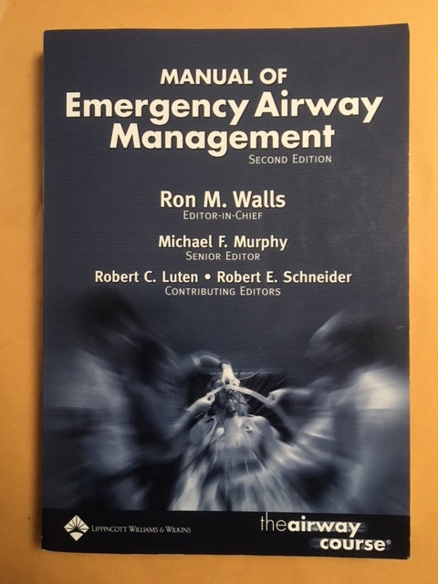

Slide 2
Q14:
You are the consultant in an emergency department in a regional hospital with off site anaesthetic back up (30 minutes away).
You receive a phone call about the arrival of a morbidly obese patient within 10 minutes with respiratory distress. The paramedic anticipates that the patient will need to be intubated.
a) List four anatomical changes with obesity which work against successful airway management
Some of anatomical changes associated with obesity are:
Increased facial girth
Increased tongue size
Smaller pharyngeal area
Redundant pharyngeal tissue
Increased neck circumference
Increased chest girth
Increased breast size
Increased abdominal girth
Increased intraabdominal and intrathoracic pressure
Note: some candidates mentioned some PHYSIOLOGICAL changes associated with obesity in here, such as reduced FRC and shortened time to desaturation.

Slide 3
Q14:
b) List six steps that you would take to prepare for the patient's arrival
Overall good answers which covered many areas,
Anticipate difficult airway, and prepare:
Staff (team): team leader, airway team (most senior person should take over airway doctor role), circulation doctor, drug nurse, scribe nurses, extra people for BMV/manual handling of patient. All should have clear understanding of their role prior to patient arrival
Equipment: usual airway equipment and adjuncts (nasopharyngeal, oropharyngeal) and difficult airway gadgets: boogie, LMA, glidoscope, consideration for delayed/awake intubation, fiberoptic intubation if available.
Surgical airway is truly the last resort, because obesity will make it even harder.
Positioning: ramp up, extra pillow, proper trolley, ...
Notification: call for assistance: Anaesthetist/ ICU/ ? ENT
Drugs, to be drown up and ready
Assure the rest of department is well looked after, which may indicate allocating another doctor to manage the floor

Slide 4
C) a few minutes later, ambulance brings a 130 kg man (BMI=40), write down three of your preferred medications for induction of anaesthesia. State the dose you would use for each choice (assume normal BP and HR)
dosing recommendations for drugs commonly used for induction of anaesthesia:
drug | loading dose
Propofol | 1-2 mg/kg IBW
Ketamine | 1-2 mg/kg IBW
Thiopental | 3-6 mg/kg IBW

Slide 5
note: many of the candidates listed the drugs used for airway management (RSI), including pre-treatment (e.g. Fentanyl) and neuromuscular agents (e.g. Succinylcholine), while the question is specifically asking the inducting agent.
the other point to remember was the dose, except for Fentanyl and Succinylcholine which are dosed based on TBW, almost all other drugs commonly used in airway management are dosed based on IBW

