Slide 1
MH 2018.1

Slide 2
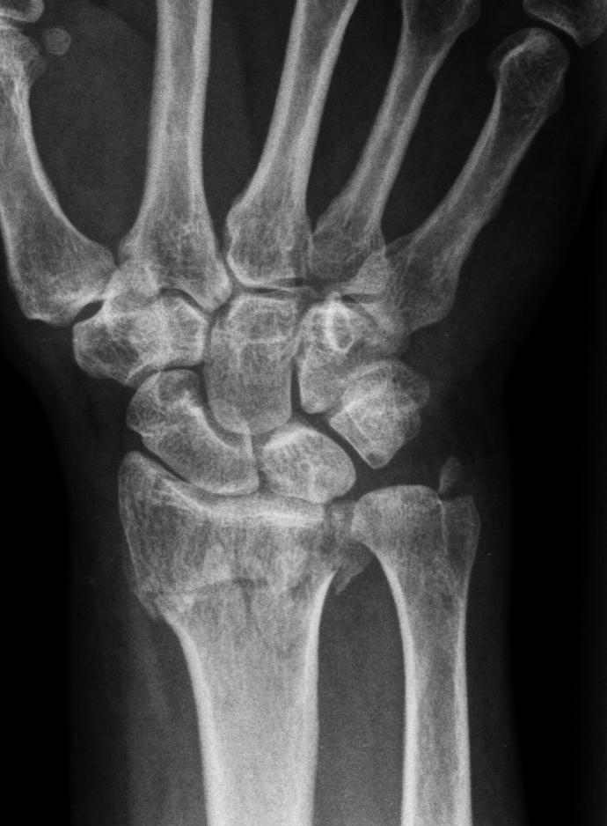
SAQ 13 A 60 yo woman presents with severe wrist pain after a fall. A. List 6 bone abnormalities on these Xrays ( 6 marks)

Slide 3
In addition to noting the presence of a fracture a number of features should be sought and commented upon:
fracture
degree of dorsal angulation
degree of impaction or shortening
degree & direction of displacement
comminution
location of the medial fracture line: does it involve the radioulnar joint
presence of intra-articular fractures +/- degree & direction of displacement
other fractures
ulnar styloid
carpal bones

Slide 4
SAQ 13 A 60 yo woman presents with severe wrist pain after a fall. A. List 6 bone abnormalities on these Xrays ( 6 marks)
Transverse # distal radius
Comminuted
Intra-articular (Barton)
Radial shortening >5mm
Dorsal angulation ~20 degrees
Ulna styloid #
Medial fracture line involving distal R/U joint

Slide 5
B. with regards to distal radius fractures. List 4 Xray findings that indicate need for operative management ( 4 marks)

Slide 6
VIew | Measurement | Normal | Acceptable criteria (not requiring intervention)
AP | Radial Height | 13mm | < 5 mm of shortening
 | Radial inclination | 26 degrees | Change of < 5 degrees
 | Articular step off | congruent | Step-off <2mm
Lat | Volar tilt | 11 degrees | dorsal angulation <5° or within 20° of contralateral distal radius

Slide 7
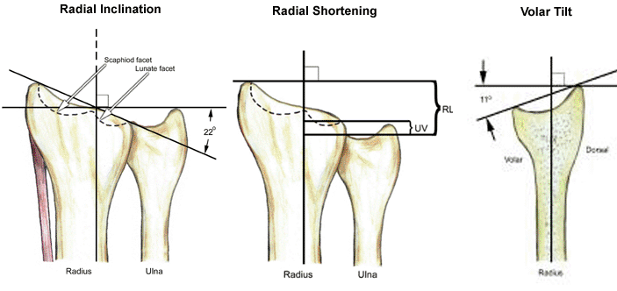

Slide 8
Xray findings indicating need for operative Mx (pre-reduction radiographs best predictor of stability)
displaced intra-articular #s
volar or dorsal comminution
articular margin #s
dorsal angulation >5° or >20° of contralateral distal radius
>5mm radial shortening
comminuted and displaced extra-articular #s (Smith's #)
progressive loss of volar tilt and loss of radial length (after closed reduction)
severe osteoporosis
associated ulnar styloid fractures do not require fixation

Slide 9
Indications for ORIF
significant articular displacement (>2mm)
dorsal and volar Barton #
volar comminution
metaphyseal-diaphyseal extension
associated distal ulnar shaft #s
die-punch #s

Slide 10
C. State the role of CT wrist in evaluating distal radius fractures ( 2 marks)

Slide 11
C. State the role of CT wrist in evaluating distal radius fractures ( 2 marks)
evaluate intra-articular involvement
for surgical planning
Further delineate fracture especially if comminuted
Associated fractures eg scaphoid/carpel bones

Slide 12
General themes preventing success in SAQ
Vague/non consultant level answers
Failing to answer specifics of question before going global ( brainstem protocol response)
Missing key/mandatory responses
Stuffing up timing/leaving questions out
Ignoring/devaluing feedback
Sitting the exam before assessments from experienced educators indicate readiness

