Slide 1
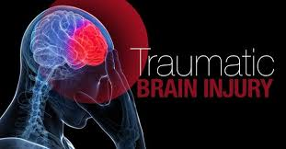
Traumatic brain injury: Assessment & Management in ED Training Module
Dr. Niloufar Kirkwood
Senior Clinical Neuropsychologist
Danielle Byrne
Occupational Therapist

Slide 2
Learning outcomes
Traumatic brain injury/ closed head injury definitions
Screening measure (A-WPTAS)
What are the clinical indicators for using the A-WPTAS
How to administer the A-WPTAS
How to score the A-WPTAS
Outcome of A-WPTAS administration
Demonstration

Slide 3
Background to current project
Time to review current Prompt procedures
Inconsistent approach identified
Not using best-practice screening tools
No objective cognitive screening in ED
Align NSQHS Standards (2nd edition)
Standard 5: Comprehensive care
People with cognitive impairment who are admitted to hospital are at a significantly increased risk of preventable complications
Although cognitive impairment is a common condition experienced by people in health service organisations, it is often not detected, or is dismissed or misdiagnosed

Slide 4
Primary objectives
Readily available definitions, severity classifications and hands-on support strategies
Screening starts in ED
Clear management strategy for symptoms and referral pathways - particularly for mTBI in the ED
Aims at reduce (unnecessary) admissions for mild TBI
Ensures standardisation of administration

Slide 5
What is TBI?
Traumatic brain injury (TBI) or closed head injury can arise from an insult to the brain from an external force or direct blow
Motor vehicle accidents, falls, assaults or sporting injuries
Occurs in 107-149 per 100,000 people (majority are young)
The majority (approximately 80-90%) of TBIs are mild in nature
Moderate & > TBIs usually require neurosurgical intervention
Recovery most rapid in first 3-6 months
Based on severity and other complicating factors recovery can take longer

Slide 6
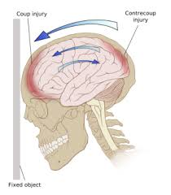
Effects of TBI
Trauma to the brain can result in:
Altered state of consciousness (GCS) &/or a period of coma
Temporary impairment in cognition (confusion, disorientation)
Persisting impairment in cognition (acquired brain injury)
Physical symptoms (e.g. headaches, vertigo, nausea)
Extent based on the severity of the injury

Slide 7
Post-traumatic amnesia
Post Traumatic Amnesia (PTA)
The transitory period following TBI during which the patient is confused, disorientated and lacks the capacity to store and retrieve new information (Schacter & Crovitz, 1977)
It is characterised by cognitive and behavioural disturbances (Ponsford et al, 2012)
NOT a psychological / PTSD symptom

Slide 8
Signs & Symptoms of PTA
CONFUSION | AGITATION | UNDERSTANDING | ODD BELIEFS | OTHER BEHAVIOURS
Disorientation | Irritability & restlessness | Reduced insight | Apparent delusional beliefs | Wandering
Impaired attention & concentration | Aggression | Difficulty reasoning | Inaccurate memories | Inappropriate behaviour
Impaired memory & recall | Altered sleep patterns | Reduced flexibility of thinking | Confabulation | Impulsivity
Can fluctuate | Non-compliance | Impaired decision-making | Fixation

Slide 9
Why assess for PTA?
GCS alone not sensitive to identifying mild TBI (mTBI)
Length & duration of PTA is one of the more sensitive predictors of:
severity of brain injury
rehabilitation & recovery trajectory
Assists accurate identification of mTBI allowing for appropriate Mx
PTA should be measures with standardised and objective measure - prospectively (not retrospectively)

Slide 10
Standard of care
Clinical practice guidelines for mTBI Mx recommends PTA is prospectively measured in ED (Tavender et al 2011)
Incorporated this into guidelines for Mx of closed head injury (NSW)
NSW Ministry of Health (2011) mandatory to administer the A-WPTAS in all EDs of NSW
Incorporated into the Ontario Neurotrauma Foundation Guidelines (2013)
Measures used at the Austin, Alfred, RMH

Slide 11
Length of stay
Liverpool Hospital (Level 1 Trauma) found that 94% of patients who were administered the abbreviated PTA screening were cleared within 4 hours & this reduced LOS by 295 bed-days (Watson et al 2017)

Slide 12
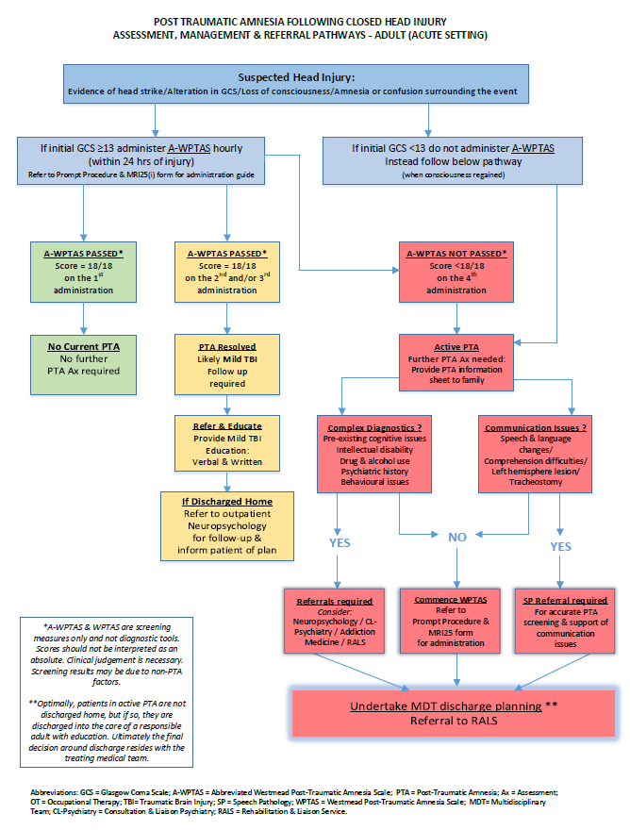
New Procedure

Slide 13
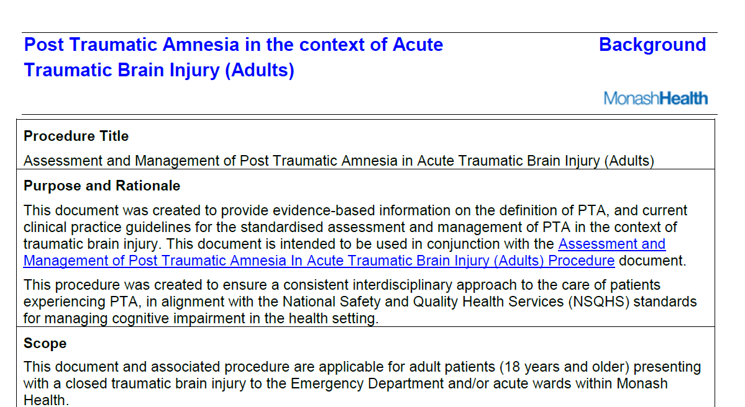

Slide 14
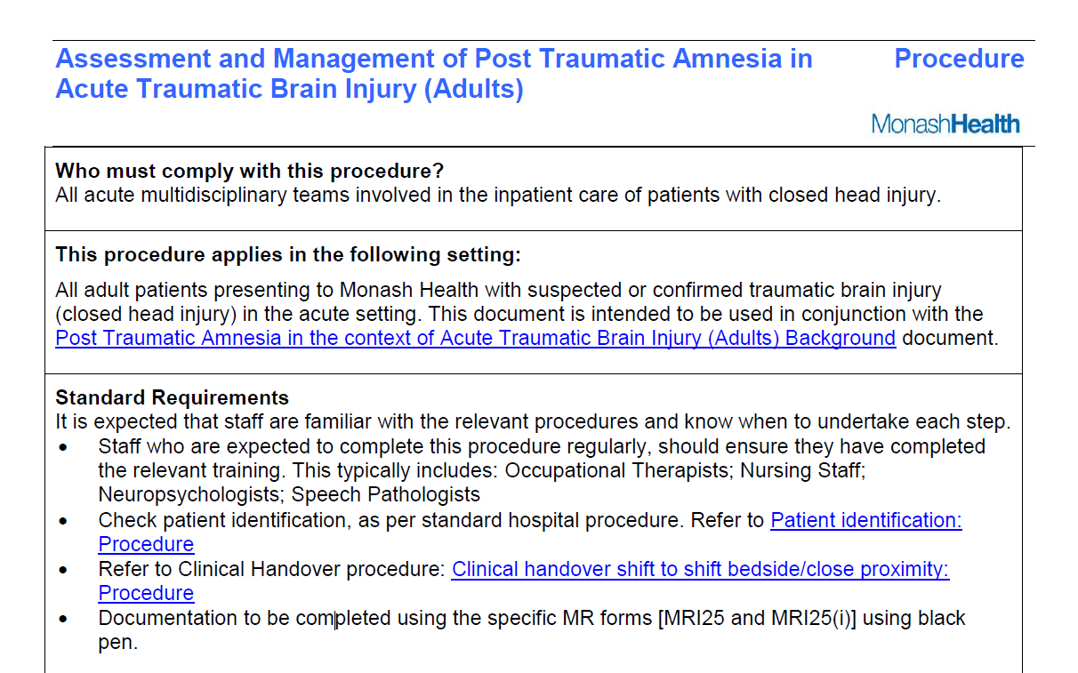

Slide 15
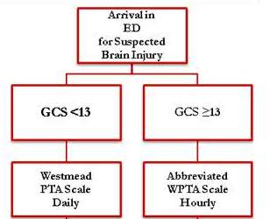
PTA screen administration guide
Full WPTAS
For more severe cases
A-WPTAS
Must be opening eyes spontaneously
Must be able to obey commands
Points lost only for verbal response
Ward Staff
ED
Staff /new fall with head strike

Slide 16
Introducing the A-WPTAS

Slide 17
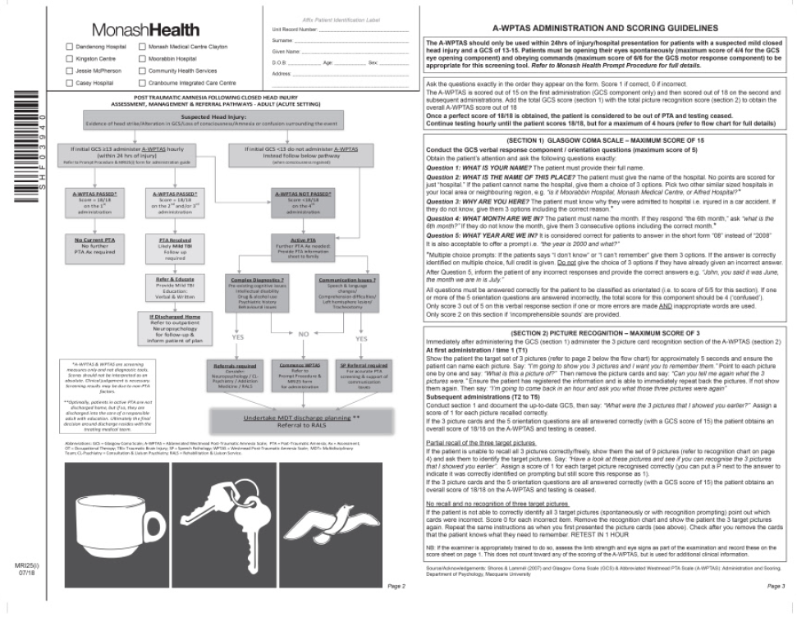
Introducing the A-WPTAS

Slide 18
What is the A-WPTAS
Screening test to identify PTA in Mild TBI
Administered hourly
Only to be used within the first 24 hours following head injury/ hospital presentation
Administered in ED or on ward (after a new fall with suspected head injury)
Includes a full GCS + recall of 3 picture cards

Slide 19
Clinical Indicators for A-WPTAS
Altered GCS (13-15)
+/- LOC
Evidence of head strike
+/- amnesia surrounding the events

Slide 20
Testing considerations
Standardised administration
Ask the questions exactly in the order they appear on the form
Speak in a clear and strong voice
Score 1 if correct, 0 if incorrect
Remove/cover orientation boards and clocks

Slide 21
Who can administer the A-WPTAS
Nursing staff
Occupational therapist
Speech pathologists
Neuropsychologists
In ED – Nursing Staff

Slide 22
A-WPTAS Administration

Slide 23
Administration: GCS Component
Glasgow Coma Scale:
Motor Response (M)
Eye Response (E)
Verbal Response (V)
Must obtain E4 and M6 for A-WPTAS

Slide 24
Administration: Orientation
5 Orientation Questions
1.What is your name?
Patient must provide their full name
2.What is the name of this place?
The patient must give the name of the hospital. If the patient can not name the hospital, then provide 3 options e.g. “is it Moorabbin Hospital, Monash Medical Centre or Alfred Health?”
3.Why are you here?
Patient must state reason they were admitted to hospital, i.e. injured in a car accident. If they do not know, give them 3 options including the correct reason
4.What month are we in?
Patient must name the month. If they respond “the 6th month,” ask “what is the 6th month?” If they do not know the month, give them 3 consecutive options including the correct month.
5.What year are we in?
Patient may answer in short form e.g. “18” instead of “2018.” It is also acceptable to offer a prompt i.e. “the year is 2000 and what?”
Must answer all questions properly to be ORIENTED (Score of 5)
Otherwise score = 4
Unless inappropriate words (score 3) or incomprehensible (score 2)

Slide 25
Administration: Orientation
If the patients says “I don’t know” or “I can’t remember”, give them 3 options
Do not give the choice of 3 options if the patient has already given you an incorrect answer
Inform the patient of any incorrect responses and provide the correct answers BEFORE MOVING ON
e.g. “John, you said it was June, the month we are in is July”

Slide 26
Administration: Pupil and limbs
For nursing staff / those trained to do so:
Record limb strength and eye signs
This is not scored, but just an obs for records

Slide 27
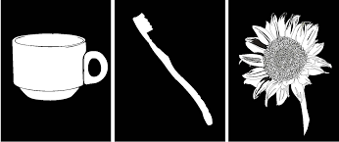
Administration: Picture Cards-T1
Place picture cards (page 4 of form) in front of patient for approx. 5 secs and say:
“I’m going to show you 3 pictures and I want you to remember them”
Point to each picture and say:
“What is this picture of?”
Ensure they have clearly registered the pictures & can recall them in the immediate situation:
“Can you tell me again what those 3 pictures were?”
Remove the cards and say “I’m going to come back in an hour and ask you what those three pictures were again”

Slide 28
Administration: T2+
Come back one hour later
Administer the full GCS
Record the new/up-to-date GCS score on the record sheet
Then say:
“What were the 3 picture that I showed you earlier?”
Assign a score of 1 for each target picture recalled correctly

Slide 29
Administration: Picture recog T2+
If the patient is unable to recall all 3 pictures correctly/ spontaneously, show them the set of 9 pictures
Ask them to identify the 3 target pictures from this group
Assign a score of 1 for each target picture recognised correctly
You can put a P next to the answer to indicate it was correctly identified on prompting

Slide 30
Administration: Picture cards
If the patient is not able to correctly identify all 3 target pictures (spontaneously or with recognition prompting) score 0 for each item
Point out which cards were correct and incorrect
Remove the recognition chart and show the patient the 3 target pictures again
Repeat the same instructions as when you first presented the picture cards.
Check after you remove the cards that the patient knows what they need to remember
RETEST IN 1 HOUR

Slide 31
A-WPTAS scoring & interpretation

Slide 32
Scoring
First administration scored out of 15 GCS component (section 1)
2nd + administrations scored out of 18 GCS + recall of 3 pictures
(Sections 1 & 2)

Slide 33
Scoring
If person scores 18/18 upon first administration = deemed to be out of PTA and Ax is ceased
Patients with a persistent score <18/18 at 4 hours post injury should be considered for admission and full Westmead PTA score should be administered by the ward Occupational Therapist
Clinical judgement required
Consider pre-existing conditions
Especially if GCS normal and picture recognition abnormal

Slide 34
Interpretation
A-WPTAS passed 18/18
=
No further PTA assessment required

Slide 35
Discharge advice
A-WPTAS passed 18/18 on 2nd or 3rd administration
Provide with Mild TBI handout & provide education
Refer to outpatient Neuropsychology

Slide 36
Outcome
A-WPTAS not passed on 4th administration
Further PTA Ax (by OT) is indicated
Consider admission to the ward & further PTA screening
Consider care co-ordinator referral

Slide 37
Discharge advice
Patients who receive education & coping strategies about the head injury manage better than those who don’t
Provide education:
Verbal
Written
Plan for follow up
Responsible person able to take them home
Able to return if deterioration occurs
Pt/carer able to understand d/c advice

Slide 38
Education
- Adults

Slide 39
Flag / make referral
Refer to outpatient Neuropsychology Unit

Slide 40
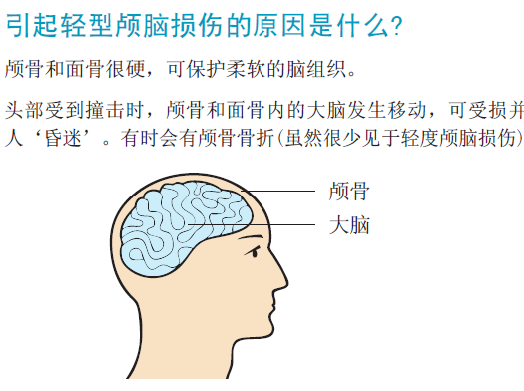
Education - CALD
https://www.aci.health.nsw.gov.au/networks/eci/clinical/clinical-resources/forms/awptas
Arabic, Chinese, Greek, Hindi, Italian Vietnamese
http://www.health.vic.gov.au/edfactsheets/
Arabic, Greek, Italian, Mandarin, Turkish & Vietnamese

Slide 41
Special populations
AWPTAS can be used with an interpreter
Provide clear instructions that interpreter should use exact wording & translate exactly
Can be used in those who are intoxicated/withdrawing
As long as they are compliant and can communicate intelligibly and meet GCS requirement

Slide 42
A-WPTAS summary
The A-WPTAS is a method of identifying PTA during acute management of Mild TBI
A basic measure of GCS, orientation & memory learning and recalling 3 pictures of objects
Tested hourly until 18/18 (perfect score achieved) but no more than 4 hours
For GCS ≥ 13 (must obtain Motor 6 and Eye 4)
Verbal orientation questions
5 = All correct and ‘oriented’
4 = <5 correct (1 or more errors) ‘confused’
3 = (1 or more errors and inappropriate response)
2 = incomprehensible sounds
Correct orientation errors for the next testing

Slide 43
A-WPTAS summary
Check picture cards are registered
Only present recognition if patient unable to freely recall one or more of the 3 pictures
If they can recognise the pictures they are given full credit
If no or partial recall, re-present the pictures and re-test in one hour
Once cleared for d/c provide written and verbal education and refer to OP neuropsychology

Slide 44
Additional Training
LMS module
Quiz
A-WPTAS Champions (*)

Slide 45
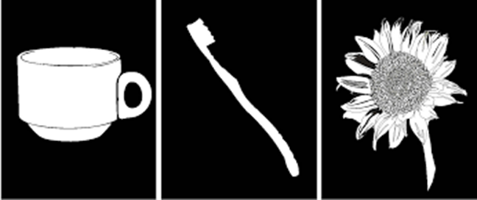
A-WPTAS Demonstration
Videos:
http://psy.mq.edu.au/GCS/AWPTAShigh.htm
https://aci.moodlesite.pukunui.net/pluginfile.php/1813/mod_resource/content/3/story.html

Slide 46
Other A-WPTAS training resources
Emergency Care Institute, NSW
https://www.aci.health.nsw.gov.au/networks/eci/clinical/clinical-resources/forms/awptas
Macquarie University, NSW:
http://psy.mq.edu.au/GCS/

Slide 47
Questions?

Slide 48
Contacts
Neuropsychology Unit, MMC
9594 3021
adultneuropsychMMC@monashhealth.org
Acute Occupational Therapy, MMC
9594 2270

