Slide 1
Question 5
Prof George Braitberg
Director Emergency Medicine Research

Slide 2
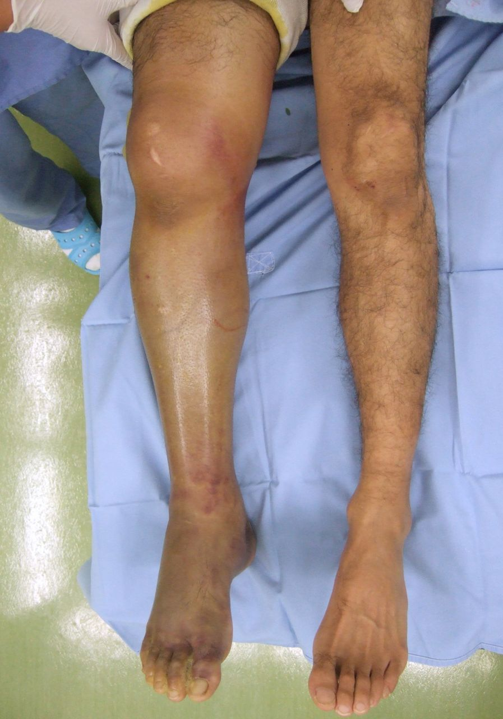
A 34 year old man is brought in by ambulance to the Emergency Department, one hour after being struck by a car. He is conscious, complaining of a painful R leg. He has no other injuries
Shiny skin
Swollen leg
Grossly swollen knee with ?haemarthrosis
Dusky colour of leg and toes
Bruised medial knee and ankle

Slide 3
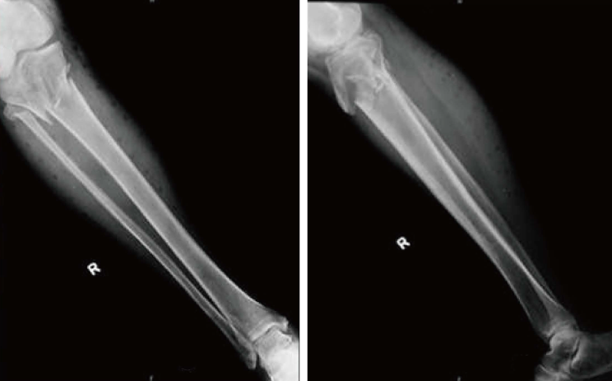
Comminuted prox T&F fracture
Soft tissue swelling
Gas in tissues
Possible tibial plateau fracture

Slide 4
Management post analgesia
Reduction rather than immobilisation due to concern about distal vascular insufficiency
CTA may delay definitive management in this setting so this option needs to be qualified
Assessment of compartment pressures – if elevated may need emergent fasciotomy - acute compartment syndrome is a surgical emergency. There is no effective nonsurgical treatment.

Slide 5
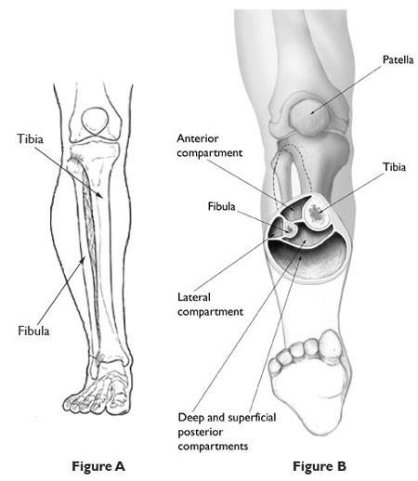
Main concern is identifying possible compartment syndrome and neuromuscular disruption of structures around the knee. Be specific and name the structures likely to be involved - poplitieal artery and common perineal nerve Bespecific in identifying the potential to perform a fasciotomy
4 major compartments; anterior, lateral, superficial posterior and deep posterior

Slide 6
Compartment pressures
The normal pressure within the compartment is between 0 mmHg to 8 mmHg.
An intra-compartmental pressure greater than 30 mmHg indicates compartment syndrome and a need for fasciotomy.
When intra-compartmental pressure increases to within 10 mmHg to 30 mmHg of the patient's diastolic blood pressure, this indicates inadequate perfusion and relative ischemia of the involved extremity.
The perfusion pressure of a compartment, also known as the compartment delta pressure, is defined as the difference between the diastolic blood pressure and the intra-compartmental pressure:
delta pressure = diastolic pressure - measured intracompartmental pressure

Slide 7
Marking distribution
n = for each score
Score (max 12)

Slide 8
Summary
To pass needed to mention compartment syndrome and neuromuscular disruption of structures around the knee
To get better than pass needed to be specific and name the structures likely to be involved - poplitieal artery and common perineal nerve
To get a higher mark needed to mention that you would attempt to reduce the fracture rather than just splint in an attempt to improve vascular supply.
To do better needed to mention potential for an emergency fasciotomy.
Do even better note how to measure compartment syndrome and what pressure is causes concern?
CT angiogram likely to delay definitive care and not recommended if compartment syndrome

