Slide 1
Question 24
Simon Craig

Slide 2
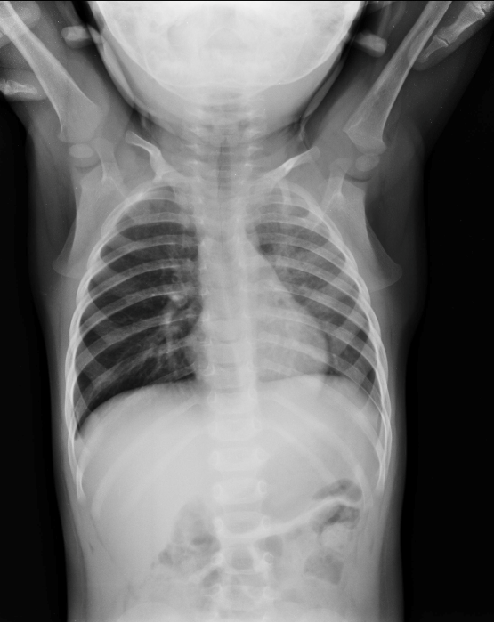
A previously well 18-month old girl is brought to the Emergency Department with a persistent cough and noisy breathing.
Her symptoms began when she and her older brother had been sharing some raw carrots at lunchtime. Her Xray is shown below:

Slide 3
Questions
List two (2) abnormal findings on the x-ray.
What is the likely diagnosis?
List four (4) important management steps
While waiting for definitive management, she develops significant work of breathing, stridor, and an ineffective cough.
List your four (4) immediate management steps.

Slide 4
This is a question about a child with an airway foreign body
Toddler
Inappropriate food (raw carrots)
Inappropriate supervision (brother)
Respiratory symptoms onset after eating

Slide 5
List two (2) abnormal findings on the x-ray.

Slide 6
List two (2) abnormal findings on the x-ray.
What I was looking for…

Slide 7
List two (2) abnormal findings on the x-ray.
What I was looking for…
Hyperinflation on right side
Mediastinal shift to left
Flattened R hemidiaphragm
Hyperlucent R lung
Diffuse ↑ opacity L lung

Slide 8
List two (2) abnormal findings on the x-ray.
What I was less happy with

Slide 9
List two (2) abnormal findings on the x-ray.
What I was less happy with
“Steeple sign” (croup)
Foreign body at top of trachea (looks like epiglottis to me)
Pneumomediastinum
Beak like upper airway
Massive hepatomegaly
↑ lung field density R hemithorax

Slide 10
What is the likely diagnosis?
What I was looking for …

Slide 11
What is the likely diagnosis?
What I was looking for …
Likely inhaled foreign body
Right main bronchus → ball-valve effect leading to hyperinflation

Slide 12
What is the likely diagnosis?
What I was less happy with …

Slide 13
What is the likely diagnosis?
What I was less happy with …
Croup
Haemolytic anaemia / G6PD deficiency
Aspiration
Left-sided foreign body

Slide 14
List four (4) important management steps
What I was looking for …

Slide 15
List four (4) important management steps
What I was looking for …
Nil by mouth
Plan for theatre / bronchoscopy
Admit / refer to ENT / Respiratory
Keep calm / minimal handling / sit up
Oxygen if needed
Monitor respiratory status

Slide 16
List four (4) important management steps
What I was less happy with …

Slide 17
List four (4) important management steps
What I was less happy with …
IV antibiotics
Panadol and nurofen
“Seek and treat” hypoxia
Treating haemolytic anaemia
Treating croup
Back blows

Slide 18
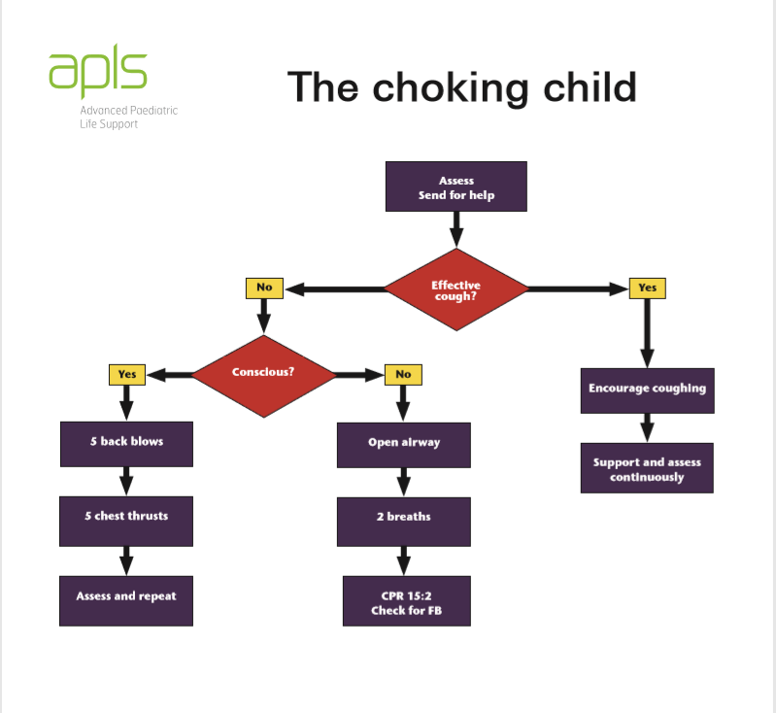
Management of the choking child
While waiting for definitive management, she develops significant work of breathing, stridor, and an ineffective cough.
List your four (4) immediate management steps.

Slide 19
Choking child: immediate management
What I was looking for …

Slide 20
Choking child: immediate management
What I was looking for …
Call for help
Back blows
Chest thrusts
Repeat if needed
If unresponsive, then
Commence CPR
Attempt laryngoscopy / remove foreign body

Slide 21
Choking child: immediate management
What I was less happy with …

Slide 22
Choking child: immediate management
What I was less happy with …
Not calling for help
Attempting RSI (particularly without help)
High flow oxygen
Abdominal thrusts
Nebulised adrenaline
Laparoscopy (presumably a typo for laryngoscopy)

Slide 28
Questions?
?
Simon.Craig@monash.edu

