Slide 1
Monash OSCE question 20
Mohan Kamalanathan

Slide 2
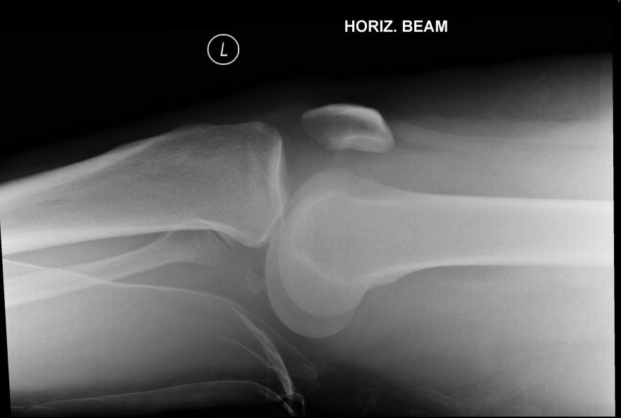
Question
23 year old with painful left knee whilst running. Xray shows:

Slide 3
Q1 – diagnosis and abnormalities
Dislocation of the knee joint.
Anterior displacement of the tibia on the femur ( I would also accept posterior displacement of the femur on the tibia.
Fracture fragment of the posterior part of the tibial plateau (tibial spine also appropriate).
Likely large haemarthrosis.
Answers that did not do well:
Fibular fracture – the fibula does not participate in the knee joint (just as the ulna does not participate in the wrist joint)
Unclear diagnosis
Overall, most candidates did this part well.

Slide 4
Q2 – indications for immediate surgery
Clinical features of popliteal artery compression (decreased pulses on the posterior tibial artery or dorsalis pedis pulse).
Inability to reduce in the Emergency Department.
Open wound consistent with a possible compound dislocation of the joint.
Decreased sensation consistent with neuropraxia of the tibial nerve, superficial fibular or deep fibular nerves.
Poor answers:
Compartment Syndrome
This does not occur during a dislocation of the knee, rather it occurs with fractures.
Overall candidates missed a mark as they had used a list of immediate surgical intervention for an fracture condition to this dislocation

Slide 5
List six potential complications
Vascular compromise
Compartment syndrome
Fibular nerve palsy
Laxity of the joint
Stiffness of the joint
Chronic pain
Loss of income
Poor answers were repetitive and did not cover a spectrum of complications, eg:
Fibular nerve palsy
Tibial nerve palsy
Sciatic nerve palsy.

Slide 6
Spectrum of marks – pass is 9

