Slide 1
Q16: Hypercalcaemia
Ben Cheung

Slide 2
Overview
Feedback
General
Question specific
Analysis of performance by candidates
Final tips / advice

Slide 3
Feedback – general
No answer = no marks
Don’t overwrite
Be specific, but “see above point 2”
** Apologies for transcription error: questions were changed without my knowledge. The one question most affected was question (d) – more on this later **

Slide 4
Feedback – question specific
(a) Aside from spurious and malignancy-related causes, name three (3) other causes of hypercalcaemia. (3 marks)
Hyperparathyroidism (primary or tertiary)
Adrenal insufficiency
Thyrotoxicosis (usu mild)
Drugs (eg thiazides – usu mild)
Granulomatous diseases (eg sarcoidosis, TB)
Milk-alkali syndrome
Hypervitaminosis (A or D)
Immobility

Slide 5
Feedback – question specific
(a) Aside from spurious and malignancy-related causes, name three (3) other causes of hypercalcaemia. (3 marks)
Rare for full marks
Common themes / controversies
Hyperparathyroidism: not specifying primary and tertiary
Dehydration: not paid
Supplemental Ca/VitD: not specifying overdose or excess

Slide 6
Feedback – question specific
(b) List 3 body systems (NOT cardiovascular) that may be affected by this patient’s calcium level, with one (1) clinical feature for each body system that may be found on bedside assessment. (3 marks)
Body System Clinical Feature
Gastrointestinal nausea/vomiting, anorexia, constipation, abdominal pain
Neurological hypotonia, lethargy, confusion, (coma)
Musculoskeletal muscle weakness, bone pain
Renal polyuria, stones-related symptoms

Slide 7
Feedback – question specific
(b) List 3 body systems (NOT cardiovascular) that may be affected by this patient’s calcium level, with one (1) clinical feature for each body system that may be found on bedside assessment. (3 marks)
Easy question, but marks lost but lack of specificity/conciseness
Common themes / controversies
Urolithiasis: need to specifiy PHx of this, or symptoms/signs of this
Microscopic haematuria
Stating hypoCa SSx, eg Chvostek sign
Not naming a body system correctly, eg intracranial

Slide 8
Feedback – question specific
(c) List two (2) ECG changes that may occur in hypercalcaemia. (2 marks)
QT shortening
Osborn waves
ST elevation
VT/VF
(PR prolongation)
(QRS widening – marginal, 7ms)

Slide 9
Feedback – question specific
(c) List two (2) ECG changes that may occur in hypercalcaemia. (2 marks)
Either knew or or you didn’t
Most people got 1 or 2 marks
Common themes / controversies
Stating changes related to hypoCa, eg QT prolongation
Stating PR shortening

Slide 10
Feedback – question specific
State four (4) treatment options (dosage not required) for this patient in the emergency department, with a brief description of how each treatment lowers serum calcium. (4 marks)
Treatment Option Treatment Mechanism of Action
Saline IV fluids Promotes diuresis / renal excretion of Ca2+
Loop diuretics (after rehydration) Decrease Ca2+ reabsorption at loop of Henle
Bisphosphonates Inhibits osteoclasts, promotes osteoblasts
Calcitonin Inhibits osteoclastic activity / PTH antagonist
Corticosteroids* Inhibits vit D effects, inhibits osteoclasts
* in vit D toxicity, haematological malignancy, granulomatous diseases only

Slide 11
Feedback – question specific
State four (4) treatment options (dosage not required) for this patient in the emergency department, with a brief description of how each treatment lowers serum calcium. (4 marks)
?Too much like primary knowledge
But only required BASIC MoA, eg diuretics to enhance urinary excretion of Ca
Common themes / controversies
Giving incorrect dose / dose units
IV fluids to “hydrate”
Diuretics, but stating HCT (which causes hyperCa!)
Inaccurate/nonspecific MoA, eg bisphosphonates binds Ca
Bisphosphonates decreases Ca release from bone

Slide 12
Candidate performance
Pass mark = 8/12
Candidates that passed = 54%
Lowest mark = 3.5/12
Highest mark = 10.5/12
19% within 1 mark off passing this question

Slide 13
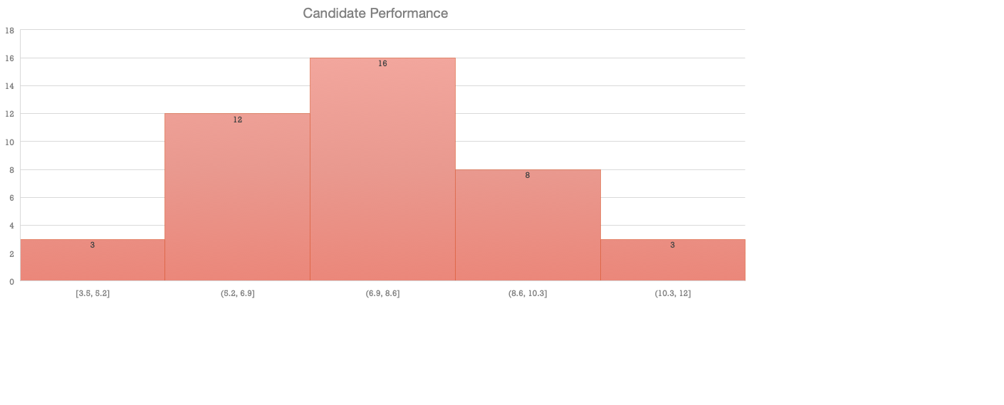
Candidate performance

Slide 14
Final tips / advice
Learn the game
Practice doing exam whilst tired / sleep deprived
Don’t forget the psychological challenge(s) that come with this exam
Questions, comments, love/hate mail to benjamin.cheung@monanshhealth.org

