Slide 1
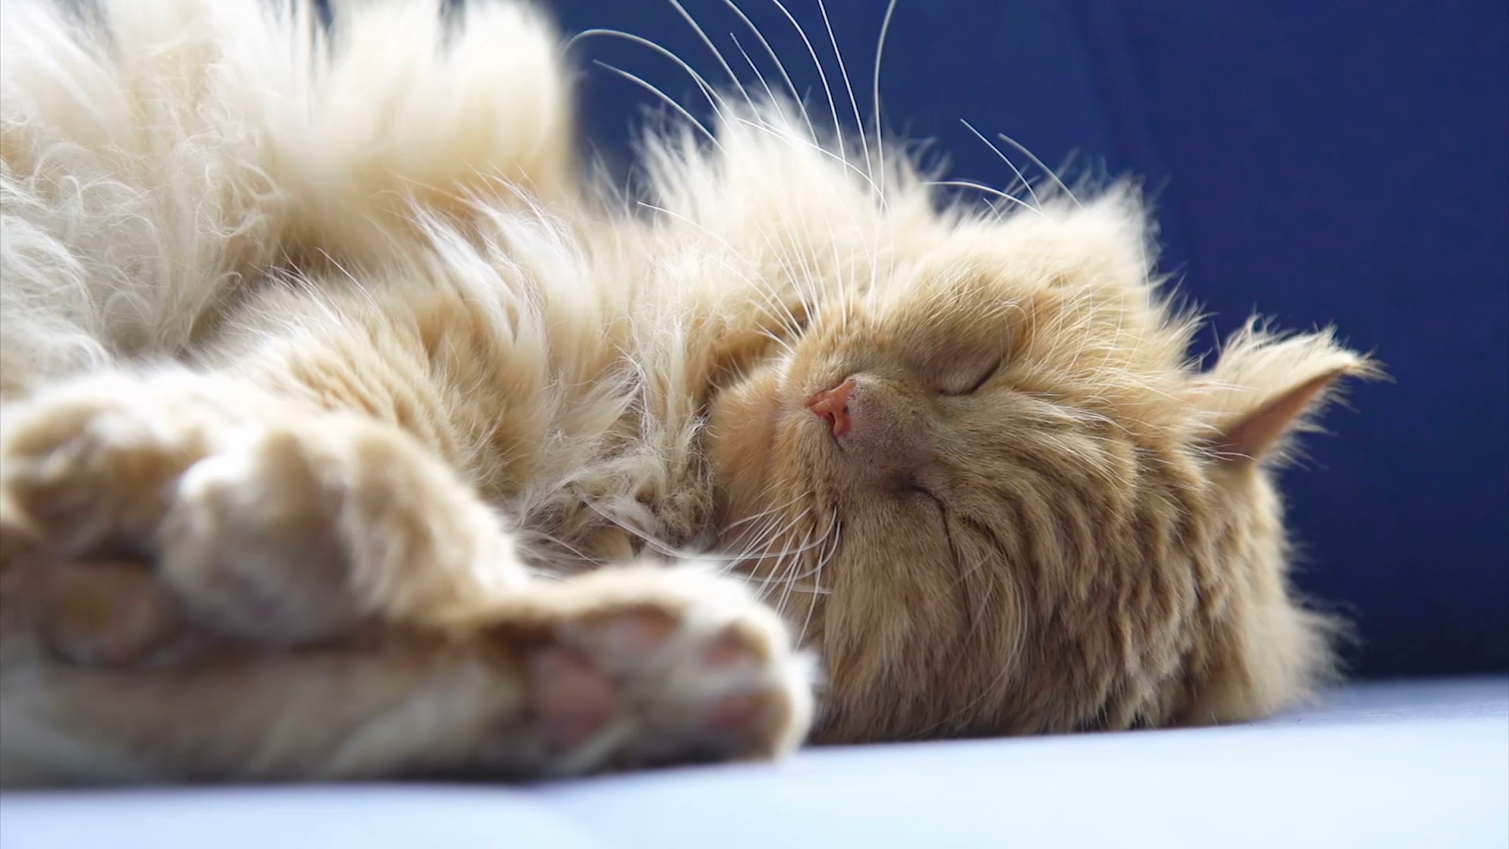
Question 7
Sheila Bryan
Network DEMT
Monash health

Slide 2
30 yo female, frequent attendances for ETOH AMS, nystagmus, ataxia
GCS 10, HR, BP, Sats T 38
Do
avoid
ETOH
ingestions
Fever
trauma
AMPLE / collateral / suicidality
SHx - diet
Specific closed Q on additional Sx
  ? HA
  (vomiting accepted)
Confirmation of Sx already presented
> I Q on same topic
  ? Infective resp Sx
  ? Infective urine Sx

Slide 3
Investigations
Do
avoid
AMS
  Glucose, B1
  ETOH level (bedside)
  Tox - EGC, Paracetamol, VBG
  Bloods –
    LFT / ammonia (encephalitis) ,
    VBG (glucose, Na, osmolarity)
    FBE, coags
Fever
  Septic WU cf blood cultures to guide AB therapy
CNS
  CT/ MRI
  (LP)
CT to exclude……
  Doesn’t exclude
  Specifically, meningitis, raise ICP
List of similar Inx
  Culture urine, culture sputum, Cxr
Stretch of Hx
  eclampsia
Incomplete/no reason
  Lactate to Guide resus

Slide 4
Eye signs
Nystagmus 0.5
Lateral rectus palsy
Disconjugate gaze
INO
Impaired horizontal vestibulo- ocular reflex
Optic disc oedema
Retinal haemorrhages

Slide 5
Mx
Thiamine , B1
Poor evidence for dose and frequency
> 200 mg
Iv not Im or oral
> daily

Slide 6
Stats pass mark 9

Slide 7
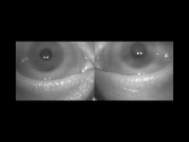

Slide 8
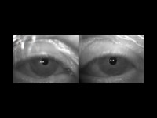

Slide 9
