Slide 1
Renal Physiology

Slide 2
Overview role of the kidney
Remove metabolic products, toxins and acid
Removal of non volatile acids (lactate, sulphuric, phosphate, acetoacetate, beta hydroxybutyrate, toxins)
Salt balance
Water balance
Ph balance
Produce erythropoetin

Slide 3
NAGMA used carp
Utero ileostomy
Small bowel fistula
Extra Cl, Normal saline
DKA, Diarrhea
Carbonic anhydrase inhibitors
Addison's
RTA
Pancreatic fistula
Low GFR

Slide 4
HAGMA - MUDPILES
Methanol
Uraemia
DKA
Paraldehyde
Fe, isoniazid
Lactic
Ethanol
salicylate

Slide 5
Getting stuff in and out
Filtration
Delta Pressure, permeability of the capillaries depends on charge, size of particle, size of capillary bed –mesangial cells ? Make renin
Dilate with dopamine and constrict with vasopressin and NA, AgtII ,
Starlings forces – hydrostatic and oncotic pressures in the cap and in the interstitium AND bowman's capsule
Passive Diffusion
Ficks law D~delta C/thickness, surface area charge, size, solubility
Water, CO2
Facilitated diffusion down concentration gradients
Passive transport through tight junctions – H2O, k+
Endocytosis – small proteins and some peptide hormones resorbed in PCT

Slide 6
Co transport
Na – glucose, limited carrier proteins – T max Na/P, Ma /AA Na/lactate
Na k 2Cl TAL
Na/H TAL
Counter transport / exchangers
Cl uptake
PCT Na/H+ PCT
Na/K TAL LOH
Active transport
Na/K ATP pump
NaK2Cl
H+
Pumps Na/K atp pump basolateral membrane
(Ion) Channels
Aquaporins PCT I, dec limb of LOH, CD 2
e Na CD CD
K= in TAL

Slide 7
hormones
Salt
RAAS
Water
ADH/vasopressin
Volume > osmotic in most cases but not with stress, pain, post op, nausea ( dilutional hyponatreamia)
Osm 2xNa+glucose+urea = 285

Slide 8
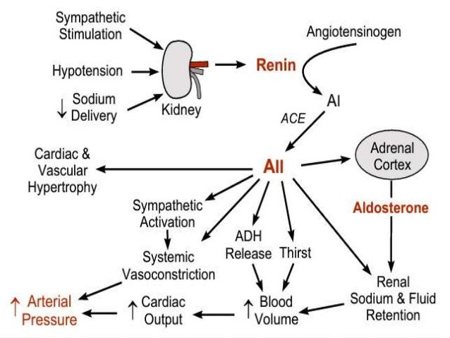

Slide 9
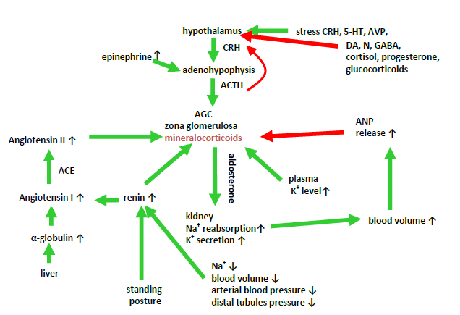

Slide 10
MCQ
Renal blood flow
A Can be measured using inulin
B Constitutes about 35% of the cardiac output
C Can be determined by applying the fick principle
D Is increased by noradrenaline
C Can be determined by applying the fick principle

Slide 11
MCQ
The acidification of urine
A In the proximal tubules is principally by secondary active transport
B Is limited to pH 4.0
C In the proximal tubules involves aldosterone sensitive proton pumps
D In the distal tubules is dependent on Na+ in the tubular lumen
A In the proximal tubules is principally by secondary active transport

Slide 12
MCQ
Which of the following plasma constituents is normally completely reabsorbed
A. HCO3-
B. Na+
C. Cl-
D. Ca+2
A. HCO3-

Slide 13
water
Monitors
Volume
Osmolarity
Receptors
Right atrium (CVP)
Baroreceptors - carotid sinus
Low – adrenalin
Osmo receptors
ADH release – water retention aquaporins in DCT

Slide 14
2010/1: What is the normal range of osmolality of the extracellular fluid? How is it maintained? What other stimuli affect vasopressin secretion?

Slide 15
2010/1: What general mechanisms are involved in renal tubular reabsorption and secretion? How is Sodium reabsorped in the various parts of the nephron?

Slide 16
2009/2: Discuss how and where H+ is secreted in the kidney. (Prompt: How is Bicarbonate involved?). What is the limiting pH for urine and how is this limitation dealt with?

Slide 17
2009/2: Describe how sodium is handled in the glomerulus and the proximal convoluted tubule. List the mechanisms that affect sodium reabsorption.

Slide 18
2009/1: How is the H+ ion secreted in the proximal tubule of the kidney. Outline the buffer systems that act to bind H+ ion in the tubular fluid. What is the importance of H+ buffering systems in the urine

Slide 19
2009/1: Describe the counter current mechanism of the kidney.

Slide 20
2010/1:
What do these blood gases show
pH 7.02 Na 136
PaCo2 12 K 3.8
PaO2 115 Cl 107
HCO3 3 FIO2 0.21
Describe the renal response to metabolic acidosis.

Slide 21
2009/1: Where does sodium reabsorption occur in the nephron? What are the mechanisms of sodium reabsorption in the nephron? What mechanisms in the kidney reduce sodium excretion?

Slide 22
2008/2: Describe the physiologic process of micturition? List other factors that stimulate and inhibit micturition.

Slide 23
2008/2: Describe how the nephron handles potassium? What factors influence this?

Slide 24
2008/2: What is normal renal blood flow and how can it be measured? How do blood flow and oxygen extraction vary in different parts of the kidney?

Slide 25
2008/1: How does the kidney handle potassium? How do other ions affect potassium transport across the membranes in the nephron?

Slide 26
2008/1: What is a typical value for renal blood flow in an adult at rest? What factors regulate renal blood flow?

Slide 27
2008/1: Please outline the structure of the loop of Henley. What happens to electrolytes in the loop? Explain the counter-current concentrating mechanism.

Slide 28
2007/2: Describe a method for measuring the glomerular filtration rate. What is the normal GFR and what are the factors which affect it?

Slide 29
2007/2: Describe water handling in the collecting ducts of the kidneys. What is an osmotic diuresis?

Slide 30
2007/2: Please describe how the urinary bladder empties. Describe the reflex control associated with voiding.

Slide 31
2006/1: What factors affect glomerular filtration?

Slide 32
2006/1: Describe how water is reabsorbed in the different parts of the nephron. What hormonal factors influence water excretion?

Slide 33
2006/1: What are the major physiological factors affecting sodium excretion from the kidney? What are the major physiological factors affecting potassium excretion from the kidney?

Slide 34
2005/2: What are the major buffers of blood? How do they work? What are the major buffers in cells? Describe the Henderson-Hasselbach equation.

Slide 35
2005/2: Describe how respiration compensates for acid-base change. What clinical conditions might cause metabolic acidosis/ metabolic alkalosis?

Slide 36
2005/2: Describe the structure of the loop of Henle. Describe the function of the loop of Henle.

Slide 37
2005/1: What is the renal response respiratory acidosis? What buffering systems are there for H+ in the renal tubular fluid?

Slide 38
2005/1: How is the secretion of rennin regulated? Describe juxtaglomerular apparatus.

Slide 39
2005/1: What factors affect filtration across the glomerular capillary bed? How can GFR be measured?
.

Slide 40
2004/2: What happens to potassium as it passes through the nephron? How does the potassium handling by the kidney change in response to changes in pH? How is aldosterone increase K secretion?

Slide 41
2003/1: What is a normal Glomerular Filtration Rate in humans? What factors would cause a decrease in GFR?

Slide 42
2003/1: What is the renal response to acidaemia? Describe the buffer systems involved

