Slide 1
Qn 20

Slide 2
QN
An 11 year old boy is brought to the emergency department limping on his left leg for 2 days.
He localises pain to his left hip. He is active with no trauma noted. He has been a previously well boy.
List three (3) important non-Hip differentials with one (1) investigation and one (1) justification for each.

Slide 3
Part a
READ THE QN! Many people gave hip Dx when the qn said NON hip.
THINGS I PAId:
Leukemia, Lymphoma, Osteoma
Testicular torsion, appendageal torsion, orchitis Inguinal hernia
Referred back pain (as long as not traumatic)
Sickle cell crisis
Rheumatic fever
UTI
½ marks for appendicitis ( L sided pain) – except for one person who wrote sinus invertus!

Slide 4
Part A
This is not a toddler – should be able to localize pain appropriately – i.e. will not have foot FB localized to L hip pain, will not have knee trauma/or septic knee (esp. since the question said no trauma and well child)

Slide 5
Justification
Please think about what actually will CONFIRM your diagnosis
FWT for renal colic, FBE for appendicitis do not confirm,
Prefered cultures to FWT for UTI
USS to FWT for renal colic
I gave ½ for those that did USS for testicular torsion – you are the patient advocate – if you think this is torsion they should go to theater for exploration.

Slide 6
X-ray
Slipped capital femoral epiphysis (based on Klein’s lines)
Loss of physis or decreased space

Slide 7
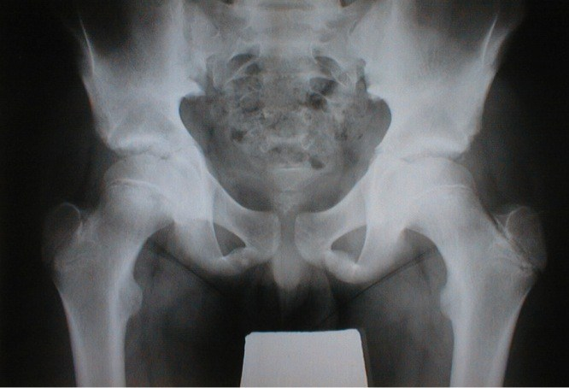
XRAY:

Slide 8
Management
Analgesia – needed qualification – which analgesic, what dose etc
Orthopaedic referral – needs qualification – you are the specialist – just referral means you don’t know what you want form the speciality
NWB
NBM
Frog leg views

