Slide 1
Question 6
Preeti Ramaswamy

Slide 2
I am not an examiner, just a passionate paediatric emergency physician!

Slide 3
You are the consultant in charge of a tertiary Emergency department. A local community hospital (1 hour away) calls you for advice on the care of a 12 day old male infant with a fever. His vital signs are:
HR 185 bpm
Temp 39 º C
O2 Sat 98% RA
capillary refill 3 seconds
a) State three (3) priorities of his care. (3 marks)
ANTIBIOTICS: cefotaxime 50mg/kg + BenzylPenicllin 50mg/kg (must mention antibiotics to pass this section)
Fluid resuscitation: 10-20mls kg 0.9% Nacl
Transfer to higher care facility

Slide 4
b) List five (5) important investigations you would consider for this patient. (5 marks)
BSL
Blood culture
Venous blood gas
Urine microscopy and culture
CSF microscopy and culture
(WCC, CRP, Electrolytes)
I didn’t think this section was a particularly good question! I wish I had said in order of clinical importance or justify your investigation

Slide 5
c) The local team caring for the child are unable to gain IV access. What is your advise to them? (2 marks)
IO access
IM antibiotics
NG fluids

Slide 6
IV access is now gained. The child appears mottled and has a BSL of 2.2
d) State two (2) specific immediate management priorities. (2 marks)
10% dextrose 2-5mls/kg intravenously
Fluid bolus: 10-20mls/kg 0.9% Nacl

Slide 7
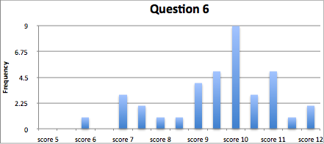
This is how you did

