Slide 1
Q17: POCUS

Slide 2
THE QUESTION
Young patient with OHCA
ROSC achieved
Vitals: hypotensive, tachypneoic, hypoxic, AC
POCUS findings and those expected
Unifying diagnosis
Pro’s & Con’s of treatment

Slide 3
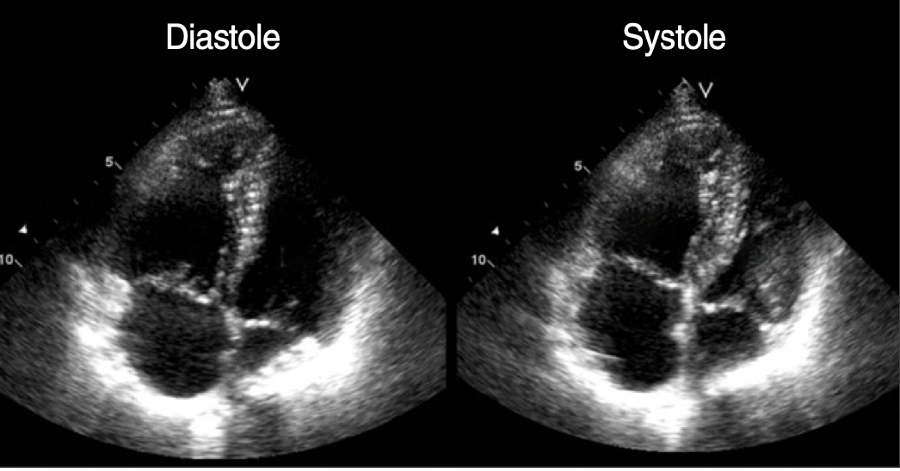
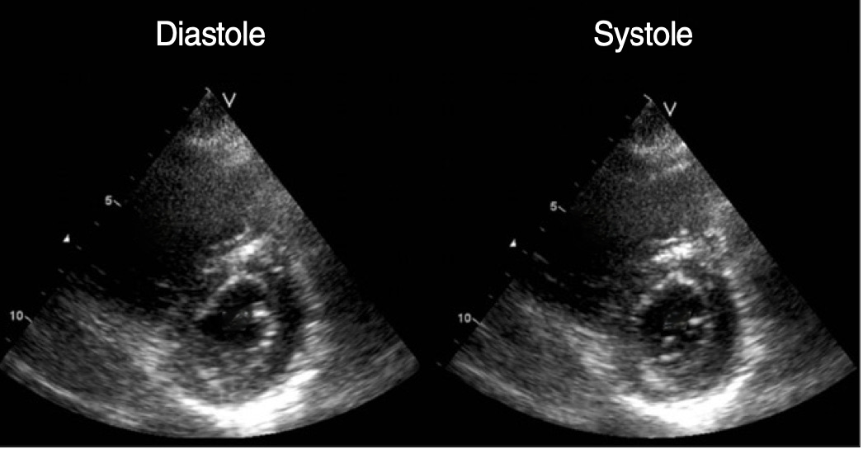

Slide 4
Abnormal findings
Increased right sided pressures
Dilated RV (RV/LV end diastolic area > 0.7) & RA
RV free wall hypokinesis and systolic dysfunction
Paradoxical septal wall motion
‘D-sign’: septal flattening in short axis view at end diastole
Small LV filling

Slide 5
Diagnosis
Massive PE
History of cardiac arrest
Hypotensive (SBP<90mmHg)
Bradycardic
Altered conscious state
Right heart strain on POCUS
In a consultant exam the differentiation from just a PE is pertinent
Big implications for treatment and disposition

Slide 6
Other POCUS findings
McConnell’s sign
Proximal DVT
Clot visible in chambers
Dilated IVC with lack of resp. collapse
Reduced TAPSE < 1.6cm

Slide 7
Thrombolysis
Pro’s
Rapidly reduce clot burden which reduces RV strain and thereby haemodynamics
Reduced long term pulmonary hypertension
Appears to have mortality benefit in massive PE
Con’s
Haemorrhage
Spontaneous (ICH etc)
Traumatic: just had CPR
Anaphylaxis/Cost

Slide 8
Performance
12-mark question
Mode and median score was 8 and average of 7
Pass mark of 7.5
60% passed
6 people scored 0!!

Slide 9
Learnings
Expert level topic
POCUS is growing in use in ED
Basic Prop with easy marks on the findings and expected findings
PE without the modifier is not adeq. In a specialist exam
History and exam in stem were given for a reason
Need to be able to discuss pro/con of Resus drugs

