Slide 1
Monash Health Fellowship Practice Exam 2022.01
Questions 26
A/prof Pourya Pouryahya MD, FACEM, GC ClinEpi, CCPU, M Trauma, MPH
Emergency Medicine Consultant, Monash Health, Casey Hospital
Director of Emergency medicine research (DEMR), Casey hospital, Monash Health
Associate professor, school of medicine, Monash university

Slide 2
Repetitive but Important to remember :
YOU ARE A CONSULTANT NOW → Think as a CONSULATNT
ANSWER as a CONSULATNT → Big picture first then add details (knowledge)
Be precise → Description/anatomical locations /significance and practice changing/System issues etc
Write something that doesn’t need explanation and NO ONE can argue
Spend 15-20 seconds scanning and understand the question first
READ the question and ANSWER the question

Slide 3
Stem
During morning hand over, you are taking over the care of a 63 year old male with a past history of untreated hypertension who presented to your non-tertiary Emergency Department overnight with central chest pain radiating to his left arm.
His vital signs on arrival:
BP 175/100 mmHg
RR 22 bpm
O2 sat 95% RA
Temp 36.2 C

Slide 4
Summary
During morning hand over, you are taking over care of a 63 year old male with a past history of untreated hypertension who presented to your non-tertiary Emergency Department overnight with central chest pain radiating to his left arm.
His vital signs on arrival:
BP 175/100 mmHg
RR 22 bpm
O2 sat 95% RA
Temp 36.2 C
Not uncommon
Non ischemic causes ?!
transfer ?!?!

Slide 5
Why is this question asked?
Difficult ?
Important ?
Sense?
What are the major issues?
Not uncommon
Non ischemic causes ?!
transfer ?!?!

Slide 6
Why is this question asked?
Knowledge
Important
You HAVE TO know what you have to know and one step further
READ THE QUESTION CAREFULLY

Slide 7
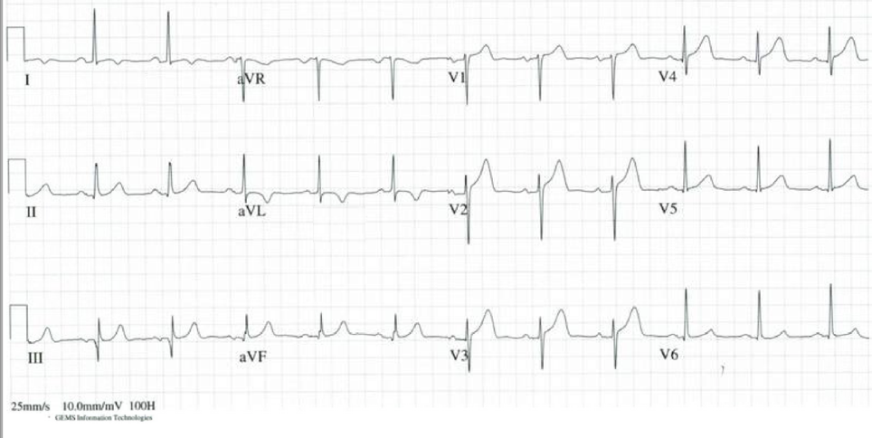
State two (2) abnormal findings in his ECG

Slide 8
State two (2) abnormal findings in his ECG
q3
TWI I and aVL
St-T changes anteroseptal
Overall non specific changes
BUT
Be as specific when stating abnormal findings :
Amplitude and characteristics of STE, STD
Depth of q wave

Slide 9
As a result of his elevated troponin, the patient was referred to cardiology overnight and accepted for transfer to the CCU of the nearby tertiary hospital.
In the interim he has received anti platelets as well as Enoxaparin.
During the morning hand over, the emergency alarm is activated by the bedside nurse and the patient is found to be unresponsive without any cardiac output.
Arrest (PEA)

Slide 10
3 management changing utilities of POCUS in this case
Interpretation
Think Categorically

Slide 11
ISSUES with ACLS #1
Cardiac output by palpating for a peripheral or central pulse
It is insensitive:
Low blood pressure
Body habitus
Providers finger tips (not sensitive enough)
Presence of gloves (sensation more dulled)
It isn’t specific:
Providers own digital pulse (pressing hard)
Inter-rater reliability of pulses is poor
Different quality of sensation in our fingertips
Tibballs and Russell : Rescuer pulse palpation was only 78% accurate (Tibballs 2008)
Providers had a difficult time rapidly (< 5 sec) locating the carotid pulse (Ochoa 1998)

Slide 12
A patient that was initially thought to be a PEA arrest Narrow complex rhythm on the monitor but no palpable blood pressure as assessed by one doctor and one nurse

Slide 13
ISSUES with ACLS #2
ACLS stresses the “Hs + Ts” as a random array of possible PEA causes
does not provide
a framework for
management

Slide 14
PEA
Pulseless Rhythm Echo Motion
PREM
Pseudo-PEA
SHOCK
Pulseless Rhythm Echo standstill
PRES
True PEA
ASYSTOLE

Slide 15
5Hs / 5Ts
Tamponade (POCUS)
Tension Pneumothorax (POCUS)
Thrombosis – cardiac (Cardiogenic shock) (POCUS)
Thromboembolism (PE) (POCUS)
Toxin – ECG
Hypovolaemia (POCUS)
Hyperkalaemia/Hypokalaemia – ECG and path
H+ (metabolic acidosis) – path
Hypoxia
Hypothermia / Hyperthermia

Slide 16
3 management changing utilities of POCUS in this case
Cardiac activity / Type of arrest
Efficacy of chest compression / CPR Diagnostic tool / Reversible causes (Hs/Ts)
Prognosis

Slide 17
Pseudo PEA True PEA
Cardiac mechanical activity without output
Good probability of saving lives;
Recognising the pathology promptly and expedite appropriate treatment:
Tension pneumothorax or Tamponade – needle
PE – thrombolysis
Hypovolaemia – fluid resuscitation/blood
Cardiogenic shock – revascularise with thrombolysis or angioplasty
Keep resus going
No or minimal cardiac mechanical activity with no output
Prognosis is poor
Early cessation of resuscitation unless reversible causes :
Hyperkalaemia
Toxins/overdose (TCA, BB, CCB)
Severe hypothermia
LV stasis thrombus
LV is full with clot → static for a long time → not survivable (stop CPR)

Slide 18
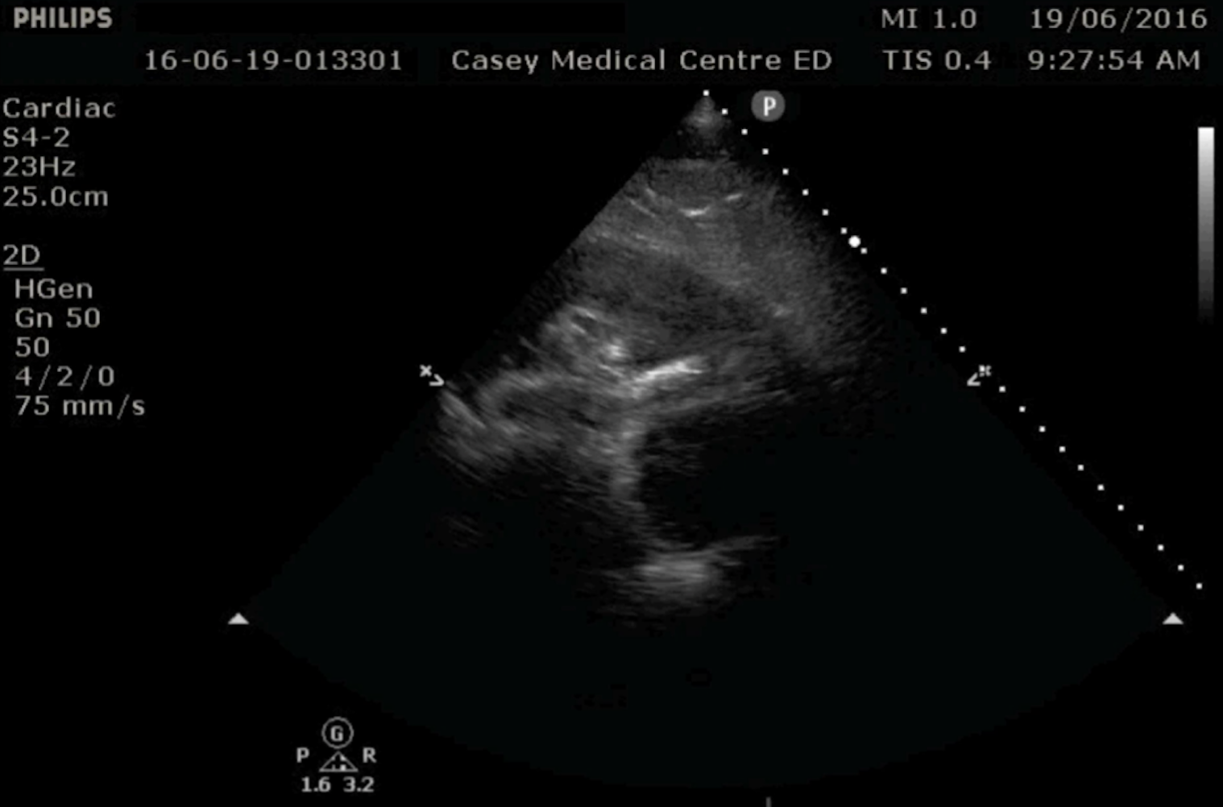

Slide 20
3 important findings on his POCUS
Tamponade
Large effusion
RA and RV collapse
Non collapsible tricuspid annulus

Slide 21
2 DDx for the above pathology
What can cause Tamponade in this patient ?
Type A TAD
Ventricular rupture (free wall) not septum

Slide 22
2 specific strategies for utilising POCUS in the emergency management of above pathology
2 strategies in Pericardiocentesis
Real time Vs land mark
Biggest pocket of fluid
Contrast (Agitated saline)

Slide 23
Contrast

Slide 24
Issues
Read the question carefully
Think before writing / typing
Why is this asked and what should I know?
Incorrect interpretation of the questions
Incorrect interpretation of the image
Forgetting the patient himself
Non specific enough description

Slide 25
Some answers
- This is not a recognisable view of any cardiac ultrasound I know
- Presumably this would be a subcostal view yet nothing is identifiable
Recommendation:
Write your best guess rather than criticising the question
In real life this might be the best picture you get and YOU HAVE TO MAKE A DECISION
You can guess tamponade and write based on the expected findings

Slide 26
General recommendations
Don’t Make up findings
Be as specific as possible
Write something no one can argue
Don’t use generic answers without any context or meaning
Don’t repeat yourself ( Try to categorise your answer)
READ THE QUESTION AND ANSWER THE QUESTION

Slide 27
Mark out of 12
Min 0
Max 10
Mean 4.3
Mode 4
Pass rate for pass mark 7: 15%
Pass rate for pass mark 8: 7.5%

Slide 29
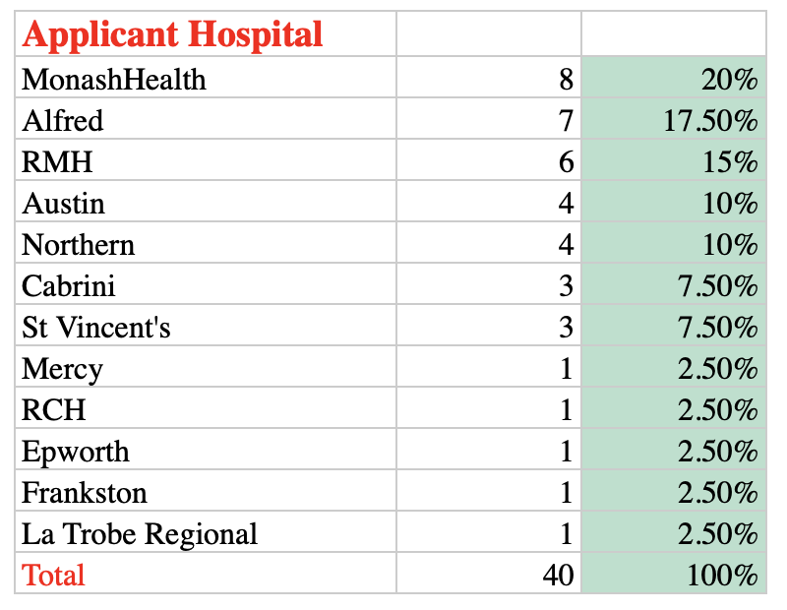
Some

Slide 31
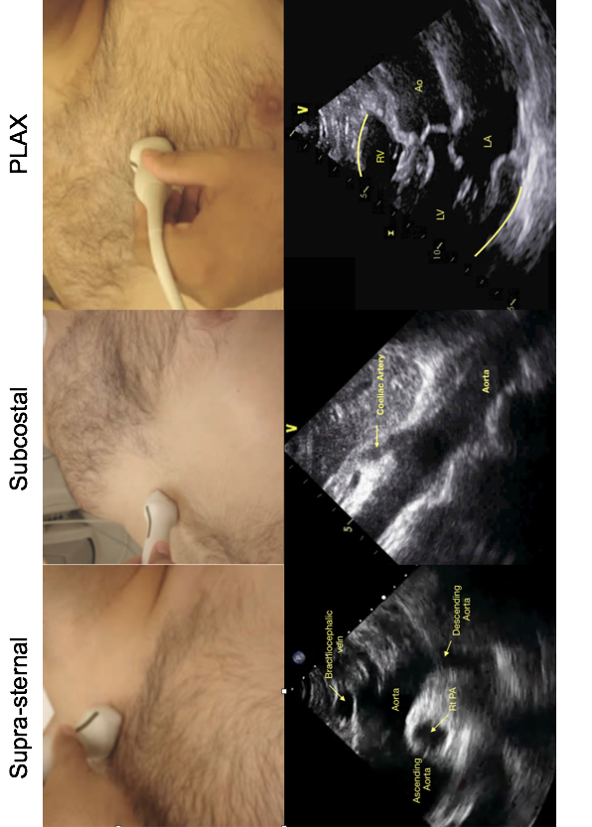
TAD

