Slide 1
Monash Health SAQ Exam
2017.2
SAQ 15 & 21

Slide 2
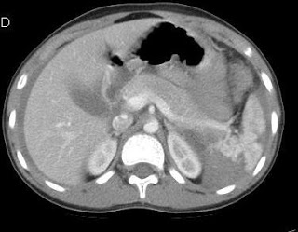
SAQ 15 A 40 yo builder presents after falling from a ladder. His only compliant is of moderate upper abdominal pain. OA GCS 15 BP 100/60 HR 90 Sat 97% RA

Slide 3
A 40 yo builder presents after falling from a ladder. His only compliant is of moderate upper abdominal pain. OA GCS 15 BP 100/60 HR 90 Sat 97% RA
List three (3) abnormalities on his CT. (3 marks)
What is your diagnosis? (1 mark)
List & Justify four (4) key further Investigations to be performed in the ED. ( 4 marks)
State four (4) criteria in this patient that would lead you to consider Angiography with embolisation. (4 marks)

Slide 4
A 40 yo builder presents after falling from a ladder. His only compliant is of moderate upper abdominal pain. OA GCS 15 BP 100/60 HR 90 Sat 97% RA
List three (3) abnormalities on his CT. (3 marks)
Significant splenic parenchymal lacerations
Devascularized area posterior segment > 25%
Free intraperitoneal fluid c/w blood
Contrast blush sign near hilum
Gas within abdominal wall c/w lower rib #s/pneumothorax
b. What is your diagnosis? (1 mark) High grade (IV) splenic injury
Notes:
Active extravasation of contrast
Splenic pseudoaneurysm
These two clinical issues can be distinguished by looking at the location of the contrast and its persistence. A pseudoaneurysm is located within the parenchyma, and the contrast will wash away, so it will not be visible on delayed images. Contrast that extends beyond the parenchyma or persists in delayed views represents active bleeding.
haematoma size (% surface area)
laceration size (parenchymal depth)
vessel involvement
integrity of spleen
vascular status

Slide 5
Points to consider when asked to justify or provide a satisfactory rationale
when and why you would perform the test(s)
What you would be looking for
Test utility/ or likely yield
Clinically relevant information

Slide 6
Features of an unsuccessful answering
Investigtion without adequate explanation
Eg FBE signs of infection
Listing investigations in a self evident fashion
Eg U+ E to check for electrolyte abnormalities
CRP/ESR – inflammatory markers
Investigations showing no clinical perspective
Eg CXR for pneumonia in this pt
Omitting key investigations
Writing “Baseline” as justification for investigations

Slide 7
C, List & Justify four (4) key further Investigations to be performed in the ED. ( 4 marks)
Investigtion | Justification
eFast/CXR/CT chest | Associated left lower rib #s/flail/pneumothorax/haemothorax
Hb/Hct | Serial measurements if falling despite transfusion = IR or OR
X/Match | Anticipate need transfusion +/- activation of MTP
POCUS/FAST | Serial monitor intraperitoneal fluid volume Associated left renal trauma
FWT urine/renal imaging | Macroscopic or microscopic haematuria depending on degree of associated renal trauma
PAN CT/CT brain/CT spine/CT or XR pelvis/Hips | Listing these non specific Trauma protocol test before specific test/investigations related to high grade splenic injury & local associated injuries misses the chance to demonstrate a consultant level understanding

Slide 8
A 40 yo builder presents after falling from a ladder. His only compliant is of moderate upper abdominal pain. OA GCS 15 BP 100/60 HR 90 Sat 97% RA
State four (4) criteria in this patient that would lead you to consider Angiography with embolisation. (4 marks)
Most hemodynamically stable injuries can be managed non-operatively (especially Grades I to III)
Injuries involving the hilum or avulsion often require surgery (Grade IV or V) —ongoing hemodynamic instability is the only real contra-indication to conservative management
Angiography with embolization should be considered if: — a contrast blush is seen on CT/active extravasation contrast — AAST grade > III — moderate-significant hemoperitoneum is present — evidence of ongoing bleeding (eg persisting tachycardia or falling hb/Hct despite transfusion increasing fluid on serial fast)
—there are no other significant injuries (CNS/chest/abdo) needing immediate surgery
— NB Patients with functional asplenism will need immunisations and follow up similar to post-splenectomy patients so relatively young pt aim is splenic preservation if possible
Some candidates included availability of IR/trained staff THIS is NOT a pt factor

Slide 9
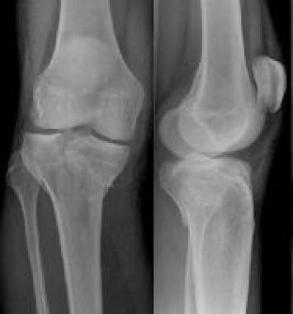
SAQ 21 A 30 yo man presents after accidentally stepping off the back of a truck 1.5m above ground level. He is complaining of severe knee pain. His BP 160/80 mmHg &HR 110
List three (3) abnormalities on this X-rays (3 marks)
What is your diagnosis? (1 mark)
List four (4) immediate (early) complications of this injury. (4 marks)
List four (4) Imaging options. State one (1) justification for each choice. (4 marks)

Slide 10
SAQ 21 A 30 yo man presents after accidentally stepping off the back of a truck 1.5m above ground level. He is complaining of severe knee pain. His BP 160/80 mmHg &HR 110
List three (3) abnormalities on this X-rays (3 marks)
# medial tibial condyle with impaction & 5-10 degrees medial angulation
# lat tibial condyle ~2mm lat displacement
Intra-articular extension with separation of condyles 2-3mm
Lipohaemarthrosis
Transverse # thru proximal tibial metaphysis
Posterior displacement tibial plateau ~2mm
b. What is your diagnosis? (1 mark)
Bicondylar intra-articular tibial plateau #
( Schatzker type V-VI)

Slide 11
SAQ 21 A 30 yo man presents after accidentally stepping off the back of a truck 1.5m above ground level. He is complaining of severe knee pain. His BP 160/80 mmHg &HR 110
c. List four (4) immediate (early) complications of this injury. (4 marks)
Popliteal artery injury (transection occlusion)
Common peroneal/tibial nerve damage/traction/palsy
Compartment syndrome
Complete Ligamentous disruption knee/dislocated knee
Venous occlusion lower leg
Massive haemarthrosis with skin ischaemia

Slide 12
SAQ 21 A 30 yo man presents after accidentally stepping off the back of a truck 1.5m above ground level. He is complaining of severe knee pain. His BP 160/80 mmHg &HR 110
d. List four (4) Imaging options. State one (1) justification for each choice. (4 marks)
Imaging | Justification
CT knee | Characterize fracture pattern/evaluate articular surface/pre-op planning
MRI knee | High rate concomitant knee dislocation/complete disruption ligaments/menisical damage with medial plateau & bicondylar #s
CT angiogram | High rate vasc injury with medial plateau & bicondylar #s
Doppler US lower leg | Evaluate Distal flow/venous congestion
Additional Xrays knee (plateau view) ankle/hip/spine | Depression/compression articular surface Associated high axial load fractures eg pilon of ankle/ calcaneus/fem neck/spine

Slide 13
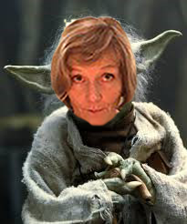
General themes preventing success in SAQ
Vague/non consultant level answers
Failing to answer specifics of question before going global ( brainstem protocol response)
Missing key/mandatory responses
Stuffing up timing/leaving questions out
Ignoring/devaluing feedback

