Slide 1
Question 9
Danny Ben-Eli

Slide 2
You are working in a rural emergency department (with General Surgery and Anaesthetic services), 90 Km away from the nearest trauma centre.
On a Saturday evening, a 35 year old previously well male without any allergies, is brought in by ambulance following a motor vehicle accident. He was the restrained driver of a car that skidded in wet weather and struck a tree. His only injury is a strike to the left lateral head.
On arrival he is alert , his pupils area equal and reactive to light but he is amnestic to the events and repeatedly asks staff what had happened.
His vitals are:
BP 130/85 mmHg
HR 90 /min
Sats 98% RA
Temp 36.5°C
GCS 14 (E4 V4 M6)

Slide 3
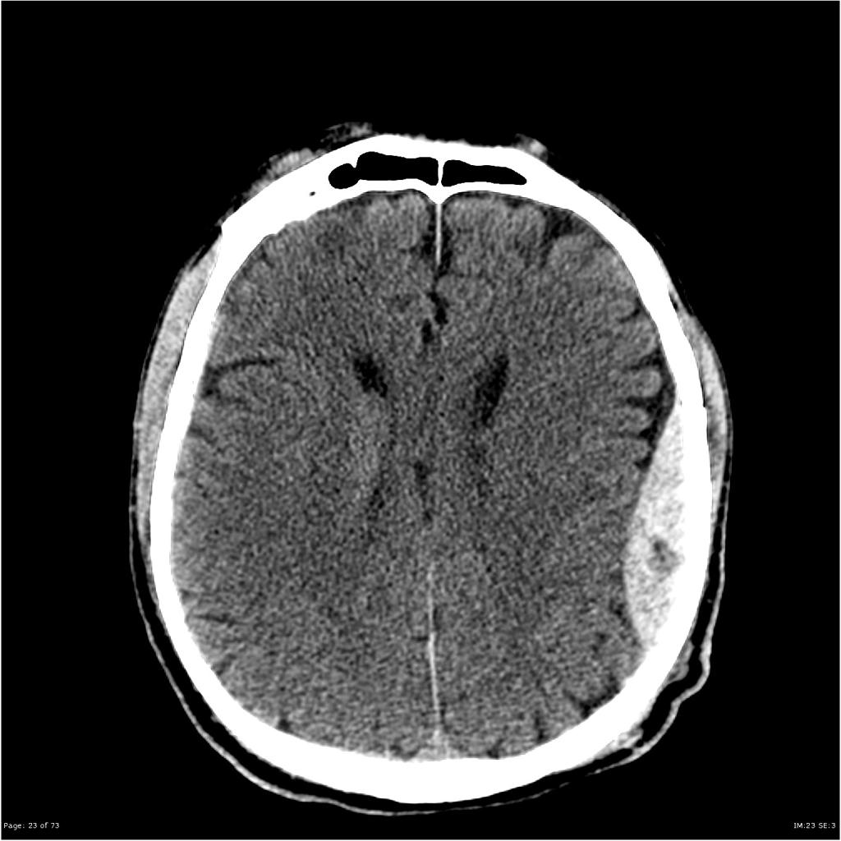
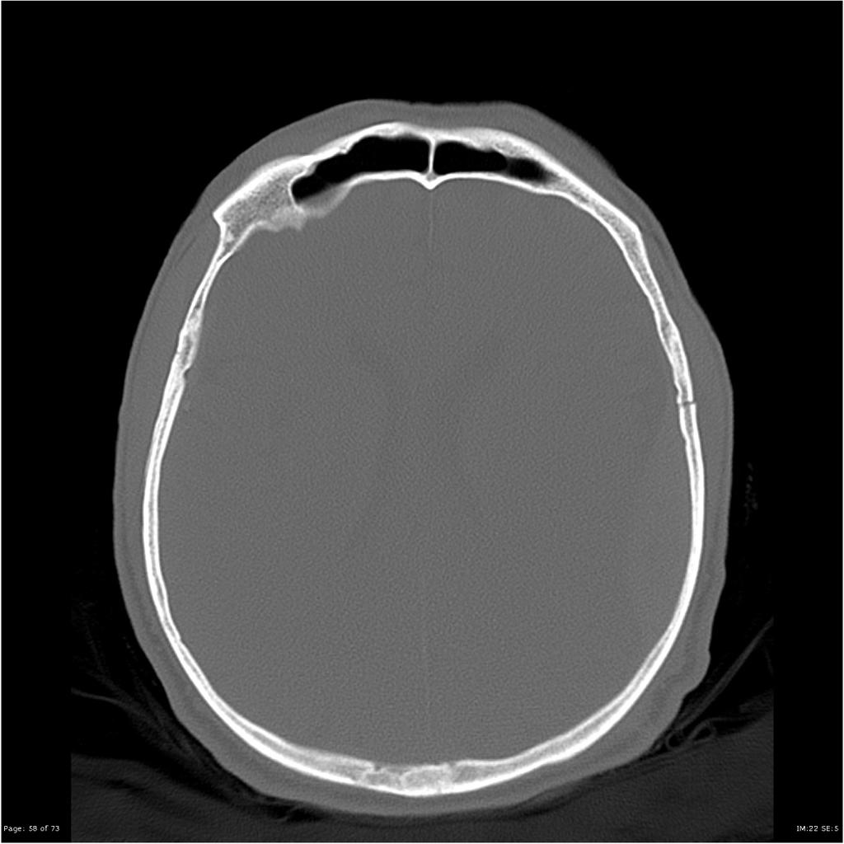
State three (3) most important abnormal findings (3 marks).

Slide 4
State three (3) most important abnormal findings (3 marks).
Moderate left lateral convexity epidural haematoma, measuring 18 mm in maximal depth.
Associated undisplaced left temporoparietal fracture.
Mild mass effect - local sulcal effacement and approximately 4 mm of midline shift to the right.

Slide 5
Following the CT the patient drops his GCS to 10 (E2, V3, M5). His pupils remain equal. You decide to intubate him.
State five (5) most important considerations when intubating this patient (5 marks).
Anticipated difficult intubation - in-line immobilisation - Get help!
Neuroprotective intubation -
Blunt sympathetic response from laryngeal manipulation - Fentanyl / propofol etc.
Maintain CPP - fluids, metaraminol / vasopressors ready.
Post intubation neuroprotective care - head at 30 degrees, loose ETT ties, maintain low-normocarbia, normothermia, normoglycemia, (anticonvulsants under advisement)
Post RSI care - sedation, fluids, IDC, NGT/OGT. ?Paralysis (qualify why or why not).
Call general surgeon in - if deteriorates after intubation for burr holes.
Contact trauma centre / activate retrieval service.
Correct coagulopathy or other AN - if exist.

Slide 6
Due to bad weather, HEMS cannot fly. You decide to transfer the patient by road ambulance to the trauma centre.
List five (5) important steps in preparing for this transfer - 5 marks.
ED cover
Team - Who will transfer - ICU level escort (CCRN / MICA)
Equipment - monitor / ventilator / syringe drives / lines
Drugs / fluids - sedation, emergency (manitol / 3% saline)
What if deteriorates on route? Verbalise plan
Notifications / Communication - receiving hospital, documentation / CDs, family, etc.

Slide 7
As you prepare to leave, the patient becomes bradycardia (HR 54) and hypertensive (BP - 200/110). Your nurse informs you that the patient’s left pupil has become dilated.
State your immediate five (5) actions for his condition (5 marks).
Head up 30º (if not done before).
Hyperventilate to to PCO2 30-35 mmHg.
Sedate / optimise. ?Paralise.
Manitol 1gr/kg IV / 3% saline 100ml IV repeated x3 (2-3ml/kg).
Call in general surgeon and OT staff if not done before - for immediate burr-hole. Can the do it?
Advise trauma centre / receiving neurosurgeon / HEMS - ?can fly
Family

Slide 8
Themes
ATFQ - Answer The F@#%ing Question!
Read the stem & question.
If you are using an answer template - tailor it to the patient / question being asked.
Give CONSULTANT LEVEL answers!
This is a “bread & butter” EM question - answers expected at a very high level.
Generic answers (that a 5th year medical student can give) will not score points.
Qualify why you are doing this. Give doses / endpoints / targets.
Use the same considerations you would use at work.

Slide 10
Question?

Slide 11
Good Luck!
(If I passed, anyone can)

