Slide 1
SAQ 7: axillary-Subclavian DVT
Ben Cheung Monash and Peninsula Health

Slide 2
overview
Apologies
Break down of SAQ 7
General feedback
Candidate performance
Final comments

Slide 3
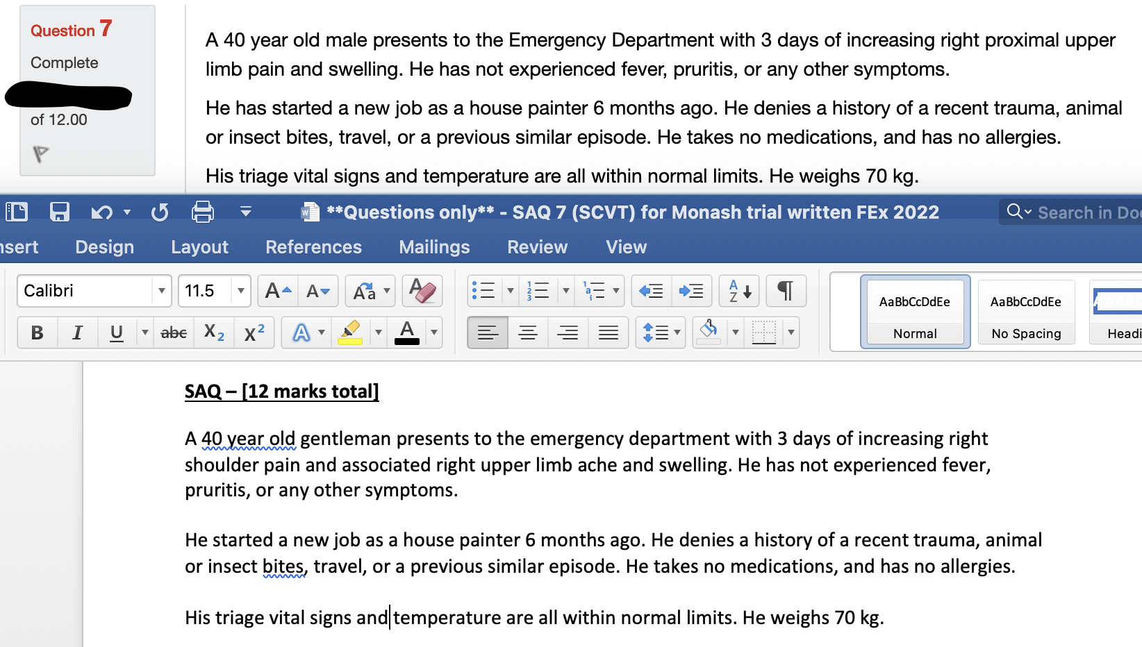
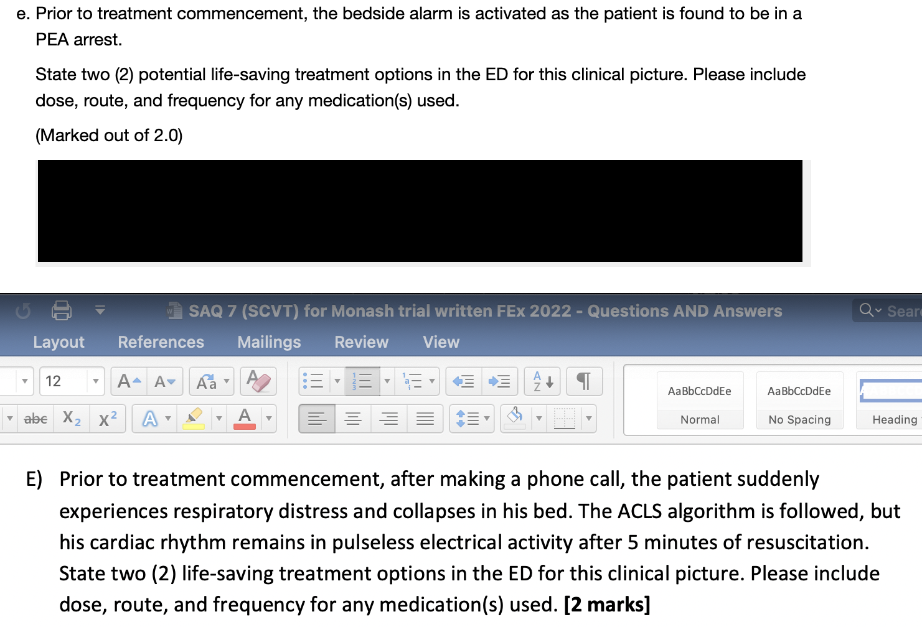
1) Apologies
Difference b/w intended stem/question and published stem/question
As a result, pass mark lowered from 8/12 to 6/12

Slide 4
2) SAQ 7 – STEM
A 40 year old male presents to the Emergency Department with 3 days of increasing right proximal upper limb pain and swelling. He has not experienced fever, pruritis, or any other symptoms.
He has started a new job as a house painter 6 months ago. He denies a history of a recent trauma, animal or insect bites, travel, or a previous similar episode. He takes no medications, and has no allergies.
His triage vital signs and temperature are all within normal limits. He weighs 70 kg.
Isolated right proximal upper limb pathology
Acute, worsening pain and swelling
Originally “… increasing right shoulder pain and associated right upper limb ache and swelling”
Not infective, not condition with systemic manifestation

Slide 5
2) SAQ 7 – Part a
List three (3) potential underlying causes for this gentleman’s working diagnosis. (Marked out of 3.0)
ie ONE working diagnosis → list three underlying causes
Effort induced thrombosis / Paget-Schroetter syndrome / obstruction of vein.
(Undiagnosed) active malignancy.
Hypercoagulable states., eg FVL mutation.
Recent indwelling vascular device / IVDU.
3 unrelated differential diagnoses
Processes with infective (eg septic joint) or systemic manifestation (eg toxicological)

Slide 6
2) SAQ 7 – Part B
What are three (3) signs that you may find on physical examination of this patient? (Marked out of 3.0)
Based on the working diagnosis
Right upper limb skin mottling / colour change.
Non-pitting oedema of upper limb.
Increased prominence of forearm/ hand veins.
Dilated superficial venules over shoulder / chest wall (Urschel’s sign).
Tenderness and/or palpable venous cord in the axilla.
Supraclavicular fullness.
Physical signs based on different diagnoses
Listing abnormal vital signs
Not being specific, eg “erythema” or “tenderness” but not listing the affected body part

Slide 7
2) SAQ 7 – Part C
List two (2) preferred investigation options to confirm the diagnosis of this presentation. (Marked out of 2.0)
Same working diagnosis → investigation to RULE IN (ie needs good specificity)
US venous doppler of right upper limb.
CT venogram, right upper limb and chest.
Mandatory: US or CT venogram
Direct venogram.
MR venogram.
CT angiography, rather than venography
Not specific, eg ultrasound but not specifying body region or type
D-dimer only excludes, CANNOT confirm

Slide 8
2) SAQ 7 – Part D
The diagnosis is confirmed by your chosen investigation. What are two (2) therapeutic options suitable for this condition? Please include dose, route, and frequency for any medication(s) used. (Marked out of 2.0)
Treatment specific for this diagnosis
Therapeutic enoxaparin 70mg, subcut, BD.
Accepted DOAC if correct dose/frequency
Catheter directed thrombolysis.
Percutaneous mechanical thrombectomy.
Symptomatic treatment
Both answers relating to anticoagulation
Wrong dose for DOAC
Why not use enoxaparin?

Slide 9
2) SAQ 7 – Part E
Prior to treatment commencement, the bedside alarm is activated as the patient is found to be in a PEA arrest. State two (2) potential life-saving treatment options in the ED for this clinical picture. Please include dose, route, and frequency for any medication(s) used. (Marked out of 2.0)
Originally “…the patient suddenly experiences respiratory distress and collapses in his bed. The ACLS algorithm is followed…” → *** MASSIVE PE ***
Systemic thrombolysis, eg tenecteplase 40mg, IV, stat, once only.
VA ECMO / ECMO-CPR.
ACLS or related treatment also accepted → although is “supportive” treatment
is required for lysis to work
ECMO is also supportive treatment
Wrong thrombolysis regime – lose 0.5 mark
Anticoagulation
Treatment unrelated to PE

Slide 10
3) General feedback
Read the question
Each word has purpose
Read the WHOLE question
Although ”cueing” should be avoided, occasionally sub-questions give clues to previous parts
This question ends in a PEA arrest
Your earlier answers re: working Dx should have the potential to cause an arrest precipitously
Be SPECIFIC, with
Terminology
Descriptions
Do NOT assume
Think BROADLY
This exam is testing BREADTH of knowledge

Slide 11
4) Candidate performance
Total marks = 12
Pass mark = 6
Passing candidates = 10
Pass rate = 26%
Within 1 mark of passing = 5 (13%)

Slide 12
5) Final comments
This is a game
Exam performance ≠ performance as doctor
Learn and play by the rules of the game, or you will not win, eg
Be specific enough but not overwriting, having breadth in answer
Give irrefutable answers
Train hard, fight easy
Performance drops on exam day, multifactorial
Make it harder for yourself with trial questions and exams
Sleep deprived
At the end of the day
Quality > quantity
Cramming → makes you feel better, but not effective
Focus and fix (common) mistakes THEN move onto the next thing
Personal exp: going through (review, dissect, work on gaps/weaknesses) trial questions/exams took 3x as long as actually doing the trial exam itself

