Slide 1
Question 7
A 42-year-old man presents to the ED by ambulance following ingestion of 200mL of anti-freeze. He is drowsy with slurred speech.
Obs: HR 110, BP 130/75, RR 24, SaO2 95% room air.
His initial blood results include:
pH 7.21 (7.35-7.45)
pCO2 24 (35-45)
HCO3 6 (24-32)
Na⁺ 140 (135-145)
K⁺ 3.9 (3.5-5.0)
Cl⁻ 100 (95-110)
glucose 5
ethanol - undetectable
Urea 5 (3-8)
Osmolality 330 (275–295)

Slide 2
a) Provide two (2) calculations to help you interpret these results. (2 marks)
1: AG = 140 - 106 = 34 = HAGMA (1 mark)
2: Calculated Osmolarity = 280 + 5 + 5 = 290
Osmol gap = 330 - 290 = 40 = elevated (1 mark)
3: Expected CO2 = 9 + 8 = 17 +/- 2 - co-existent mild resp acidosis
(1/2 mark)
HAGMA/high osmolar gap - hallmarks of EG poisoning , used to confirm diagnosis and guide treatment
Full marks required some interpretation i.e HAGMA and high osmolar gap

Slide 3
b) List three (3) possible life-threatening features that could occur from this ingestion (3 marks)
Coma/CNS depression (intoxication) – airway compromise
Seizures
AKI/renal failure
Shock/cardioresp failure
Hypocalcaemia - ventricular arrhythmias
Delayed neurological injury/encephalopthy
Marks not given:
Severe metabolic acidosis
not life threatening by itself in this scenario
a marker of toxicity

Slide 4
c) What is the role of decontamination in this poisoning? (1 mark)
No role
Activated charcoal does not bind to ethylene glycol !!
WBI no benefit
Some confused about decontamination vs enhanced elimination
Notes:
List directly from Tox handbook

Slide 5
List three (3) key steps in your management of this patient.
State one (1) justification for your choice of each step. (6 marks)
Management step | Justification
IV or NGT ethanol | Antidote in EG ingestion Competitively blocks formation of toxic metabolites (glycolic acid) because higher affinity for ADH
Haemodialysis | Definitive treatment. Enhances elimination of EG/significantly reduces elimination half-life Indications in this patient: - large ingestion - osmolar gap - severe acidaemia
Intubation/hyperventilation | Airway protection in setting of progressive sedation/vomiting/ethanol administration
IVF | correct dehydration, maintain adequate UO

Slide 6
List three (3) key steps in your management of this patient.
State one (1) justification for your choice of each step. (6 marks)
To pass the question (>3 marks) - must mention ethanol and haemodialysis
No marks for:
Fluid management if you didn't mention HDx AND ethanol
“Supportive care”
IV bicarb
Fomepizole

Slide 7
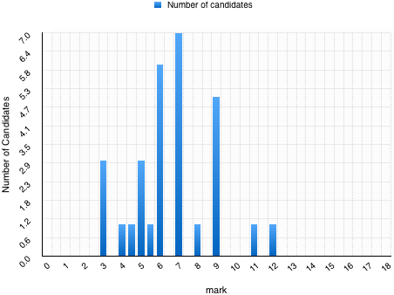
Pass mark – 8/12
8/31 candidates achieved a pass.

Slide 8
Summary
Revise your toxicology
Especially Ch 1 & 2 of handbook
Hand writing!!!

