Slide 1
Question 7: PID
Ben Cheung

Slide 2
Overview
Disclaimer
Overall feedback
Question + answers
with specific feedback for each question
Group performance

Slide 3
Disclaimer
I am not an examiner
Miscommunication b/w myself and uploader
Uploaded question was not the final version
ABx choice based on eTG from 2018 – there has since been an update
Marking for ABx question more lenient

Slide 4
Overall feedback
Some great answers
Common themes being efficient use of words, and answers that showed breadth
Common mistakes
NOT reading the stem / question
Answers not specific
Overwriting, and writing incorrect info
Scattergun approach

Slide 5
Questions + answers w feedback
A 28 year old female is referred from her GP with 1 week of abdominal pain, fever, and offensive vaginal discharge. She is not pregnant. Past medical history includes anaphylaxis to penicillin.
a) What is the most likely diagnosis? (1 mark) Pelvic inflammatory disease

Slide 6
Questions + answers w feedback
a) What is the most likely diagnosis? (1 mark)
Generally answered well
A few people overwrote – eg added “due to STI” → cannot assume this, and subsequent question states the PID was not sexually acquired

Slide 7
Questions + answers w feedback
b) List three (3) risk factors for the development of this patient’s condition, giving an example for each. (3 marks)
Sexually transmitted infections (eg Chlamydia trachomatis, Neisseria gonorrhoeae)
Surgical procedure involving the genital tract (eg D+C)
Intrauterine contraceptive device (eg Mirena, esp w/i first 3 weeks of insertion)
Postpartum (eg from retained products of conception)

Slide 8
Questions + answers w feedback
b) List three (3) risk factors for the development of this patient’s condition, giving an example for each. (3 marks)
Good answer showed breadth, ie utilised different categories → NOT just STI-related, esp when subsequent question states that this PID was not sexually acquired
Things not accepted / common mistakes
Immunosuppression → true, but not PID specific
PHx of PID → you can’t give an example for this
Not including an example with each RF

Slide 9
Questions + answers w feedback
c) List five (5) indications for inpatient management of this patient. (5 marks)
Systemic toxicity / severe PID
Complication requiring surgical intervention, eg tubo-ovarian abscess
Pain refractory to oral medications / severe pain
Unable to tolerate oral medications, eg from vomiting
Failed outpatient therapy and/or compliance issues
Surgical emergency not excluded, eg appendicitis
Sexual abuse
(Some others were accepted)

Slide 10
Questions + answers w feedback
c) List five (5) indications for inpatient management of this patient. (5 marks)
Good answer themes
showed breadth
efficient use of words
Things not accepted / common mistakes
points relating to the same category
eg 1) septic shock, 2) AKI → both relate to disease severity
“simple analgesia”
pregnancy; minor
immunosuppression without qualifying → immunosuppression is a spectrum
wording which was vague / not specific enough
eg requiring IV ABx

Slide 11
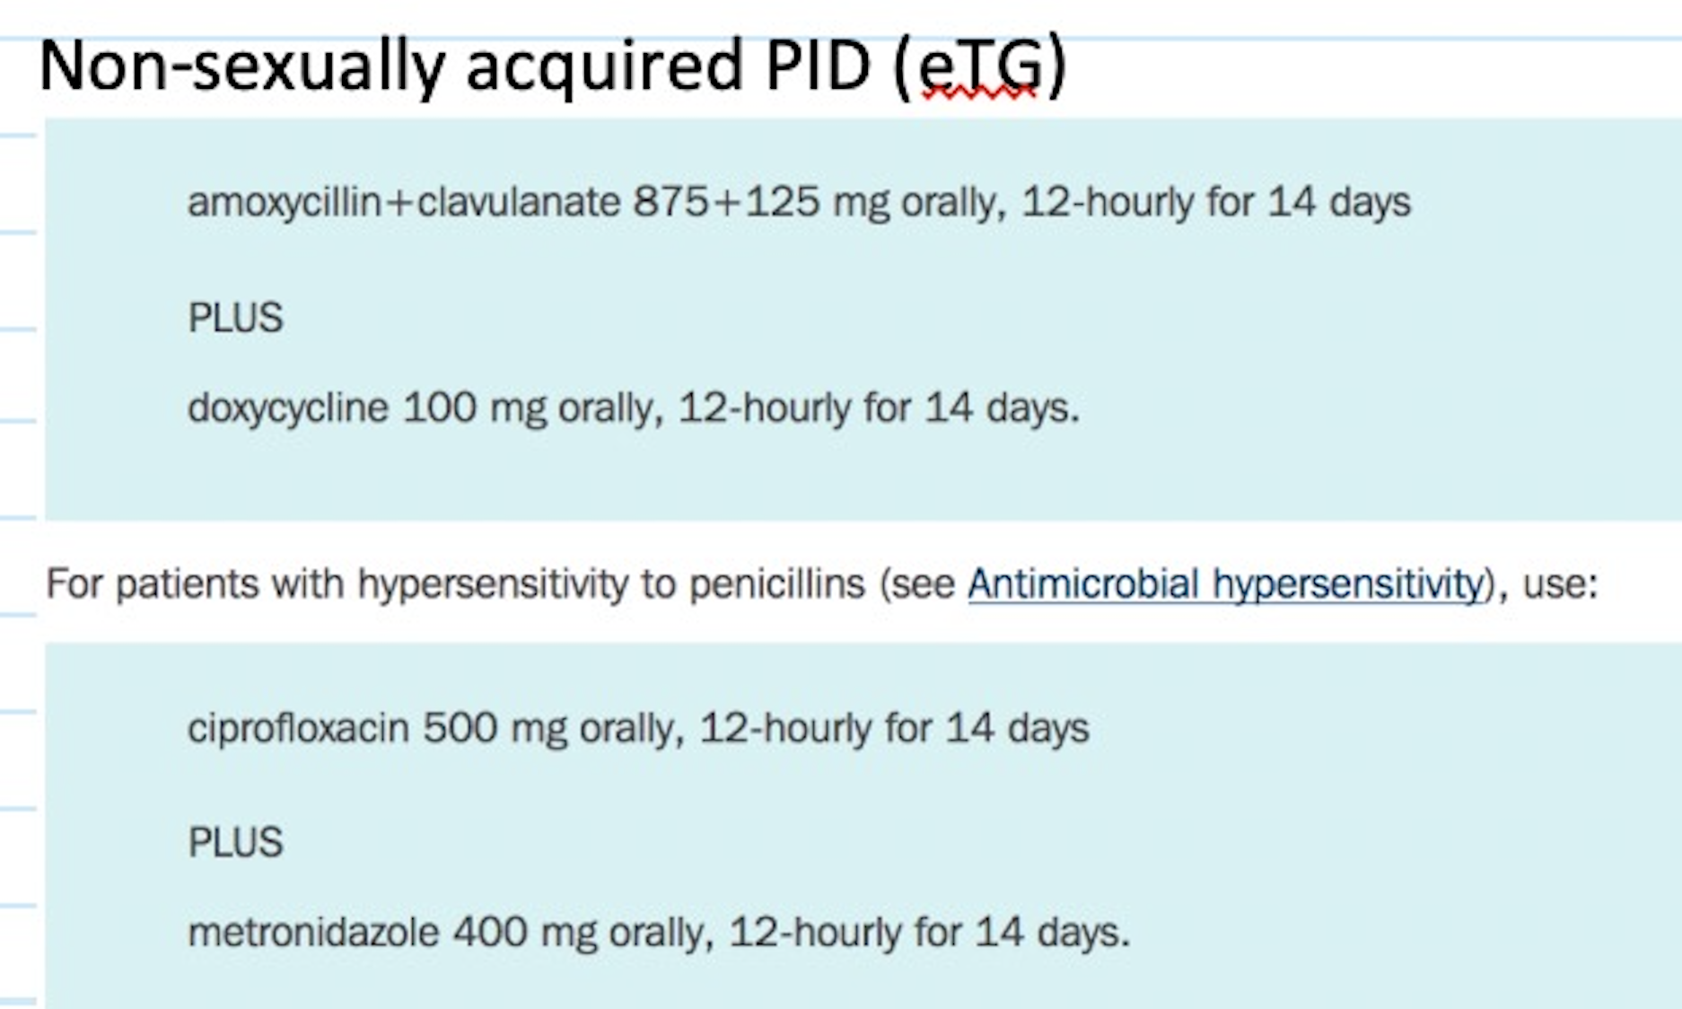
Questions + answers w feedback
d) None of the indications for inpatient management are present. Her condition was not sexually acquired. Prescribe your treatment. (2 marks)

Slide 12
Questions + answers w feedback
d) None of the indications for inpatient management are present. Her condition was not sexually acquired. Prescribe your treatment. (2 marks)
Sorry about the mix-up with this question.
You either knew it or you didn’t.
Marked more leniently → also accepted doxy (but no full marks for doxy+metro combo).
Things not accepted / common mistakes
prescribing a penicillin or cephalosporin → automatic 0 marks for this question
not including duration of therapy, ie 14 days
metronidazole dosing → tabs are 400mg, not 500mg

Slide 13
Questions + answers w feedback
e) She returns 3 days later with worsened abdominal pain. She has not been compliant with your treatment plan. On examination, her abdomen is tender in the right upper quadrant. An abdominal ultrasound demonstrates a normal biliary tree. What complicating syndrome is she likely to have? (1 mark)
Fitz-Hugh-Curtis Syndrome

Slide 14
Questions + answers w feedback
e) What complicating syndrome is she likely to have? (1 mark)
You either knew it or you didn’t.
Lenient here – 0.5 mark given if left out “Hugh”
but really shouldn’t have, b/c named after Fitz-Hugh & Curtis
Things not accepted / common mistakes
Tubo-ovarian abscess
Overwriting, then digging a hole
eg saying that FHC syndrome = peri-hepatic abscesses

Slide 15
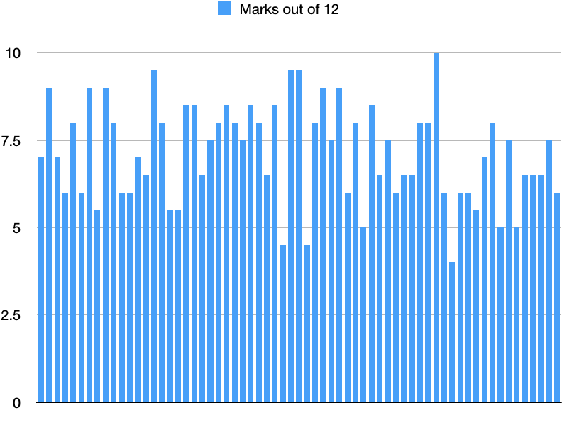
Group performance

Slide 16
Group performance
Pass mark 8/12
Top mark 10/12
Bottom mark 4/12
Pass rate 26/65 → 40%
10 people failed by 1 mark or less
A lot of mistakes related to not reading the question / stem → RTFQ

Slide 17
Questions/comments?
Thank you for answering my question
Happy to discuss further if keen
benjamin.cheung@monashhealth.org
All the very best in the coming weeks / for the actual exam ☺

