Slide 1
Question 5
Sarah Mikhail Monash health

Slide 2
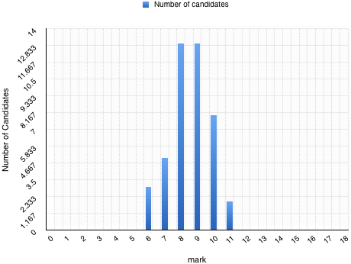
MArks

Slide 3
Part A
Epiglottitis (A MUST)
Retropharyngeal abscess
Quinsy
Pharyngitis
Laryngitis
FB with collection, lymphoma (cervical lymphadenopathy)

Slide 4
PART A (don’ts)
Throat infection – What? Where? Strep throat - ?pharyngitis ?tonsillitis
Listing multiple etiology for same illness (EBV, strep tonsillitis)
Trauma, FB etc. should not cause fever

Slide 5
Part B
Thumb print sign
If you don’t know what it’s from don’t add extra information that will show you up!

Slide 6
Part C
Stridor
Drooling
Dyspnoea
Rapid progression of Sx

Slide 7
Part C (don’t’s)
Hypoxia in this instance would be the patient almost at arrest – not a predictor
Unable to lie flat – why would you lie this patient flat?
Agitation

Slide 8
Mx
Ceftriaxone, ceftazidime
Choices for penicillin allergy are either clindamycin or chloremphenicol
I did pay anything reasonable

Slide 9
Mx Donts
Don’t treat as tonsillitis – Benzyl penicillin and metronidazole not appropriate
Don’t further risk the airway!

