Slide 1
MH 2018.1

Slide 2
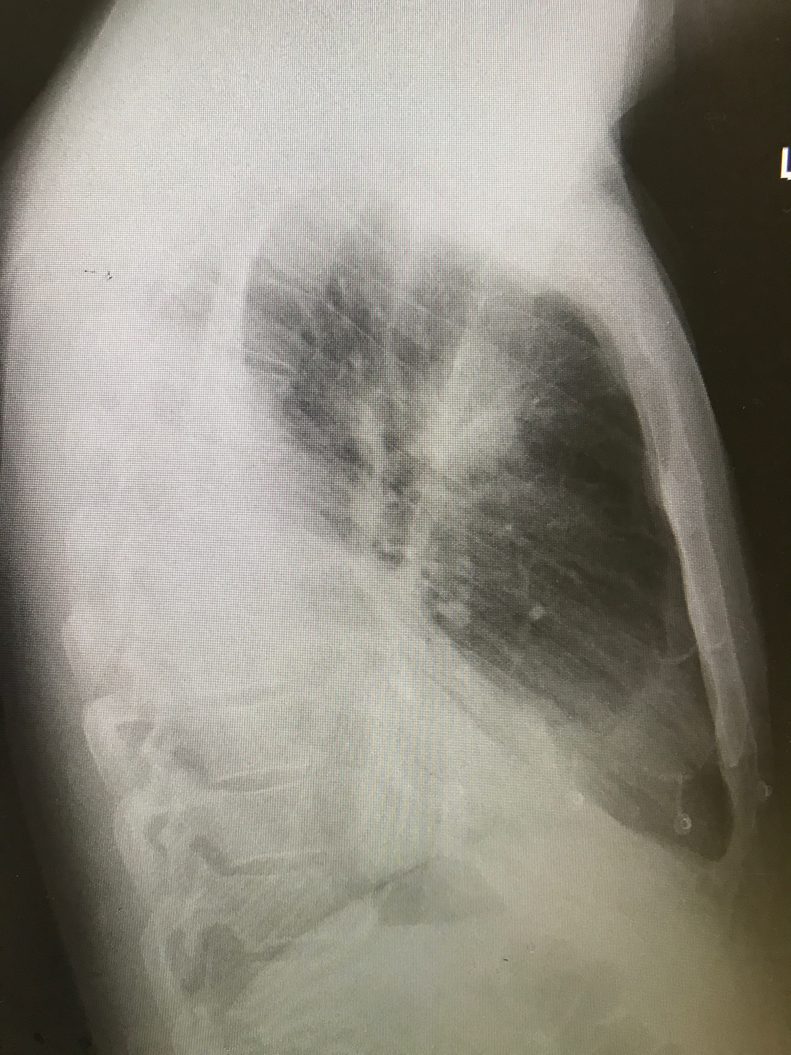
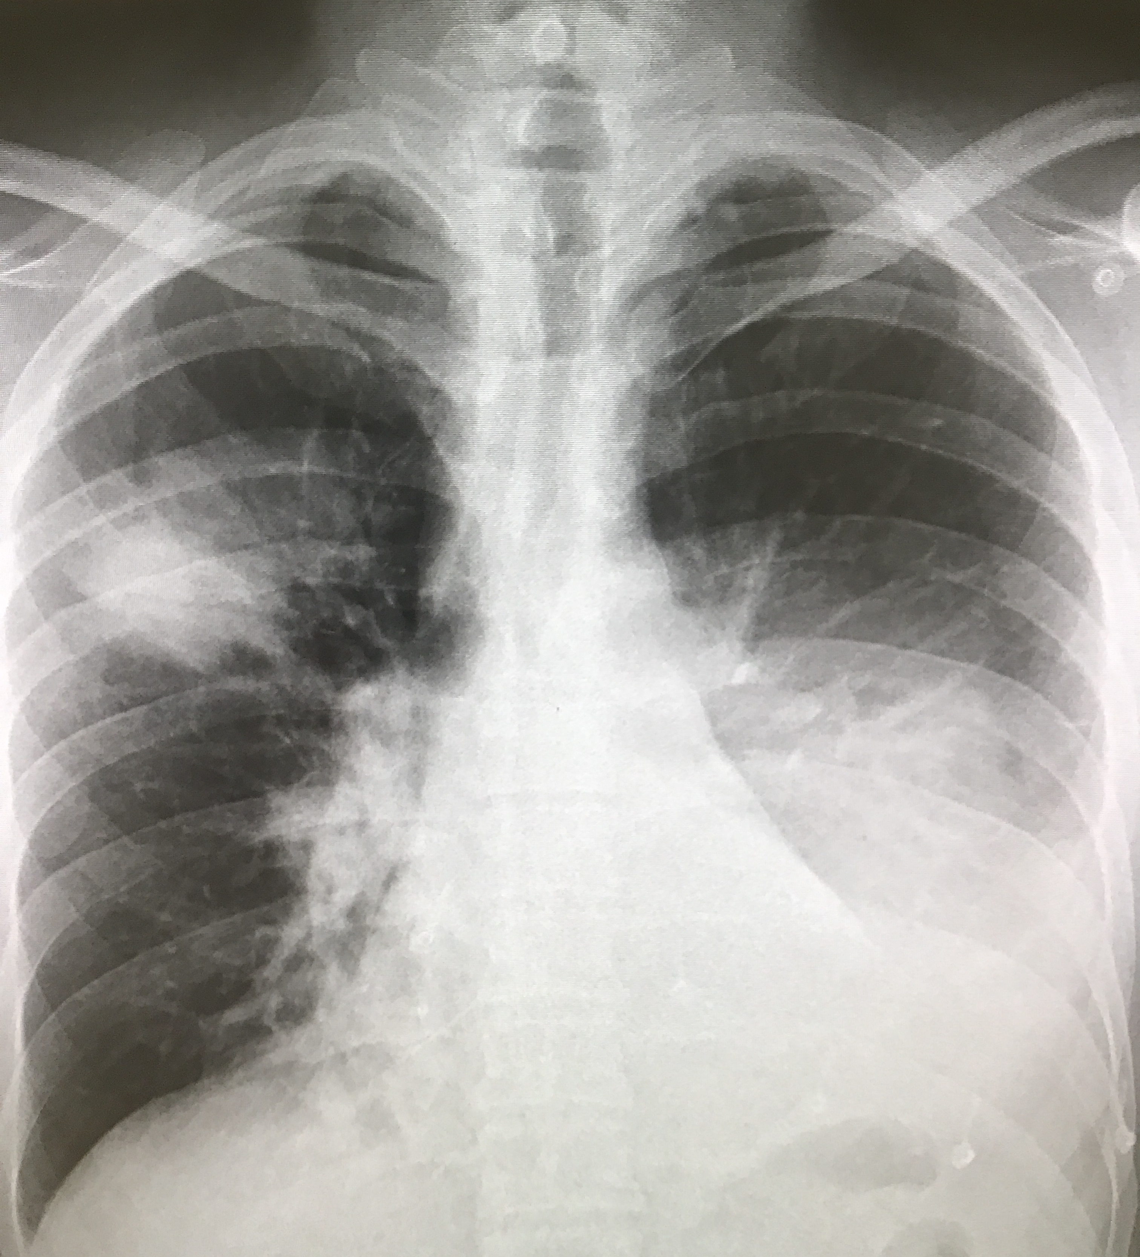
Q 3 A 33 yo man presents with 5 days of worsening cough & dyspnoea. His GP has confirmed a diagnosis of influenza B, 7 days ago. O/E RR 30 sat 88% RA BP 110/70 HR 115 temp 39

Slide 3
a. List 3 abnormalities on the images provided (3 marks)

Slide 4
B. List 3 strategies to improve his respiratory status. For each strategy state 1 explanation/rationale for its use. (6 marks) C. List 2 organisms most likely involved in this complication (2 marks)
 | Strategy | Rationale
1
2
3

Slide 5
B. List 3 strategies to improve his respiratory status. For each strategy state 1 explanation/rationale for its use. (6 marks)
 | strategy | Rationale ( WHY rather than when)
 | Oxygenation (HFNP/NRB etc) | increase FiO2 to improve PAO2
 | positioning | open collapsed alveoli, increased FRC and area available for gas exchange better V/Q, improved mechanical advantage, less lung compression from abdominal and mediastinal contents
 | NIV /PEEP | augmentation of alveolar ventilation, helps reverse acidosis and hypercapnoea alveolar recruitment and increased FiO2, helps reverse hypoxia reduction in work of breathing and respiratory effort
 | ETT/PEEP | Anticipate prolonged need respiratory support (days)/respiratory muscle fatigue Presence of septic shock requiring vasopressors or with acute respiratory failure requiring intubation refractory hypoxemia despite above measures increased airway pressure increased functional residual capacity (FRC) (prevention of airway and alveolar collapse)/increase PaO2/maximises recruitment of alveoli by preventing cyclic de-recruitment on expiration/decreased airway resistance reduced ventilation/perfusion (V/Q) mismatch improved distribution of inspired gas
 | Adjuncts (salbutamol) | Additional bronchodilation

Slide 6
C. List 2 organisms most likely involved in this complication (2 marks)

Slide 7
C. List 2 organisms most likely involved in this complication (2 marks)
Seasonal infection with influenza viruses has occurred annually in the human population over the last several centuries.
Periodically, due to the antigenic shift in circulating strains, influenza virus infections reach pandemic levels, with global spread of disease affecting up to 1/4 to 1/3 of the world population.
Despite significant vaccination efforts, antigenic drift and shift of the virus can result in large-scale susceptibility to disease.
While most influenza virus infections result in mild to moderate pulmonary infection, severe, life-threatening disease can occur.
Often, the worst disease outcomes are associated with secondary bacterial pneumonia caused primarily by Staphylococcus aureus or Streptococcus pneumoniae.
Influenza with bacterial superinfection can result in the hospitalization and/or death of both patients with preexisting lung disease and previously healthy individuals.

Slide 9
General themes preventing success in SAQ
Vague/non consultant level answers
Failing to answer specifics of question before going global ( brainstem protocol response)
Missing key/mandatory responses
Stuffing up timing/leaving questions out
Ignoring/devaluing feedback
Sitting the exam before assessments from experienced educators indicate readiness

