Slide 1

SAQ 27 – Trauma (EDH)
DISAPPOINTMENT!
Danny Ben-Eli & Amit Maini

Slide 2
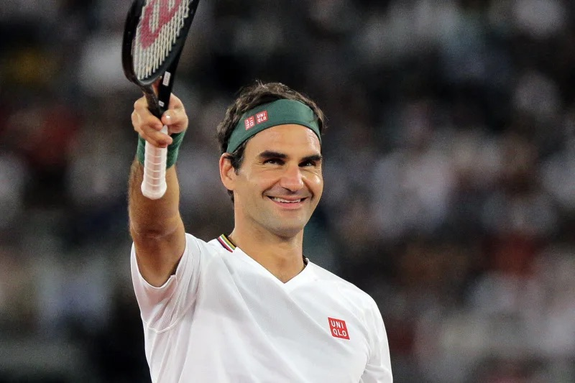
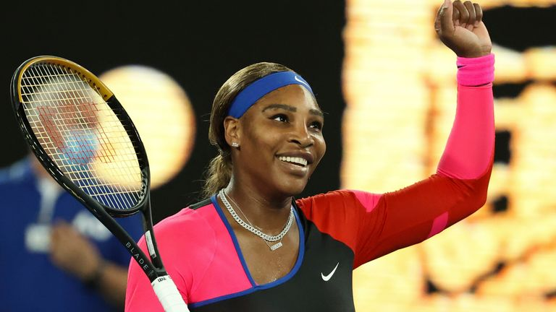
We Wanted This

Slide 3
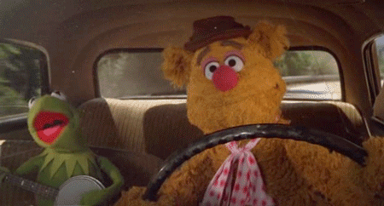
But We Got This

Slide 4
The Stem
A previously well 35-year-old male without any allergies, is brought by ambulance to your rural ED. You are 90 km away from the nearest trauma centre. General Surgery and Anaesthesia services are onsite. He has suffered an isolated head injury.
On arrival the patient is alert and complains of a headache. He is amnestic to the events, repeatedly asking staff what had happened. He has no significant neurological deficits.
His vitals are all stable, aside from GCS 14 (confused).

Slide 5
The Stem
A previously well 35-year-old male without any allergies, is brought by ambulance to your rural ED. You are 90 km away from the nearest trauma centre. General Surgery and Anaesthesia services are onsite. He has suffered an isolated head injury.
On arrival the patient is alert and complains of a headache. He is amnestic to the events, repeatedly asking staff what had happened. He has no significant neurological deficits.
His vitals are all stable, aside from GCS 14 (confused).

Slide 6
The Question
This is a bread & butter life-threatening scenario.
Every Emergency Specialist must be able to manage this expertly.
Pass mark set appropriately at 13/18 (7.2/10).

Slide 7
What We Expected
High-end consideration of management issues:
  Qualify / Justify
  Targets / Aims / Endpoints
  Drugs - Reason / Doses / Effect
  Integration of knowledge, experience, clinical acumen and finesse – the art of Emergency Medicine.
AT EMERGENCY CONSULTANT / SPECIALIST LEVEL.

Slide 8
What We Got
Poor quality answers.
  Answers at HMO or Junior Registrar level.
Generic / template answers, not SPECIFIC or tailored to THIS patient.
Vague, non-comital, non-consultoid answers.
Dangerous answers which would compromise the patient further.
Only 3 of 42 candidates passed this SAQ.

Slide 9
End of Specialty Exam
ACEM allows sitting the Written Fellowship Exam after first year of Advanced Training, however:
  THIS IS STILL PART OF YOUR END-OF-SPECIALTY EXAMS.
  ANSWERS ARE EXPECTED AT THIS LEVEL.
  This is a good example why sitting early should be discouraged.
A lot of effort put into preparation and marking of this SAQ - results are disheartening.

Slide 10
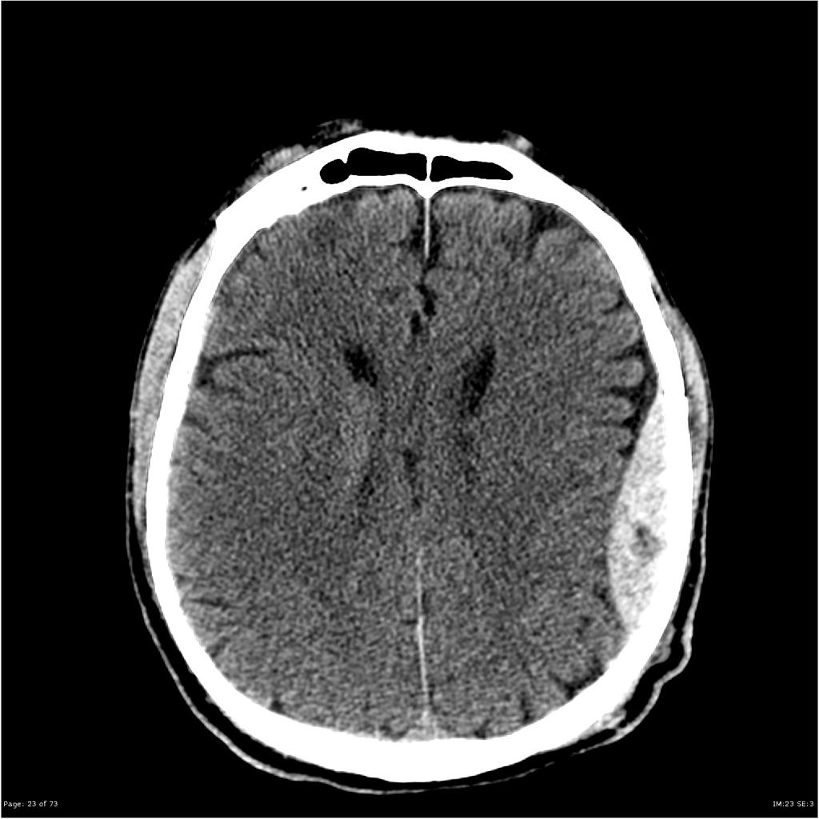
Section A – CT Interpretation
LEFT
MLS – 4mm
(scale not provided)
EDH – 18mm
(scale not provided)
Normal lateral
ventricles
Swirl Sign
Effaced sulci
Image courtesy of Radiopaedia.org

Slide 11
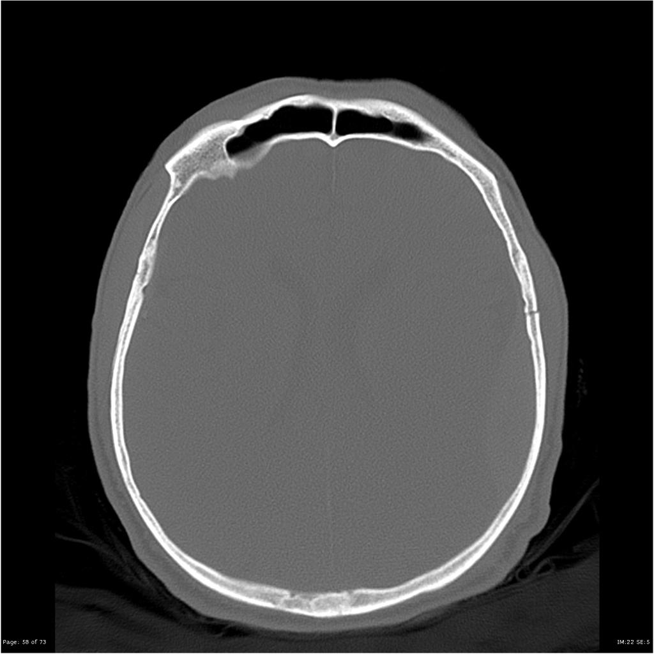
Section A – CT Interpretation
LEFT
parietal
fracture
Image courtesy of Radiopaedia.org

Slide 12
Examples of Poor Answers for Section A
Some of you can’t differentiate extra-dural bleeds from sub-dural bleeds on a CT.
Some of you don’t understand left / right on an axial CT slice.

Slide 13
Section B
Shortly after the CT scan, the patient deteriorates. His GCS falls to 10 (E2, V3, M5). His pupils remain equal. You decide to intubate him.
  State five (5) MOST IMPORTANT peri-intubation considerations SPECIFIC to this patient.
Peri-intubation =
  Before intubation - preparation
  During intubation - induction / procedure
  Post intubation management

Slide 14
Section B – Before Intubation
Anticipated difficult intubation - in-line immobilization and collar –
  Get help - Anasthetics or most experienced airway operator!
  Prepare and use VL / bougie / hyperangulated blade.
Call General Surgeon in - if deteriorates after intubation for burr-holes in rural hospital (if surgeon unavailable - ?qualified local EP).
Contact Trauma Centre / activate HEMS / Retrieval Service.

Slide 15
Section B - Intubation
Key issues which must be reflected in your answers (otherwise are generic) -
Avoid spikes in ICP
Maintain CPP

Slide 16
Section B – Intubation (continued)
  Avoid spikes in ICP
  Deep sedation - explain why important in this patient.
  Pretreat with fentanyl (200mcg) to prevent sympathetic response to laryngeal manipulation.
  Maintain CPP:
  Ketamine – cardiac stable - explain why important in this patient.
  Frequent BP measures – NIBP or A/L.
  Fluid bolus as needed.
  Metaraminol 0.5mg IV PRN. Vasopressor infusion if needed (unlikely).

Slide 17
Section B – Post Intubation Management
Loose ETT ties or tape - DO NOT LEAVE UNTIED (dangerous).
Use sandbags / rolled-up towels instead of collar.
Tilt whole bed with head 30° up (anti-Trendelenburg).
Ventilate to mild hypocapnia – PCO₂ 35-40.
Deep sedation – propofol & fentanyl preferred; M&M okay.
Paralysis – qualify why or why not.
NGT / IDC / seizure prophylaxis / normothermia / euglycemia / fluids / correct electrolytes & coagulation (unlikely to be abnormal) / Fluffy Bunnies / etc.

Slide 18
Section C
List three (3) important considerations for the patient’s ongoing management.
Management –
  General management – covered in sections A & B.
  Specific management – covered in section B (no marks for repeating).
  Disposition – this needs to be covered now.

Slide 19
Section C
Key issues:
Time critical - potential for deterioration (Swirl Sign).
Needs Neurosurgery - expertise not available onsite (rural hospital).
Safest option - Burr Hole by General Surgeon in hospital.
Needs retrieval to trauma service - time critical.
HEMS transfer (ideal) vs road - weather considerations / platform availability.
If by road – will need competent medical escort / ?cover for ED.

Slide 20
Pitfalls and Poor Answers – Sections B & C
Peri-intubation considerations:
Generic answers - e.g “avoid hypotension & hypoxia” - true of all ED RSIs!
  Question was - “considerations SPECIFIC to this patient”.
“Avoidance of ketamine as an induction agent as it may increase ICP”
Leaving ETT untied / unsecured.
“Avoidance of PEEP and NIV (if DSI considered) to reduce ICP”???
“Ensure electrolytes optimized - normal sodium and potassium".
“Ensure adequate haematinics (?): calcium > 1.1, pH < 7.2, INR < 1.4”.

Slide 21
Section D – Patient Deterioration
Patient becomes bradycardic (HR 54) and hypertensive (BP - 200/110). His left pupil becomes dilated.
State four (4) immediate actions for this deterioration in the patient’s condition.
Key Issues:
Patient is coning = neurosurgical emergency
  INFORM TEAM.
Will die without immediate burr-hole / EDH evacuation.

Slide 22
Section D – Patient Deterioration
Actions:
Hyperventilate – PCO₂ - 30
Sedate / optimize / paralyze – what / how / why.
Manitol (50gr) OR 3% saline (100ml) STAT - give doses / endpoints.
If not done before - call in General Surgeon and OT staff - for immediate burr-hole.
If Surgeon unable to do burr-holes, check if other local expertise (EP) able to do this.

Slide 23
Section D – Patient Deterioration
Actions (continued):
Advise trauma centre / receiving neurosurgeon / Retrieval Service / HEMS
Family
Note:
The hypertension associated with increased ICP / coning is part of cerebral autoregulation response to maintain CPP and SHOULD NOT BE TREATED.
Use of GTN / Esmolol / Hydralazine / Labetalol, will further reduce the already compromised CPP and cause an iatrogenic secondary brain injury.

Slide 24
Examples of poor answers for section D
Immediate steps in a coning patient with EDH:
“Patient will need urgent re-scanning of head for details of expansion of extradural haematoma and concern of Cushing response”
Labetalol / esmolol / hydralazine / GTN infusions.
Reduce PEEP to reduce ICP.
Hyperventilate to 40-50mmHg PCO₂
Doses for mannitol / hypertonic saline - wrong / missing.
You won’t get 2 marks for mannitol and hypertonic saline.

Slide 25
Section E – The Distressed Registrar
A junior registrar who has been assisting you manage the patient, bursts out crying and leaves the resuscitation cubicle.
State three (3) actions you would take to manage this situation.
Key Issues:
Need to continue managing CRITICAL patient – now one doctor short.
Need to ensure registrar’s safety.

Slide 26
Section E – The Distressed Registrar – Actions:
  Continue managing patient - is time critical.
  Seek assistance from other registrar / doctor to assist managing patient while you coordinate care.
  Assign senior staff member to check on junior registrar and ensure their safety - ?gender equivalent - likely to be a senior nursing colleague or other senior doctor.
  Arrange for junior registrar to be relieved - time off floor or go home. Reassign their patients to other doctors.

Slide 27
Section E – The Distressed Registrar – Actions:
  Once able, meet with junior registrar off the floor (if other gender - chaperone).
    In non-confrontational manner discuss / try to understand circumstances and causes of behaviour.
  Further discussions regarding expectations, professionalism, responsibilities, may need to be differed - preferentially done by DMET / Mentor.
  Advise DEMT / DEM about events.
  Discuss events with doctor’s Mentor and ask them to check registrars wellbeing as soon as practical.
  Debrief Team (Hot / Delayed).

Slide 29
We don’t only need to know what we need to know, we need to know one step ahead of this.
EM-RAP
Good Luck!

