Slide 1
Question 26
A 30 year old female, G2 P1,
currently 14 weeks pregnant
presents on a Saturday evening to your rural emergency department without Obs and Gyne cover on weekends
with post coital light pv spotting.
She is afebrile and hemodynamically stable.

Slide 2
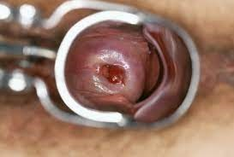

Slide 3
State the performed examination shown in the image below with 2 relevant findings
A small polyp (approx. 0.5 cm) protruding through the cervix
closed cervix
No active PB bleeding
Cautions
Dx of open cx

Slide 4
List three other causes of PV spotting in this patient.
Polyp/Threatened miscarriage
cervical/vaginal malignancy
vaginal /cervical trauma
vaginal infection
Other site
(cervical ectropion )
Categorically (pregnancy related / non pregnancy related: Infective, malignancy, trauma, anatomical/other) 1 mark per category
Cautions
placenta praevia, abruption

Slide 5
investigations and rationale - 3
Ultrasound to locate the polyp and assess the pregnancy
Blood group /rh
(Hb )
Vaginal swab ( with caution if infective cause is considered)
1st catch Urine/FWT
Cautions
Confirm m/c
Group and hold/xmatch
Sti screen modalities

Slide 6
Discharge advice
Specific indications regarding return
Needs review Refer to ANC / O and G /LMO
Advice to avoid intercourse (nothing in the vagina – tampons, douching)
Cautions
r/o polyp
Non specific return advice

Slide 7
Average 6.7, pass mark 8, 26% pass rate

