Slide 1
Saq 24
Victor Lee

Slide 2
SAQ 24

Slide 3
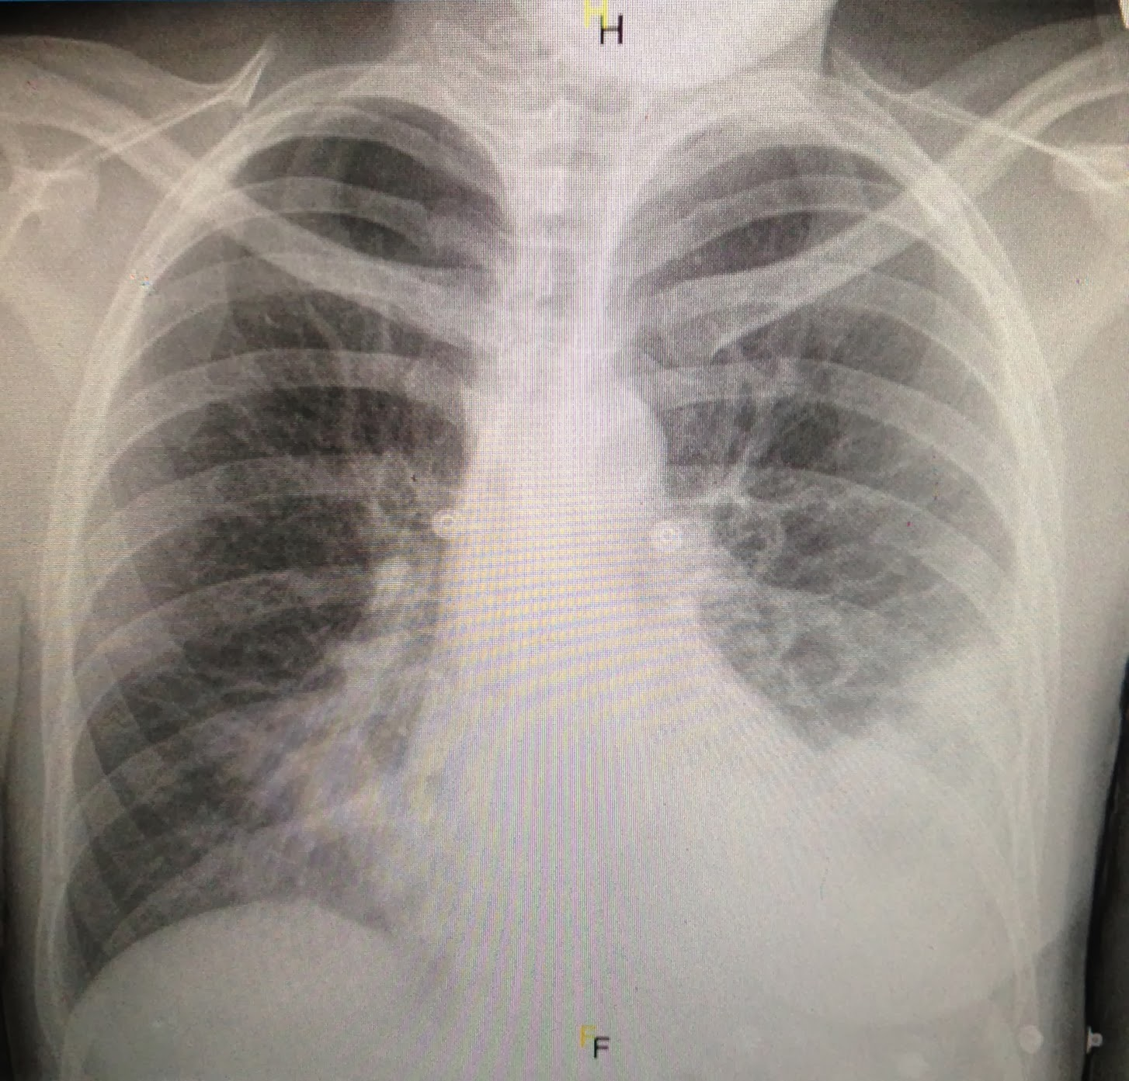

Slide 4
Predictors of Irvs
CORB
SMART-COP
Both Australian studies
Not mortality predictors

Slide 5
