Slide 1
Question 24
Amit Maini
Chris Groombridge

Slide 2
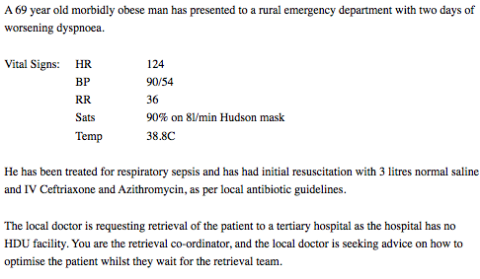

Slide 3
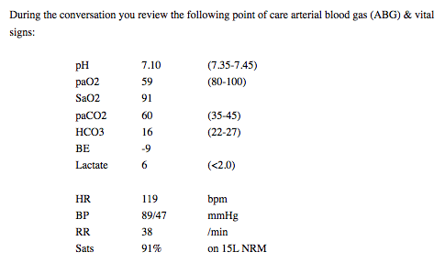

Slide 5
Mixed / combined respiratory & metabolic acidosis
If acidaemia present then acidosis must be present
If HCO3 & PCO2 move in opposite directions then a mixed disorder must be present.

Slide 6
For Respiratory Acidosis
Expected HCO3- =
24 + pCO2 – 40 10
Expected HCO3- =
24 + 2
= 26
Actual HCO3-
= 16

Slide 7
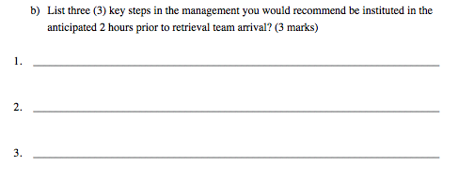

Slide 8
Key Issues
Ventilation / Oxygenation
Haemodynamics (Shock Index > 1.0)

Slide 9
Address ventilation / oxygenation - commence BiPAP / NIV
Address haemodynamic compromise - commence vasopressor - noradrenaline
Invasive monitoring and IV access - arterial line & central line

Slide 10
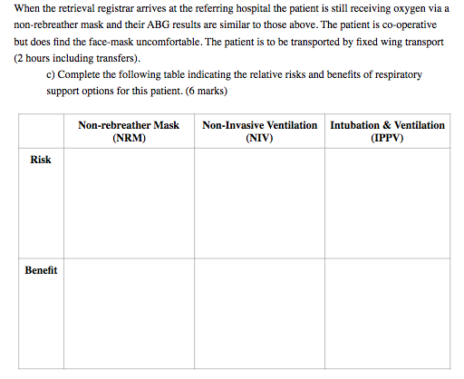

Slide 11
Key Issues
Ventilation / Oxygenation
Haemodynamics (Shock Index > 1.0)
Other patient issues - obesity
Logistics of transport
i.e - altitude
equipment

Slide 12
Inadequate oxygenation
altitude
need sea level pressure cabin - fuel etc
Excessive O2 use - i.e may run out of O2
(not a sealed circuit - lots of leak)
Barotrauma - risk of pneumothorax
Gastric insufflation / aspiration risk
Risk of haemodynamic collapse (Shock index > 1) on induction & IPPV
Risk of rapid desat - obese
Barotrauma - risk of pneumothorax
Patient comfort - likely to be better tolerated
Provides PEEP for shunt physiology - may aid recruitment and oxygenation / ventilation, reduce work of breathing
Good pre-ox in case of need for RSI
May avoid need for intubation
Optimises respiratory support with greater overall control of ventilation & oxygenation parameters
Closed circuit - less O2
Secure airway / definitive respiratory support
Does not require any expertise to administer

Slide 13
General Themes
This was question was a gift, that should have scored easy marks for the majority - simple acid / base, shocked, hypoxic septic patient - our bread and butter EM question. High level answers required!
The question was answered on the whole poorly, and even those that passed the question - the majority did not give what I consider consultant level answers. In reflection, I was still too generous with my marking - based on the ease of topic and expertise I expected
Too many generic answers akin to medical student style - answers should relate to the specific question.
Qualify answers - drug doses / targets / end-points
Read the question properly, and answer the question being asked.

Slide 15
Good Luck!

Slide 16
a.maini@alfred.org.au

