Slide 1
Q2 & Q 9
Tom Reade

Slide 2
Overall- Advice
Read the Question
Answer the Q
Don’t add multiple points to one line
Don’t add extra points below lines
Comments to examiners
X-outs
No more gaps
Writing (few only)

Slide 3
Cut score 6/9 8/35

Slide 4
Q2a
A 32 year old male presented to your emergency department with shortness of breath. He is previously well and has never smoked. A Chest X-ray is taken.

Slide 5
Q2a
A 32 year old male presented to your emergency department with shortness of breath. He is previously well and has never smoked. A Chest X-ray is taken.

Slide 6
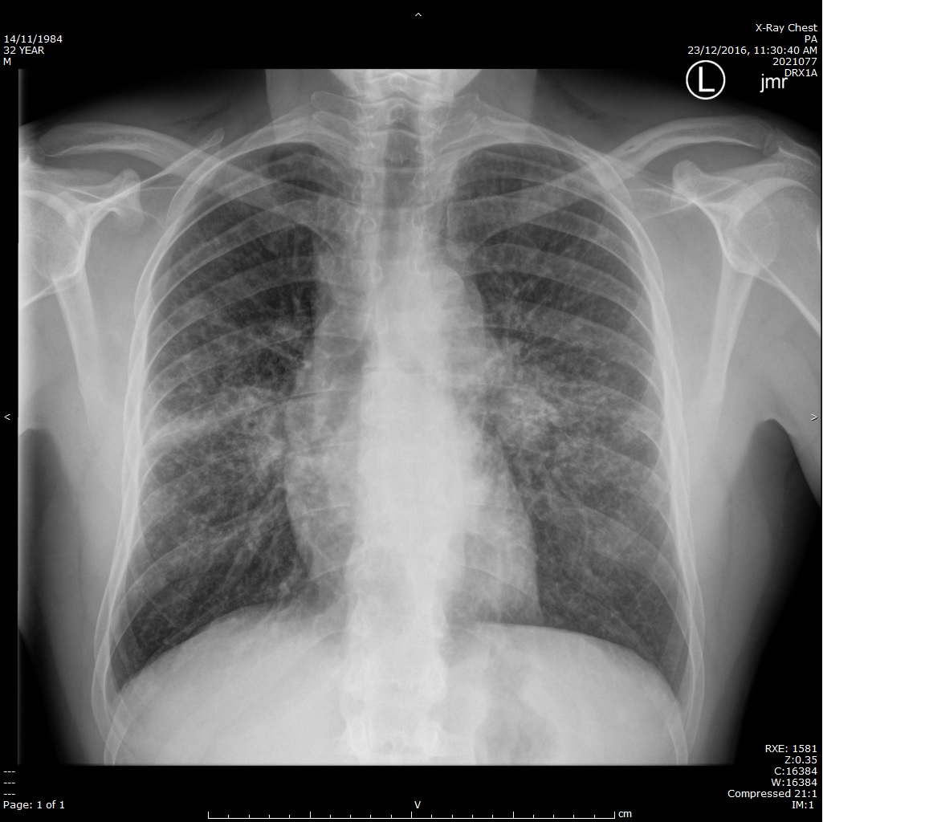
Q2a
A 32 year old male presented to your emergency department with shortness of breath. He is previously well and has never smoked.

Slide 7
Q2a
A 32 year old male presented to your emergency department with shortness of breath. He is previously well and has never smoked.
Pulmonary hila are bilaterally prominent
Thickening of the right paratracheal stripe
Bilateral ill-defined parahilar airspace opacity- esp “R Upper lobe” or “midzone”
Scattered nodular airspace opacities throughout both lungs
(Opacification of the aortopulmonary window)

Slide 8
Describing CXR changes
Large opacities can be described as: ● Diffuse homogeneous
● Multifocal patchy
● Lobar without atelectasis
● Lobar with atelectasis
● Perihilar
● Peripheral
These terms should be used rather than the word "infiltrate,"
BASIC PATTERNS — The main radiological patterns often used to describe diffuse lung disease are as follows:
● Nodular (including micronodular and miliary)
● Reticular (fine or ground glass, medium or irregular, coarse or honeycomb)
● Linear (interlobular septal or Kerley lines and intralobular septal lines)
● Combined reticular and nodular
● Destructive
● Alveolar
● Bronchial
● Vascular

Slide 9
“significant findings” : Problems
“Hilar changes”- not specific enough
“Hilar lymphadenopathy”- an interpretation
“Bilateral consolidation”- an interpretation “Opacification”
“No pneumothorax”
“ No CCF”

Slide 10
Q2b
List three (3) LIKELY diagnoses for these changes in this patient. (3 marks)
LIKELY:
Sarcoidosis
Acute community acquired bronchopneumonia
Tuberculosis- inc. miliary Tb
Legionella/ mycoplasma
Lymphoma
Varicella pneumonia
Influenza/ viral pneumonitis
LESS LIKELY: (allow 1 of the following only)
PCP
Carcinoma lymphangitis
Hypersensitivity pneumonia (extrinsic allergic alveolitis)
Pneumoconiosis
Talc granulomatosis

Slide 11
Q2b - Problems
List three (3) LIKELY diagnoses for these changes in this patient. (3 marks)
“Primary lung cancer” (“never smoked”)
“Infection”
“Malignancy”
“connective tissue disease”

Slide 12
2 c
List three (3) MOST USEFUL investigations, that can be initiated in the emergency department, to assist in confirmation of the diagnosis. (3 marks)

Slide 13
2 c
List three (3) MOST USEFUL investigations, that can be initiated in the emergency department, to assist in confirmation of the diagnosis. (3 marks)
Sputum mc+s
Sputum zeill neilsen stain
Sputum cytology
CT chest
HIV serology
Blood cultures
Atypical serology

Slide 14
2 c- Problems
List three (3) MOST USEFUL investigations, that can be initiated in the emergency department, to assist in confirmation of the diagnosis. (3 marks)
FBE
CRP
ABG
Broncoscopy
List = 1-3 words = qualification not required

Slide 15
9 cut 12/18 21/38

Slide 16
Q9
A 73 year old man presents via ambulance with 3 days of severe abdominal pain. He has a history of IHD, NIDDM, hypercholesterolaemia and early onset dementia. He usually lives with his wife at home as his primary carer. According to his wife, he has not experienced other symptoms other than abdominal pain.
His current medications: metformin and coloxyl
His observations on arrival are:
BP 80/40 mmHg
HR 130 bpm
RR 26 bpm
Sats 93% high flow oxygen
GCS13 (E2, V3, M3)

Slide 17
ABG are drawn soon after arrival:
pH 6.95 (7.35- 7.45)
pCO₂ 20 (35-45)
HCO3 8 (22-26)
BE -25 (-1- 1)
Lactate 16 (0-2)
Glucose 12 (3-6.5)
Na 138 (135-145)
K 4.5 (3.5-5-0)
Ur 13.6
Cr 0.15
(No Chloride…)

Slide 18
Q9 a
a. State three (3) calculations that would help you to interpret these results. (3 marks)

Slide 19
Q9 a
a. State three (3) calculations that would help you to interpret these results. (3 marks)
NB: AG, delta gap and osmolar gap cannot be calculated
calculated osmolarity (you would not be expected to perform “calculated osmolarity”)
Expected CO2 (Winter’s Formula) = 1.5 (Actual [HCO₃] ) + 8 mmHg = 1.5x 8 +8= 20
K correction: Each 0.1 pH fall below 7.4 expect K⁺ to rise by 0.5mmol (above 5mmol/L)
= 5 + 2.25 = expect K⁺ 7.2
various formulas: accept 6- 7.5 (key is that the corrected level will be higher)
Ur: Cr 13.6: 0.15 = (90) < 100
40- 100:1 -> normal or post renal cause of AKI
> 100:1 -> pre-renal cause (urea absorption increased compared to creatinine)
< 40:1 -> intrinsic renal damage (urea unable to be absorbed)
AG, Delta gap and osmolar gap “would help to interpret”- need Cl⁻, provide formula

Slide 20
Q 9 a - Problems
a. State three (3) calculations that would help you to interpret these results.
No calculation
State = “short statement/ phrase/ clause”
“Anion gap” / “Delta ratio”etc
Providing an interpretation-> next Q
AG etc crossed out

Slide 21
Q 9 b
b. List four (4) pieces of information that these results provide you for this patient. (4 marks)
Primary severe metabolic acidosis
Lactic acidosis as probable cause for metabolic acidosis
Secondary respiratory alkalosis- appropriate level compensation
Post renal cause of renal failure
Prognostic value severe acidaemia/ lactate > 10 :
survival unlikely
mortality approaches 100%

Slide 22
Q 9 b - problems
b. List four (4) pieces of information that these results provide you for this patient. (4 marks)
“renal failure” or “acute kidney injury”

Slide 23
Q9 c
c. Other than mesenteric ischaemia, list four (4) LIKELY diagnostic causes of the lactate result for this patient. (4 marks)

Slide 24
Q9 c
c. Other than mesenteric ischaemia, list four (4) LIKELY diagnostic causes of the lactate result for this patient. (4 marks)
Abdominal trauma- major intraabdominal bleeding
Metformin therapeutic use and dehydration/ sepsis
Severe dehydration
Decompensated liver failure
Severe pancreatitis/ necrotic
Bowel obstruction with perforation
Acute hepatic failure/ hepatitis
Seizures
Cyanide poisoning- homicide/ suicide/ accidental
Massive rhabdomyolysis is unlikely- given normal K and Ur:Cr
Metformin OD would expect other symptoms: N / V / Ds / SOB

Slide 25
Q9 c – Problems:
c. Other than mesenteric ischaemia, list four (4) LIKELY diagnostic causes of the lactate result for this patient. (4 marks)
Not providing a diagnosis:
“Severe sepsis”
“Shock”
“hypovolaemia”
“HONK”
Not relating to this patient “3/7 abdo pain” …”no other symptoms”- visualise
Not “LIKELY”

Slide 26
Q9d
d. What is the value of CT scanning for the investigation of possible mesenteric ischaemia for this patient? State three (3) points in your answer. (3 marks)

Slide 27
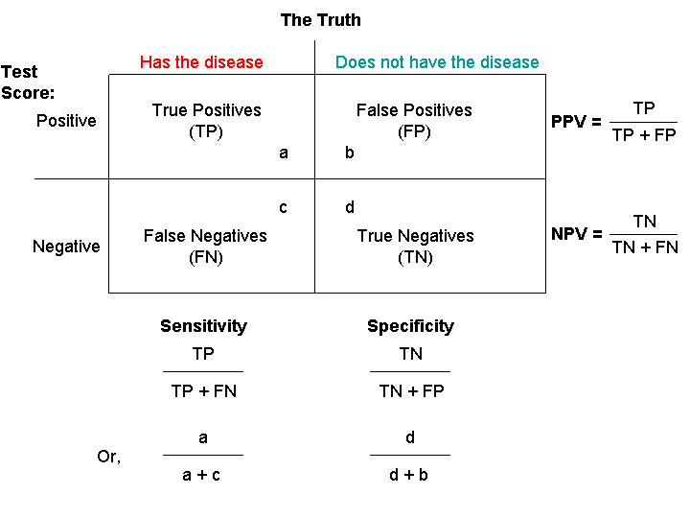
Q9d
d. What is the value of CT scanning for the investigation of possible mesenteric ischaemia for this patient? State three (3) points in your answer. (3 marks)
Overall accuracy ~ 75-80%- high specificity (true negative rate/ low false +ve) (> 90), lower sensitivity (true positive rate/ probability of detection) (~ 60%)
Indicated only to:
ally diagnostic uncertainty in wife/ family/ probably not a Sx candidate / probably will not alter management
prognostication
May demonstrate alternative diagnosis

Slide 28
Q9d- problems
d. What is the value of CT scanning for the investigation of possible mesenteric ischaemia for this patient? State three (3) points in your answer. (3 marks)
“to confirm Dx”
Value = the importance, worth, or usefulness of something
≠ how the test may be detrimental

Slide 29
Q9e
e. Other than analgesics and antiemetics, list two (2) medications that may be useful for symptom control for this patient. (2 marks)
Midazolam (2.5mg boluses for agitation)
Glycopyrolate (0.2- 0.4mg for secretions)
Atropine (0.3- 0.6 mg for secretions)

Slide 30
Q9e- Problems
e. Other than analgesics and antiemetics, list two (2) medications that may be useful for symptom control for this patient. (2 marks)
analgesics or antiemetics
Fluids/ NGT insertion
list = “1-3 words”
doses & indications no required

Slide 31
Summary- Q2 + 9
Ranking:
Bottom 30%
Middle 30%
Top 30%
Practice SAQ to time
Have answers reviewed by a FACEM

Slide 32
For the exam
Next few weeks- Consolidate
Use your clinical confidence and skills
Think
Focus on each Question:
don’t get flustered by a bump

Slide 33
