Slide 1
Q1

Slide 2
No clinical gaps Attention to detail Think

Slide 3
Silly things
Adding extra eg “list 5” and 8 given
Give 1 detail – 5 given
Comments back to the examiner:
“depends on the problem!”

Slide 4
Q1
Tough ECG
….so take your time
Core clinical questions
US role
Unstable patient treatment

Slide 5
Q1
You are a consultant in a tertiary emergency department. A 31 year old man presents with 6 hours of severe central chest pain, on the background of a flu-like illness over the last week.
Vital signs at presentation:
BP 100/60 mmHg RR 35/min
O2 Saturation 93% on room air Temperature 37.5°C

Slide 6
Q1
Tertiary ED
31 man
6 hours
severe central chest pain
flu-like illness
RR 35/min
O2 Sat 93% on room air

Slide 7
i ECG Av: 1.3/ 3
Good:
Defining the leads with ST change
Defining the degree of ST change ie 1mm
Give detailed description when it matters
(ie nearly all of the time)

Slide 8
i ECG
Good:
Defining the leads with ST change
Defining the degree of ST change ie 1mm
Bad:
“STE in most leads”
“Widespread STE”
“STE”
Giving normal findings eg “Narrow QRS”

Slide 9
Initial BP 110/60 PR 60
Soon after this ECG is taken, his blood pressure falls to 85/50 (was 100/60). His pulse is 110 (was 60)(same rhythm pattern as shown in the ECG on page 1 of the props booklet). He is increasingly dyspnoeic.
Ii List five (5) likely differential diagnoses for his condition. (5 marks)

Slide 10
ii Av 3.2/ 5
31 M
6 hours
severe central chest pain
flu-like illness
Good:
Pneumonia with septic shock/ severe pneumonia
Pericarditis with pericardial effusion + cardiac tamponade
Tension PTX
Massive PE
Inf lat STEMI
85/50 (was 100/60)
HR 110 (was 60)
same rhythm
increasingly dyspnoeic

Slide 11
ii
Bad:
Pneumonia
Pericarditis
PTX
PE
Too general:
Acute coronary syndrome
Cardiogenic shock
Not “likely”
Aortic dissection
31 M
6 hours
severe central chest pain
flu-like illness
85/50 (was 100/60)
HR 110 (was 60)
same rhythm
increasingly dyspnoeic

Slide 12
Boom!

Slide 13
iii List five (5) key uses for bedside ultrasound in this patient. Av 4.3/ 5
Silly:
Leaving out lines- peripheral, central
4 cardiac points- assess LV, RV, LA, RA
List any application of US
Irrelevant:
AAA rupture
Free abdominal fluid

Slide 14
iv Av 7.3/ 10
His haemodynamic state continues to deteriorate rapidly. Prior to any treatment, his blood pressure falls to 60/50 and his heart rate increases to 160 (same rhythm pattern as shown in the ECG on page 1 of the props booklet).
iv. List five (5) treatment options to improve his haemodynamics. List one (1) relevant detail for each of your choices

Slide 15
iv
“Improve his haemodynamics”
“relevant detail”
Picture yourself in Resus
Good
Fluids – qualify amount and why
Adr if LV Fx poor
NA if septic shock
Use your Dx in iii

Slide 16
iv
Bad
Spaces!!
Not using your own DDx in part ii
Eg- Abs for sepsis, Pericardiocentesis for Tamponade, Thrombolysis if massive PE, PCI for STEMI
20 ml/kg fluids
Oxygen
Fluids + 4 different inotropes unqualified

Slide 17
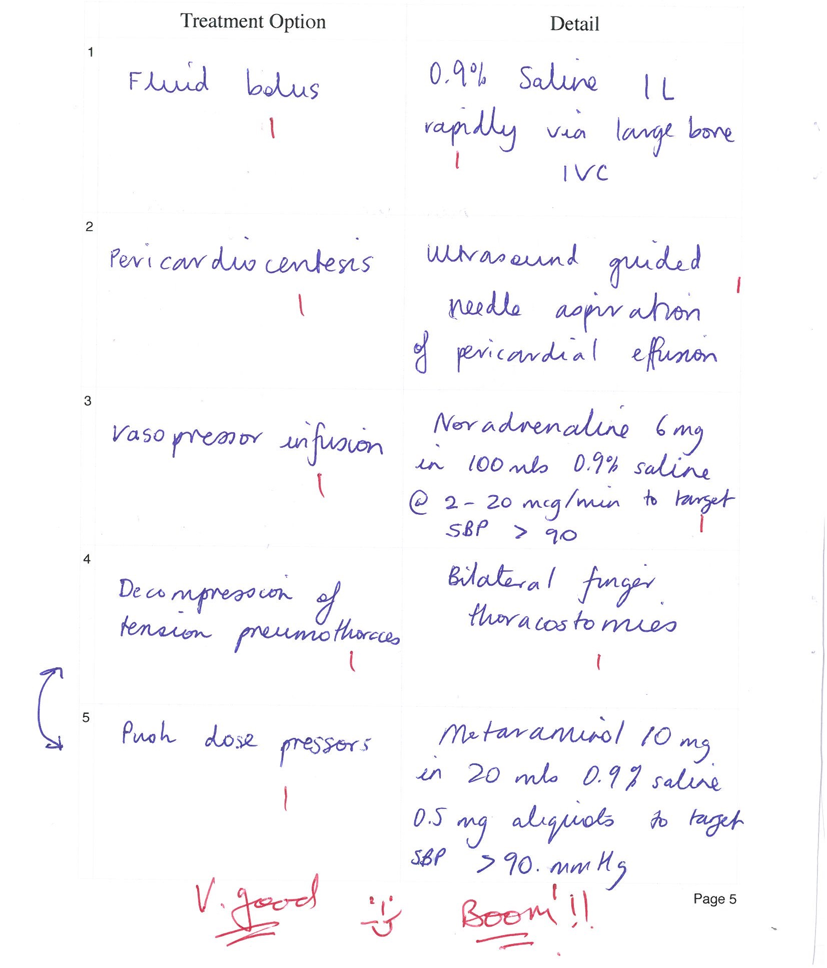
Boom!

