Slide 1
Question 19
Authors: Kim Pollack, Victor Lee, Yit Leang
Examiners: Jason Scop, Suzanne Doherty

Slide 2
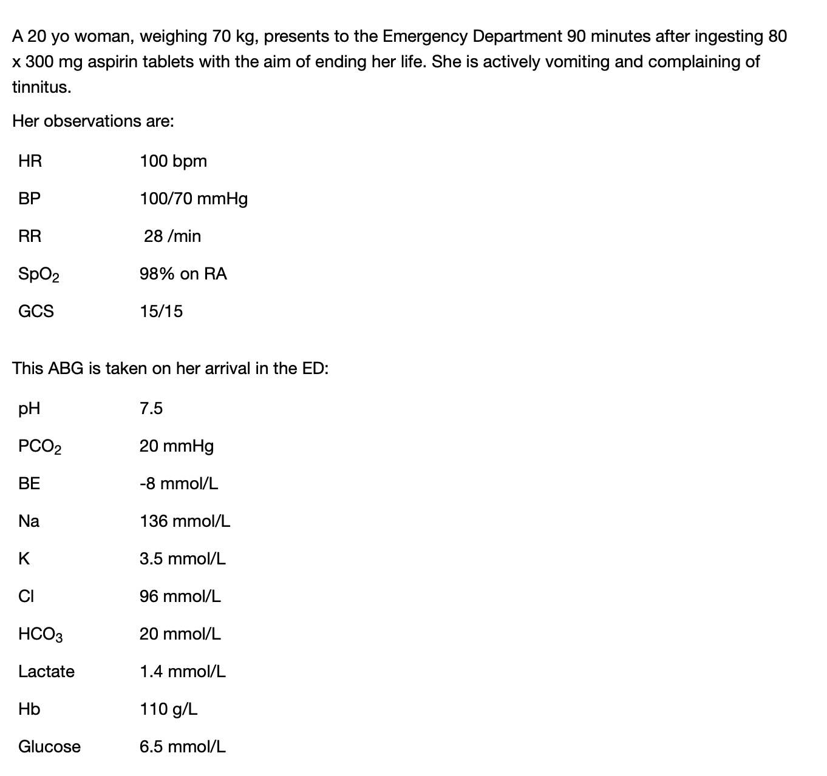

Slide 3
a)Regarding this ABG, complete the calculations and provide an interpretation of your findings in the context of this patient’s presentation. (3 marks)
Equations: don’t just write the answer, write how you got there. eg.
AG = Na-Cl-HCO3
AG=20
As opposed to:
AG= 20

Slide 4
a)Regarding this ABG, complete the calculations and provide an interpretation of your findings in the context of this patient’s presentation. (3 marks)
Interpretation: put the data and the clinical stem together
eg. HAGMA with respiratory alkalosis consistent with salicylate toxicity

Slide 5
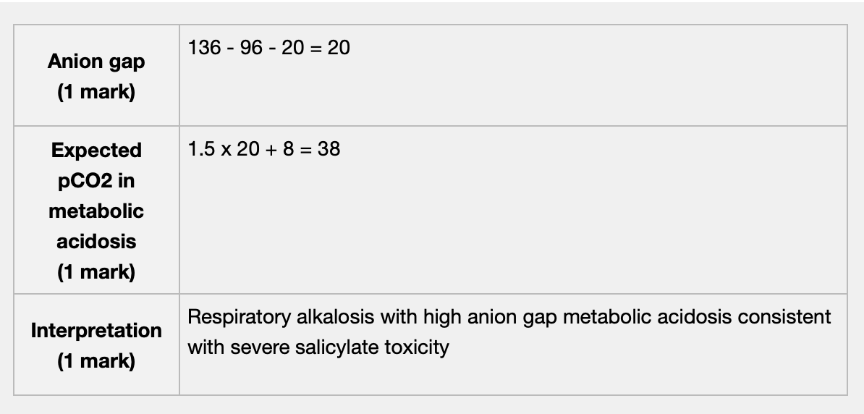
Model answer:

Slide 6
b) List and justify three (3) additional investigations you would perform for this patient (6 marks)
Lots of answers with vague, non-specific justifications
eg. UEC – check renal function
As opposed to:
UEC - ensure normal baseline renal function to allow for appropriate enhanced elimination
eg. ECG-arrhythmias
As opposed to:
ECG- assess for cardiotoxic co-ingestants

Slide 7
b) List and justify three (3) additional investigations you would perform for this patient (6 marks)
Note: Salicylate level – salicylate concentration doesn’t correlate with toxicity but the trend will guide ongoing management

Slide 8
List seven (7) management steps you will undertake for this patient (7 marks)
General feedback:
ENDPOINTS!!!!!!!!!! Not putting them in risks losing marks
Don’t write more than one answer per line as this will be marked and counted as a point, which means your last point won’t be marked
If stating you would give a drug—give a dose / route please
Management = treatment, supportive care and disposition
Management does NOT include investigations

Slide 9
List seven (7) management steps you will undertake for this patient (7 marks)
Some candidates wrote very generic answers
eg. ‘intubate’
As opposed to
‘intubation with hyperventilation to maintain resp alkalosis if CNS depression/seizures’
Avoid sweeping statements in these management questions- using a point to highlight that this is a high risk salicylate overdose does not get you any marks

Slide 10
Enhanced elimination
MDAC is not indicated in salicylate toxicity
Revise urinary alkalinisation:
IV bolus 1-2mmol/kg 8.4% sodium bicarbonate over 5—10mins,
Followed by infusion:
100mmol sodium bicarbonate in 1L 5% dextrose at 250ml/hr
Aim: urinary pH >7.5. (note: this is not end point)
EP: clinical and laboratory evidence of toxicity is resolving
Adverse effect: hypokalaemia (hypokalaemia also impedes urinary alkalinisation)
Intermittent haemomdialysis (revise indications)

Slide 11
Disposition
Avoid ‘refer’ – use the word ‘admit’ instead
‘ICU and haemodialysis’ – these are 2 management points, keep them separate
‘discuss with tox team’ ---why?
(perhaps "Enhanced elimination with intermittent haemodialysis in consultation with clinical toxicologist" would be a better answer)

Slide 12
d) Name two (2) therapeutic endpoints for ceasing enhanced elimination in this patient? (2 marks)
Resolving clinical symptoms
Resolution of biochemical abnormalities eg. metabolic acidosis
Evidence of two down trending serum salicylate concentrations
You either knew it/ guessed it – or you didn’t

