Slide 1
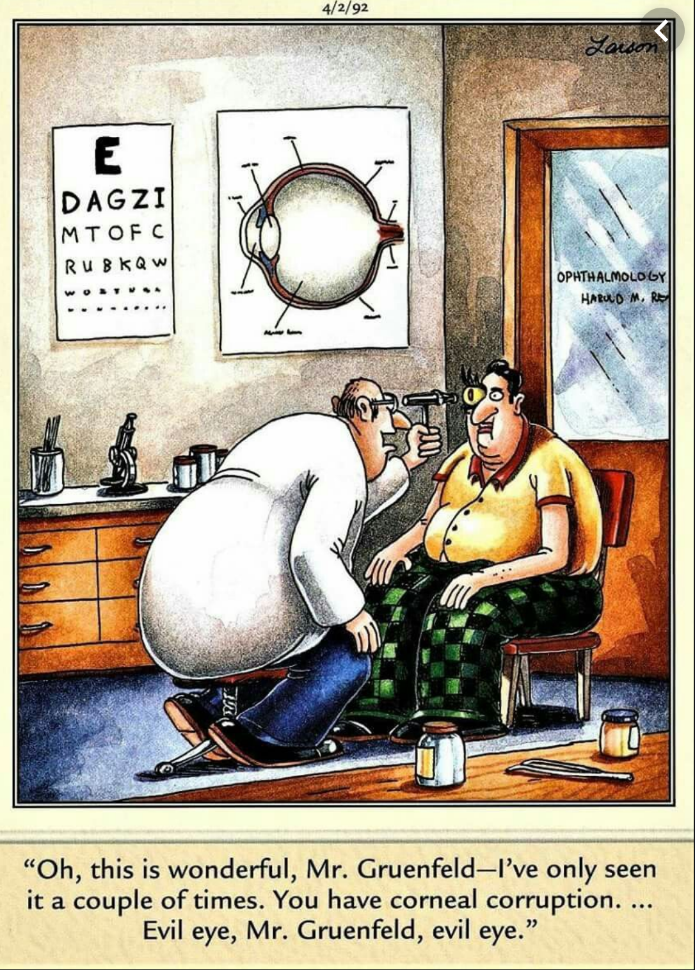
Question 16
Simon Craig

Slide 2
8 year-old boy.

Slide 3
Part 1
Features on history and examination which can help distinguish periorbital (pre-septal) cellulitis from orbital (post-septal) cellulitis
8 marks available
Easy question!
6 is a “pass” for this

Slide 4
Part 1 (8 marks)

Slide 5
Part 1
Also gave marks for RAPD
Less useful answers
“Fever” in both columns
Septic shock / meningitis (pretty uncommon!)
“Injected cornea”

Slide 6
Part 2
CT scan shows orbital cellulitis with large periosteal abscess
List 4 specific management steps

Slide 7
Part 2 (4 marks)

Slide 8
Part 2
Done reasonably well, however…..
A number of people advocated for lateral canthotomy (guided by measurement of IOP)
Some “odd” antibiotic choices
Medication doses incorrect
Incorrect IV fluid choice
ICU admission

Slide 9
A few “basics”
A drug with no dose is better than an incorrect dose
Children are dosed by the kg
Usual maintenance in kids is 0.9% NaCl + 5% glucose (not Normal saline)

Slide 10
A few “basics”
Don’t say things that draw attention to yourself.
You will only frighten the examiner and draw attention to yourself!
An ED physician doing a lateral canthotomy in a child without trauma based on measurement of IOP is a little “out there”

Slide 11
Good luck!

