Slide 1
SAQ 16

Slide 2
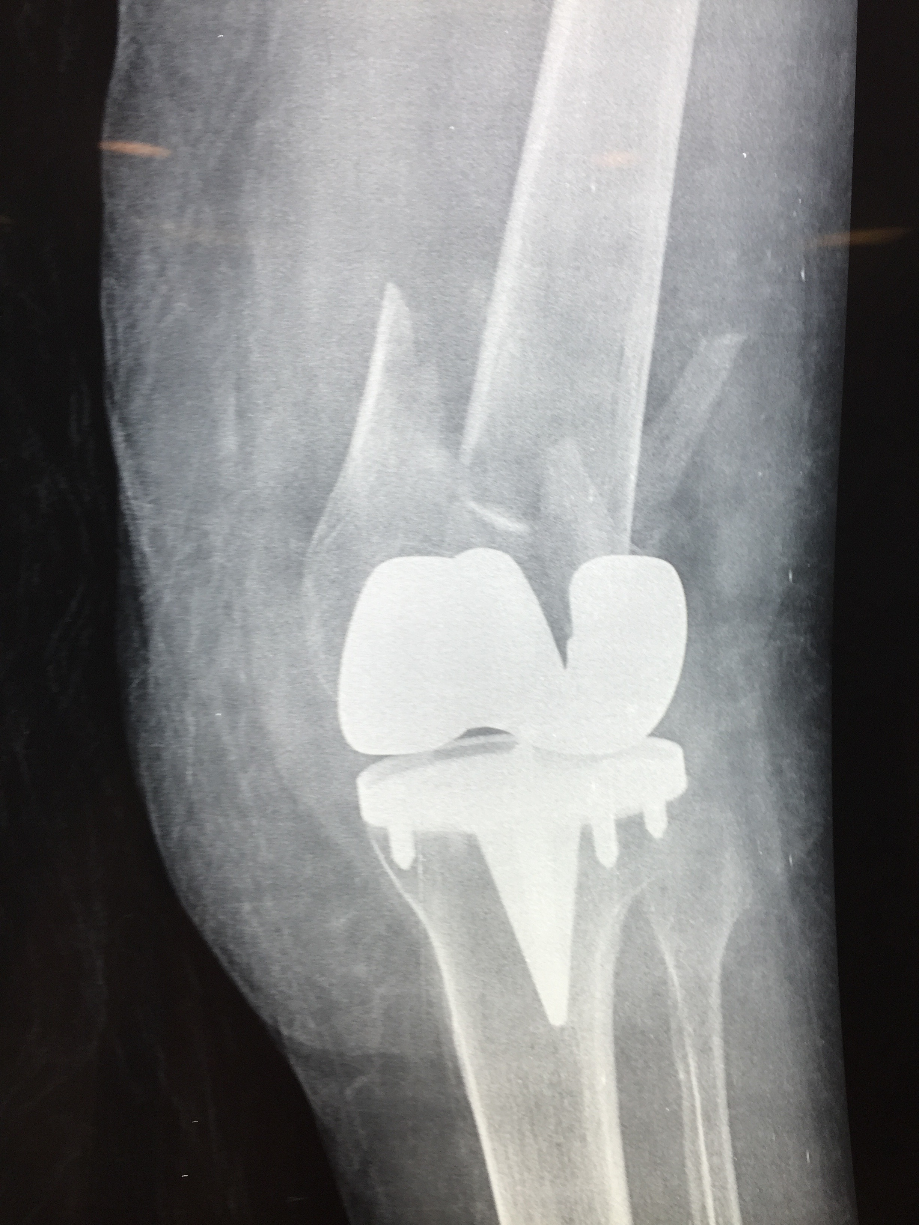
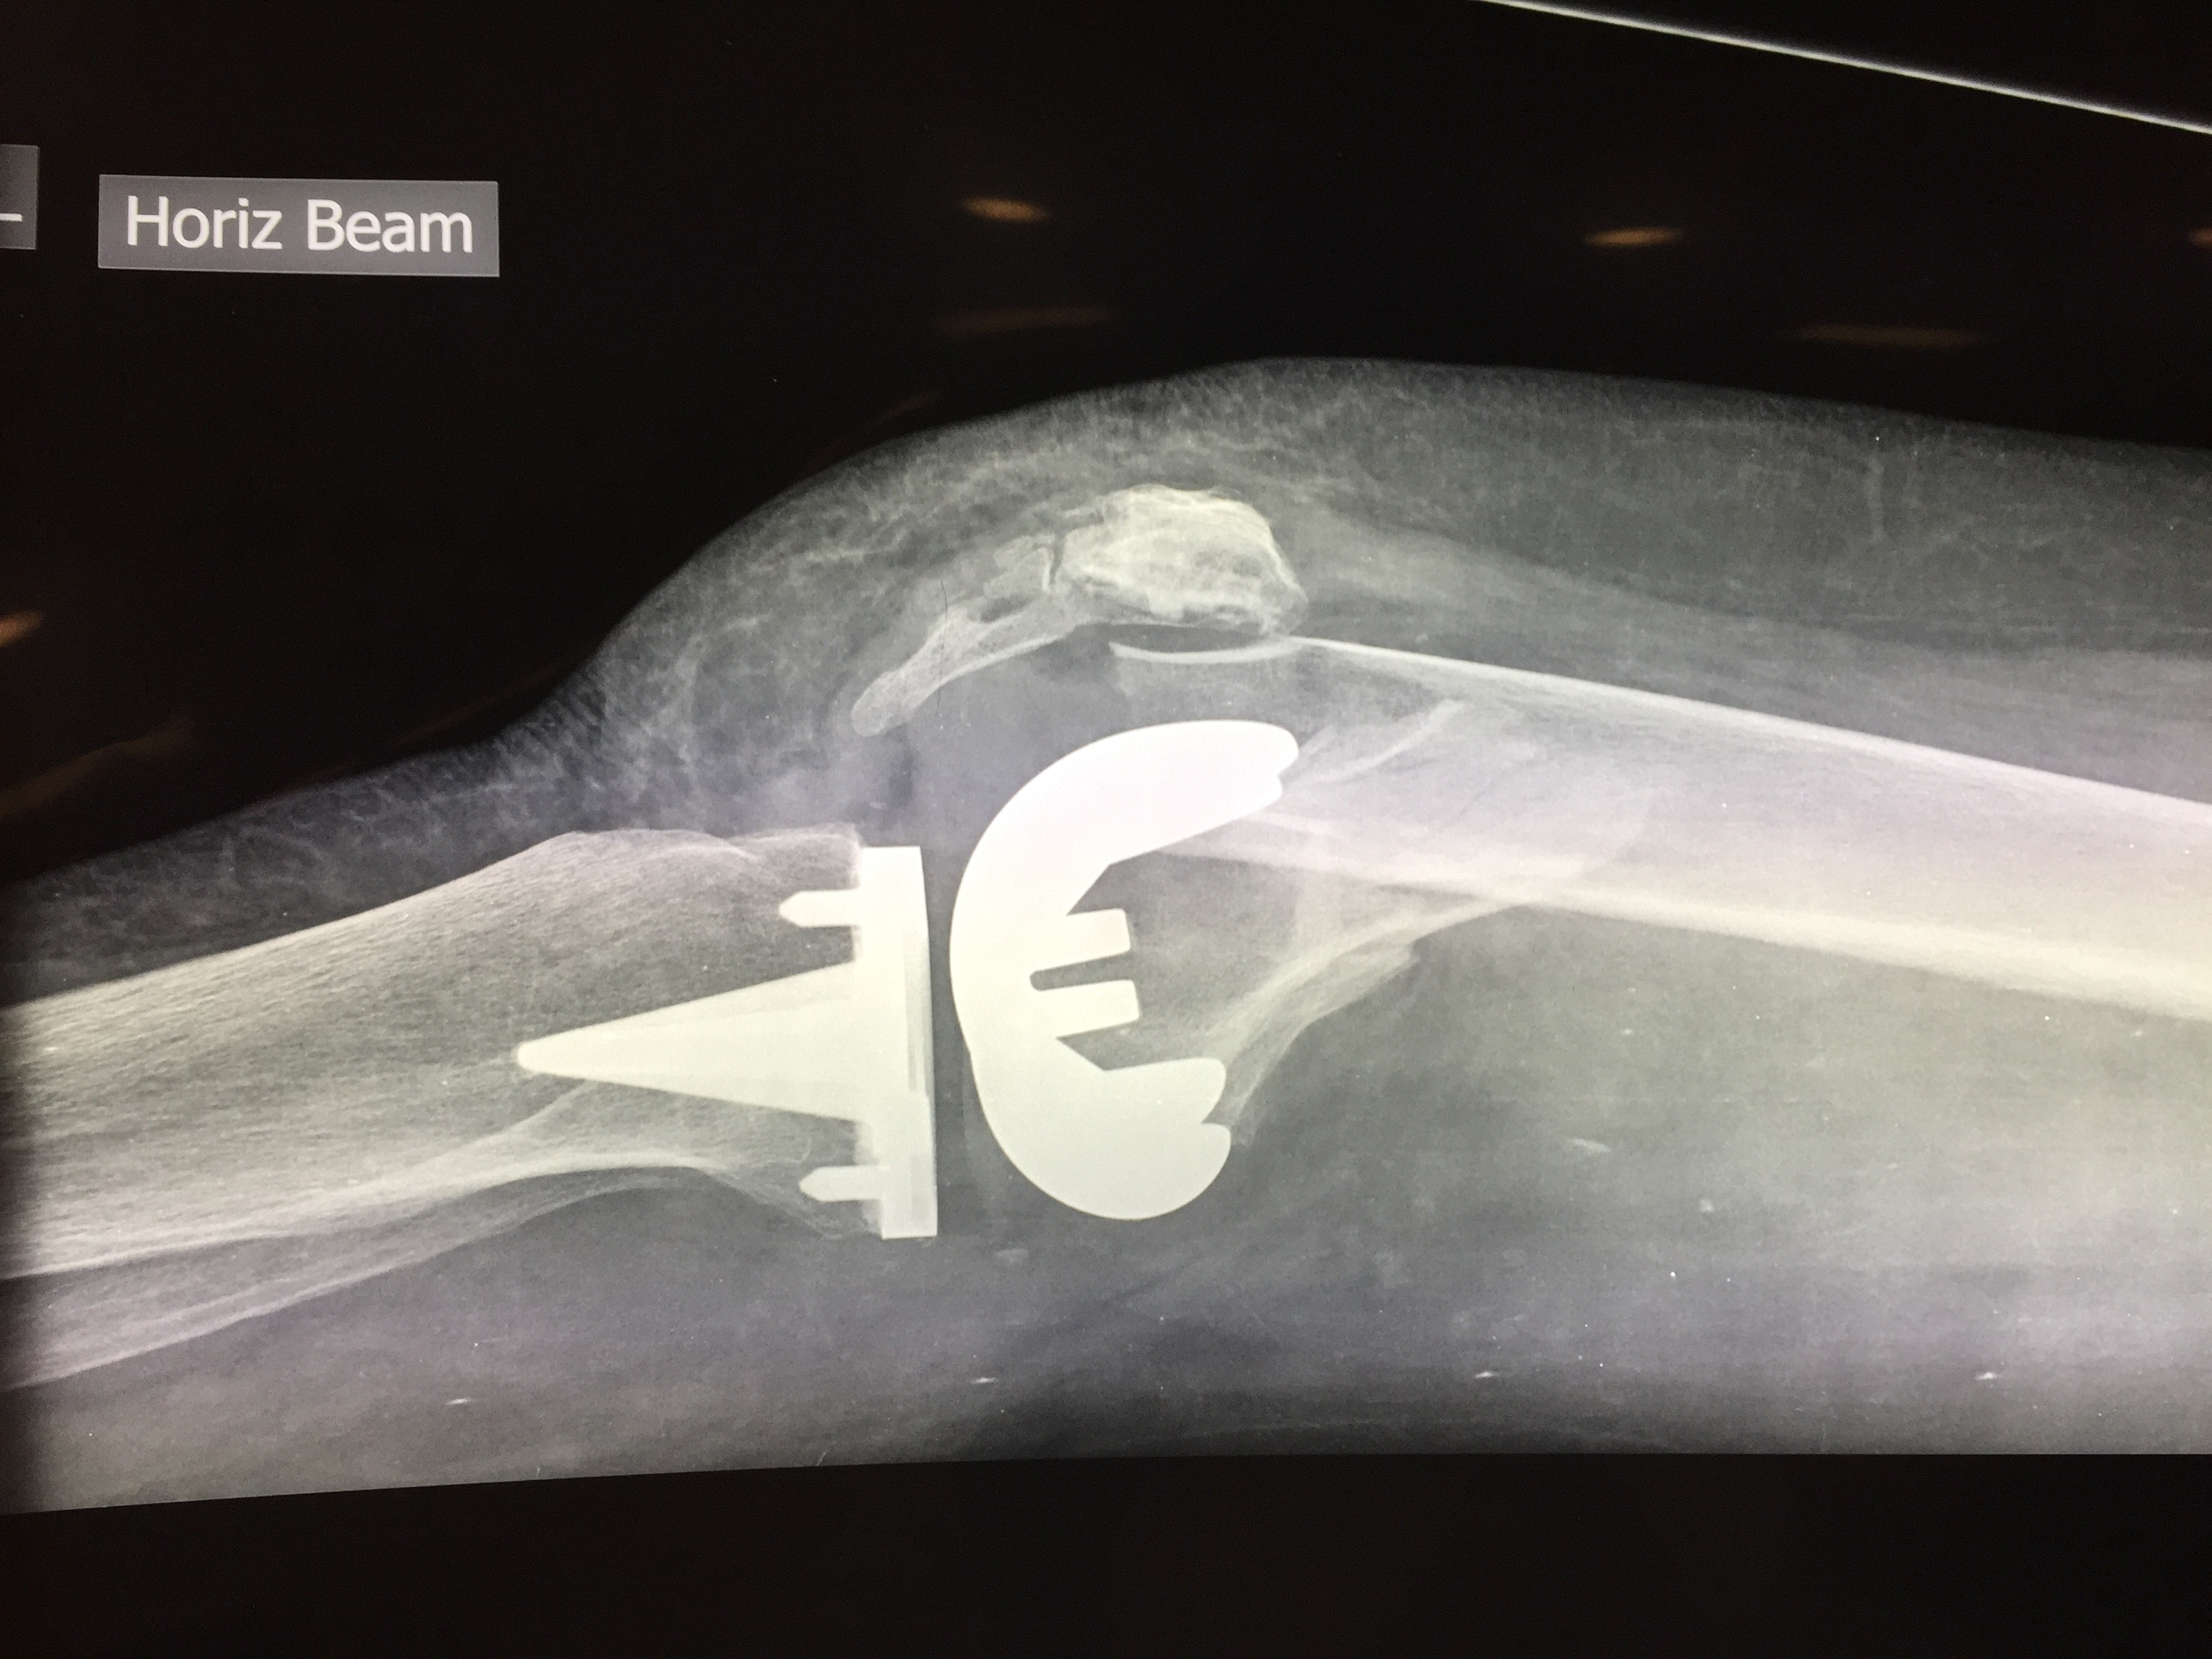
A 78 yo female with PMH LTKR AF GORD presents after slipping over in the supermarket. She is very distressed. Ambulance treatment enroute includes NSaline 500mls Airsplint to left leg & fentanyl 250mcg . BP 180/95 HR 110 Temp 36.5 GCS 14 ( E3 V5 M6) RR 12 Sat 96% on 6L/min

Slide 3
SAQ 16
List 5 abnormalities on the Xrays
List 4 options that you will utilize for pain management in this patient
List & Justify 5 investigations for this pt.

Slide 4
A 78 yo female with PMH LTKR AF GORD presents after slipping over in the supermarket. She is very distressed. Ambulance treatment enroute includes NSaline 500mls Airsplint to left leg & fentanyl 250mcg . BP 180/95 HR 110 Temp 36.5 GCS 14 ( E3 V5 M6) RR 12 Sat 96% on 6L/min

Slide 5
List 5 abnormalities of the Xrays
Comminuted distal femur #
Periprosthetic
Impacted
Shortening (amount)
(Lat view) ~5-7cm
Angulation ( degree & direction)
(lat view) ~30-40 degrees dorsal/posterior
Osteoporotic bones
Soft tissue swelling (significant)
Bleeding/anticoagulation/popliteal artery damage
NO marks for listing the TKR

Slide 6
List 4 options for pain management in this patient
Analgesia
IV narcotic MUST take into account pt has RR 12 & has had 250mcg fentanyl. (dose/total/endpoint)
Non-narcotic IV eg tramadol
Adjuncts such as paracetamol/combination oral
Regional block
Immobilization (after PS or regional block)
Ideally with traction (skin/thomas/donway)
Backslab alone NOT enough
Other
Eg Ketamine infusion

Slide 7
List & Justify 5 Investigations
FBE
INR
G&H
U+E/RF
VitD/Ca
ECG
CT Knee
ABI
Vascular imaging
Angio/doppler
Xray
femur/hip/pelvis
Other

Slide 8
List & Justify 5 Investigations
FBE
Hb /hct useful in deciding if preop or intraoperative transfusion is needed
Blood loss from # +/- anticog/vessel damage can be >1-3L
INR
Pt with AF/may be anticoagulated/guide reversal Rx
G&H
Anticipate significant blood loss from # +/- anticoag/pop art damage
U+E
Determining renal function & eGFR prior to any contrast
VitD/Ca relating to osteoporosis etc would be acceptable
Popliteal vessel imaging
ABI >0.9 serial examination & arterial duplex studies
ABI <0.9 angiography
CT Knee
Scatter artifact from Knee Prosthesis will make this difficult but may provide anatomical detail of fracture fragments & position
Other Xrays
full femur/hip/pelvis important to ensure imaging of entire bone/joints above & below
Other imaging only if indicated by history or examination
ECG ( pt HR 110 BP 180/95)
Pt HR 110 determine if currently in AF / LV strain/LVH
CXR
Current saturation 96% on 6L & RR 12 makes resp depression from narcotic >>>>likely than chest trauma from simple slip & fall
CT head/neck
NB : GCS 14 & anticoagulation if any evidence head strike with fall or focal neurology BUT again may reflect narcotic administration
Investigations looking for infection or cause of fall when the STEM clearly states SLIPPED in the supermarket miss the point

