Slide 1
Monash Practice Exam 2020
Jonathan Dowling
Deputy Director Emergency Services
Peninsula Health
Regional Censor, ACEM

Slide 2
A 54-year-old man presents to your Tertiary level emergency department with severe right-sided abdominal pain. He has no allergies.
His vital signs are:
HR | 110 bpm
BP | 98/65 mmHg
RR | 24 /min
Temp | 37.6 ºC

Slide 3
What does this mean?
You have all services available
Right sided Abdominal pain (think what the differentials might be)
Haemodynamic instability plus low grade fever
Remember everything in the question is there for a reason
Need to interpret what they mean (but don’t make up things that are not there)

Slide 4
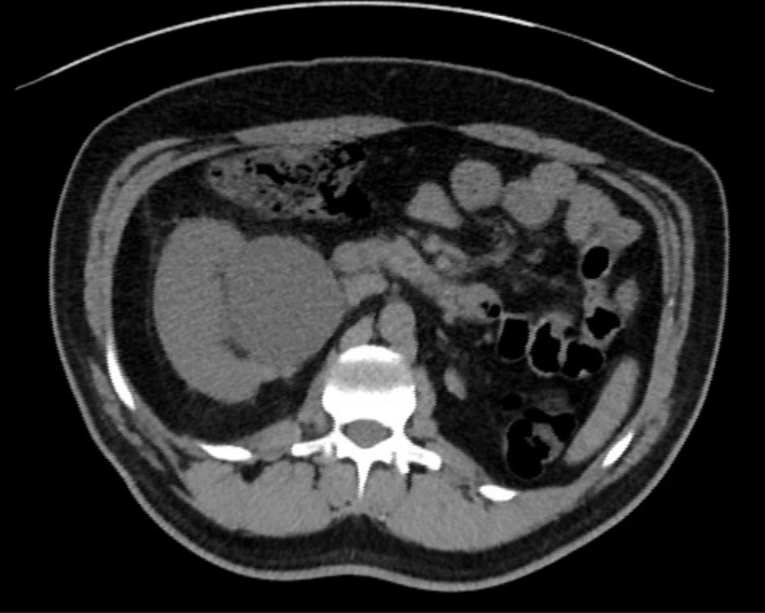
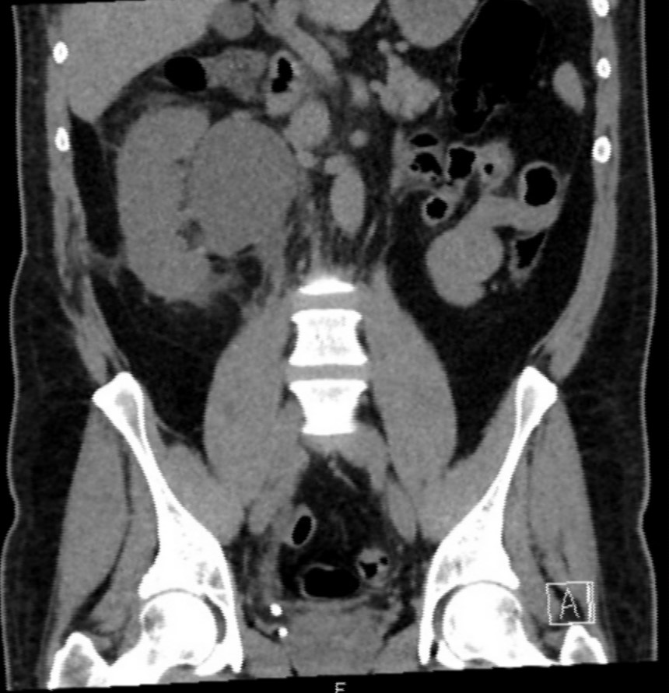
List five (5) clinically relevant findings on his CT. (5 marks)

Slide 5
Part a
Solitary Kidney
Radio opaque lesion at distal ureter consistent with stone
Hydronephrosis
Grossly distended collecting system/renal pelvis
Perinephric stranding
Possible distention of kidney but no scale provided
→ Obstructed single kidney!
Normal aorta on visualized slices, normal bowel, no free fluid etc

Slide 6
Marking scale
1 mark for each underlined point
At least one point identifying obstruction but would give a mark for each alternate point (eg could score a mark for hydronephrosis as well as a mark for perinephric stranding
Maximum of two marks for the non kidney related details

Slide 7
Common errors
Missing the single kidney
Missing the stones
Describing the collecting system as a cyst
Ascribing pathology as intraperitoneal
Describing things that weren’t there
eg Gall bladder
Non medical terminology
Eg “large ureter” vs “dilated ureter”
No mention of the location of pathology
eg distal ureter, medial to kidney

Slide 8
Part b
In the table below list four (4) interventions that you would arrange for this patient. For each intervention provide a rationale that justifies its use. Where listing medications, please ensure you provide dosage and route of administration. (4 marks)

Slide 9
Interventions (1 mark for each if appropriate justification)
Urgent decompression of blocked kidney
Happy for either percutaneous nephrostomy, or Urologic intervention.
Did not accept answers “Urology review”. Must have some sense of urgency
Eg Urgent Urology referral – Relief of obstructed single kidney”
Resuscitation of some sort
Hypotension, tachycardia
Antibiotics
Low grade fever with hypotension
Analgesia
The patient has presented with pain
Need to have some concerns regarding this patient’s renal function so this may alter abx use

Slide 10
Common issues
Not putting doses, volume or duration to medications/fluids (the question even spells it out for you!)
Not recognizing an urgency to decompression
Many candidates wrote urology referral without a qualifier
Generic answers (eg “keep the patient fasted”)
Choosing inappropriate antibiotics
Multiple different versions of the same thing
Tamsulosin
Not understanding what a justification is - the Why” not the “what”
Eg Intervention = analgesia Justification = fentanyl will not get a mark

Slide 11
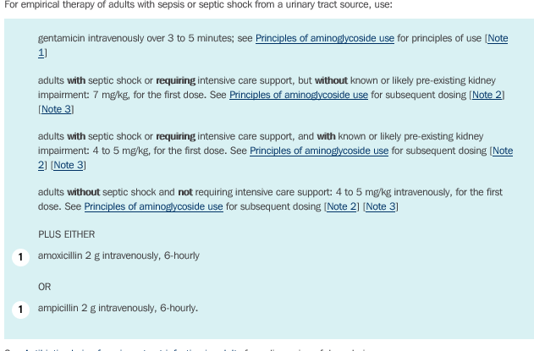
Antibiotics for sepsis from Urinary source
Therapeutic guidelines

Slide 12
Part C
You are about to provide clinical teaching for junior registrars and need to discuss the indications of various imaging modalities in generally managing the above condition.
State two (2) clinical indications for each of the following imaging modalities.
This is a question that asks the indications of when you would order the different modalities for Renal Tract stones

Slide 13
C.A.R.A.C.A.S for imaging
Cost
Availability
Radiation
Associated diagnosis
Contrast (allergy)
Accuracy
Speed

Slide 14
AXR/KUB
When other imaging modalities unavailable
In a patient with recurrent renal colic in a known radio lucent stone to minimize radiation of repeat CT
To determine whether a stone on seen CT is radiolucent
To track the whether a stone has moved at subsequent follow up
Generally available after hours

Slide 15
US
Performed at Bedside in patient unable to be transported to CT
Repeatable due to no ionizing radiation
Diagnose hydronephrosis and gives an indication of urine production or obstruction (ureteric jets)
Useful in patients with recurrent renal colic
Imaging of choice in pregnant, anyone where radiation needs to be avoided
May determine alternate pathology (eg gynaecological)
Limited availability after hours

Slide 16
CT
Most sensitive to diagnose renal stones
Tells site and size of stone
Tells alternative diagnosis
Imaging of choice for for first presentation in > 50 yr old
Ionizing radiation, not as useful for follow up
Availability may be limited after hours in smaller centres

Slide 17
Results
15 marks
Standard (pass) set at 10
37/65 at standard – 57%
Another 9 scored 9/15

Slide 18
Good Luck!

