Slide 1
Q1 & Q 19
Tom Reade

Slide 2
- Read the Question - Answer the Q - Don’t add multiple points to one line - Don’t add extra points below lines - Writing (few only)
Overall- Advice

Slide 3
Q1a
You receive ambulance pre-notification of a patient in cardiac arrest. The patient is a 45 year old female with unknown past history. She complained of chest pain prior to collapse nearby to the hospital. She is currently in VF arrest with ACLS in progress. Estimated time of arrival is 5 minutes.
a. Other than duration of ACLS, state six (6) key pieces of information that should be obtained in ambulance handover. (6 marks)
“What must I receive/ ask?”
“What info can I not get from another source?”
Core knowledge

Slide 4
Q1a
You receive ambulance pre-notification of a patient in cardiac arrest. The patient is a 45 year old female with unknown past history. She complained of chest pain prior to collapse nearby to the hospital. She is currently in VF arrest with ACLS in progress. Estimated time of arrival is 5 minutes.
a. Other than duration of ACLS, state six (6) key pieces of information that should be obtained in ambulance handover. (6 marks)
Identifiers- Name & DOB
NOK/ bystander friends
Circumstances- drugs nearby/ access to drugs/ prior symptoms expanded
Bystander CPR- duration prior to ambulance
Initial cardiac rhythm
Number of shocks
Presence of ROSC/ down time
IV access working
Total drugs given/ especially whether amiodarone given
Infusions currently running
Airway manoeuvre difficulties- difficulty with ETT/ depth of ETT
BSL

Slide 5
Q1a
You receive ambulance pre-notification of a patient in cardiac arrest. The patient is a 45 year old female with unknown past history. She complained of chest pain prior to collapse nearby to the hospital. She is currently in VF arrest with ACLS in progress. Estimated time of arrival is 5 minutes.
a. Other than duration of ACLS, state six (6) key pieces of information that should be obtained in ambulance handover. (6 marks)
Not so good:
Not able to come up with 6 options for answer
State = short statement/ phrase/ clause not “List” 1-3 words
“IV access”
“medications”
“ETT tube”/ “intubated or not”

Slide 6
1 b
The patient arrives. CPR was performed for a total of 12 minutes. She is currently in slow AF at a heart rate of 40 /min with spontaneous circulation. An adrenaline infusion is running.
b. Should this patient be transferred urgently for primary coronary intervention ? (1 mark)
Core knowledge

Slide 7
1 b
The patient arrives. CPR was performed for a total of 12 minutes. She is currently in slow AF at a heart rate of 40 /min with spontaneous circulation. An adrenaline infusion is running.
b. Should this patient be transferred urgently for primary coronary intervention ? (1 mark)
Yes
Core knowledge

Slide 8
1 c
c. Justify your decision. State three (3) points in your answer. (3 marks)
Indicated post OHCA arrest with ROSC- Included in ANZCOR guidelines
Likely acute coronary occlusion given age 45
80% of > 45 yrs of age
35 yrs is the cutoff point between genetic vs structural
Especially if STEMI on ECG
Even in absence of ECG STEMI criteria (absent in ~ 1/3 of post arrest pt with acute coronary occlusions)

Slide 9
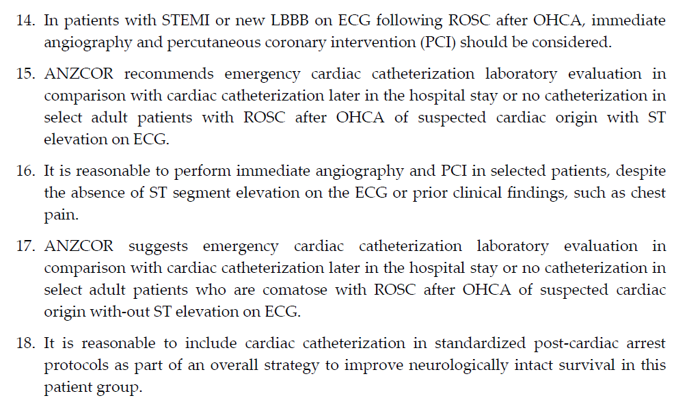

Slide 10
1 d
Prior to your decision, the patient deteriorates to VF.
d. State four (4) benefits of cardiac ultrasound in the ongoing management of this patient. (4 marks)

Slide 11
1 d
Prior to your decision, the patient deteriorates to VF.
d. State four (4) benefits of cardiac ultrasound in the ongoing management of this patient. (4 marks)
More accurate than pulse check if rearrest
Adequacy of CPR
Differentiation between fine VF/ Asystole/ PEA
Exclude cardiac tamponade as the cause of arrest
findingss suggestive of massive PE
Can confirm mechanical capture if pacing required
Guide pericardiocentesis

Slide 12
1 e
Despite ongoing standard ACLS management, ventricular fibrillation persists for a further 20 minutes without return of spontaneous circulation.
e. List four (4) circumstances under which prolonged CPR may be warranted for this patient.(4 mark)
Core Knowledge

Slide 13
1 e
Despite ongoing standard ACLS management, ventricular fibrillation persists for a further 20 minutes without return of spontaneous circulation.
e. List four (4) circumstances under which prolonged CPR may be warranted for this patient.(4 mark)
Poisoning
Envenomation likely- snake
Asthma
Hypothermia
Thrombolysis recently administered for suspected PE
Pregnancy- if perimortem CSection is considered
To allow family to see efforts if close and specific request

Slide 14
Q19 a
A 35 year old woman presents following one episode of haematemesis. She has no documented past history, but reports a long history of excessive alcohol consumption. She takes no regular medications.
Her observations are:
BP 135/65 mmHg
HR 85/min
Sats 99% RA
Temp 37°C
State five (5) points to explain your approach to volume replacement for this patient. (5 marks)
Core knowledge

Slide 15
Q19

Slide 16
Q19 a
She is haemodynamically stable at present- no fluids required
Potential for massive ongoing losses (possible varices):
Prepare for deterioration
2x large bore IV access
Activate MTP if massive haematemesis/ haemodynamic instability (Not now)- But endoscopy is Rx of choice, not MTP
Permissive hypotension resuscitation- may reduce ongoing bleeding
Fluids should be not overly aggressive (avoid overload/overtransfusion)
Permissive hypotension resuscitation- most effective when combined with definitive endoscopic care
If required- Crystalloid/colloid (may be albumin deplete) initially then blood
If coagulopathic or thrombocytopaenic (2° to CLD) - replacement
Blood transfusion only if: major haemodynamic instability or Hb < 70 g/L

Slide 17
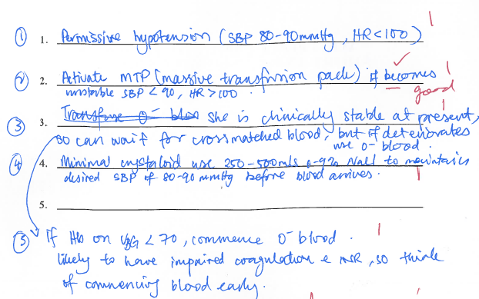

Slide 18
Q19a
Not so good:
“explain your approach to volume replacement”
start PPI
urgent endoscopy
refer gastroenterology
Activate MTP
Not points of explanation:
“transfuse 1:1:1”
“capilliary refill > 4 sec”
“any ongoing vomiting”
“2 large bore IV access”

Slide 19
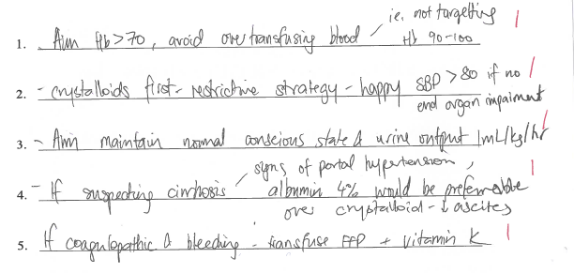

Slide 20
Q19b
b. What is the role of antibiotics for this patient? State two (2) points in your answer. (2 marks)
Advanced knowledge

Slide 21
Q19b
b. What is the role of antibiotics for this patient? State two (2) points in your answer. (2 marks)
Broad spectrum IV if cirrhosis and variceal bleeding clinically likely
Even in absence of infective precipitant
If cirrhosis:
Up to 20% of Cirrhosis with GIT bleed will have bacterial infection present at presentation
50% develop when in hospital
Multiple trials show prophylactic Abs ↓ complications
Multiple trials show prophylactic Abs ↓ mortality
Abs should be broad spectrum- no consensus in which “broad spectrum” ab is indicated
Advanced knowledge

Slide 22
Q19b
b. What is the role of antibiotics for this patient? State two (2) points in your answer. (2 marks)
Not so good
“Rx sepsis”
“reduce infection”

Slide 23
Q19c
The patient is observed in your department. Investigations are pending.
c. List five (5) markers that may be used to predict the need for transfusion or urgent endoscopy for this patient. (5 marks)
Core knowledge

Slide 24
Q19c
The patient is observed in your department. Investigations are pending.
c. List five (5) markers that may be used to predict the need for transfusion or urgent endoscopy for this patient. (5 marks)
NB: answer based on Glasgow Blatchford scale and AIMS65 score
Urea level
Hb level
Systolic BP
Heart rate
Presence of melaena
Presence of syncope
Presence of Liver disease
Presence of Cardiac failure
INR
Altered mental state
Serum albumin
Core knowledge

Slide 25
Q19c
c. List five (5) markers that may be used to predict the need for transfusion or urgent endoscopy for this patient. (5 marks)
Not so good:
“BP, HR, U/O, change in HR over time”
detailed answers

Slide 26
19d
d. What is the role of proton pump inhibitors for this patient? State three (3) points in your answer. (3 marks)
Core knowledge

Slide 27
19d
d. What is the role of proton pump inhibitors for this patient? State three (3) points in your answer. (3 marks)
IV high dose bolus followed by infusion is considered standard of care
Maintains gastric pH >6 - important for platelet aggregation
↓ hospital LOS
↓ bleeding rate at endoscopy in those with delayed endoscopy
Does not ↓ transfusion requirements
Does not ↓ recurrent bleeding
Does not ↓ mortality
Core knowledge

Slide 28
19d
d. What is the role of proton pump inhibitors for this patient? State three (3) points in your answer. (3 marks)
Not so good:
“↓ acidity in stomach”
“less effective if variceal bleed”

Slide 29
19e
e. What is the role of Tranexamic acid for this patient? State three (3) points in your answer.
Advanced knowledge
But………………….

Slide 30
19e
e. What is the role of Tranexamic acid for this patient? State three (3) points in your answer.
Advanced knowledge
But………………….
Do we use it?
When might we use it?

Slide 31
19e
e. What is the role of Tranexamic acid for this patient? State three (3) points in your answer.
No established indication for routine use
Current evidence inconclusive
Consider in unresponsive bleeding/ exsanguination despite routine care- especially where endoscopy is unavailable or significantly delayed
HALT-IT trial (large RCT) currently in progress
Advanced knowledge

Slide 32
Summary- Q1 + 19
Ranking:
Bottom 30%
Middle 30%
Top 30%
Practice SAQ to time
Have answers reviewed by a FACEM

Slide 33
For the exam
Next few weeks- Consolidate
Use your clinical confidence and skills
Think
Focus on each Question:
don’t get flustered by a bump

Slide 34
